Slide 1
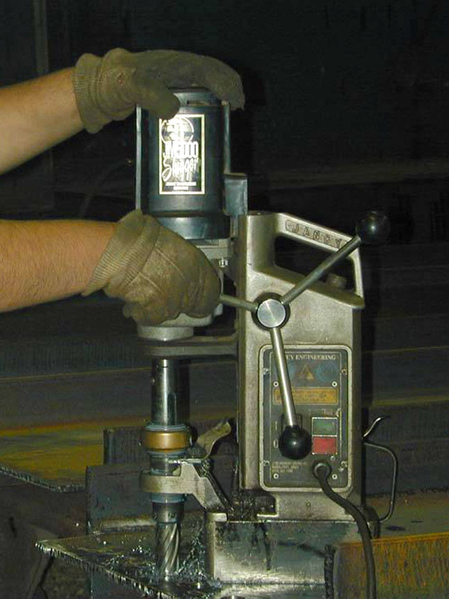
Preventing Musculoskeletal Injuries Module 5
Special Warehouse
Worker Hazards
in Structural Steel
Fabricating and
Supply Companies
1

Slide 2
Preventing Musculoskeletal Injuries Module 5
OSHA Grant Information
This material was produced under grant number
SH-26316-SH4 from the Occupational Safety and Health Administration, U.S. Department of Labor. It does not necessarily reflect the views or policies of the U.S. Department of Labor, nor does mention of trades names, commercial products, or organizations imply endorsement by the U.S. Government.

Slide 3
Preventing Musculoskeletal Injuries Module 5
Program Development
This program was developed by faculty and students in the School of Planning, Design and Construction at Michigan State University in conjunction with
the American Institute of Steel Construction - Safety Committee and the University of Puerto Rico
March 2015

Slide 4
Preventing Musculoskeletal Injuries Module 5
Learning Outcomes: Participants shall be able to:
Demonstrate understanding of the principles of ergonomics and their applications
Use good work practices, including proper lifting techniques
Demonstrate awareness of work tasks that may lead
to pain or injury
Recognize early symptoms of MSDs
4

Slide 5
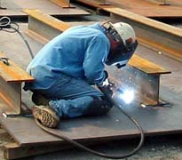
Preventing Musculoskeletal Injuries Module 5
MSDs Emphasis in Steel Companies
Repetitive stress, improper lifting, awkward position, body twists causes damage both short and long term
Change position including height of the work, rotate workers, fatigue mats, and anti-vibration gloves all help
Stretching helps
Working in an awkward position
Photo from CIANBRO
5

Slide 6
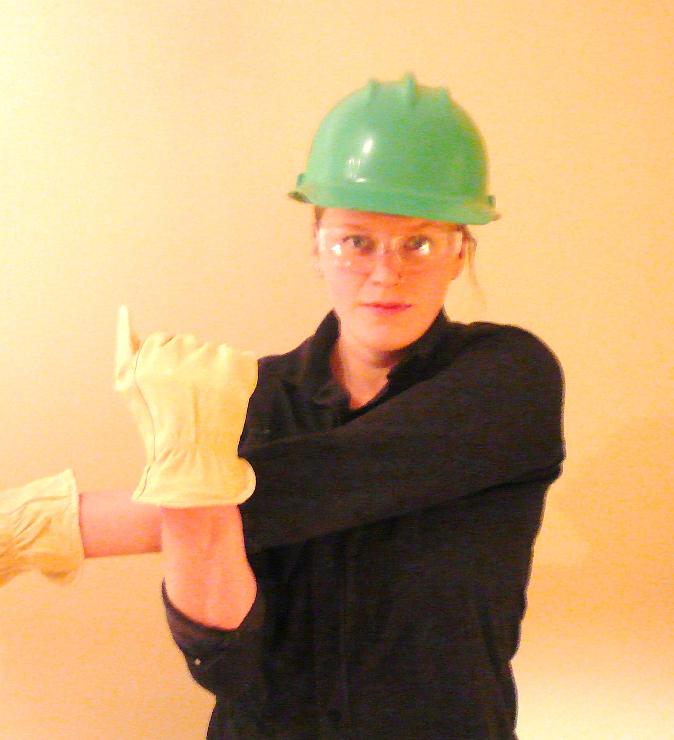
Preventing Musculoskeletal Injuries Module 5
Stretching & Wellness*
Shoulder Stretch
In Class Stretching Exercise
Instructor Lead Class in Stretching demonstration
Source CIANBRO
Notes:
Presenter’s Notes:
You are a professional Workplace Athlete. You owe it to the only body you have to keep it in shape…not only for the job…but also for a satisfying life. A personal fitness plan is vital to your successful career and life. You would keep yourself fit for competition if you played on a professional sports team. There is a little difference between professional sports and your job. You must keep fit for your job or you will suffer needlessly. You will not perform well. You will go home exhausted and sore from the day’s work. You know that it is worth the effort. Just ask anyone who is involved in such a program.
Benefits of a Cardiovascular Work out
Sleep better
Lose weight, gain weight, or maintain weight, depending on your needs
Improve your resistance to fight infections
Lower your risk of cancer, heart disease and diabetes
Help your brain work better, making you smarter
Makes you feel better-happier mood
CLEANS OUT THE carburetor
Stretching
Stretches help prevent Injuries. Warming up before work is the best way to reduce the risk of these injuries. Cold joints, tendons and muscles are more likely to get strained or sprained by sudden movement or exertion. Benefits of pre-work stretches are.
Raises the heart rate so that the body is prepared for physical exertion
Speeds up nerve impulses so that reflexes are enhanced
Reduces muscle tension
Sends oxygenated blood to the muscle groups
Reduces the risk of injury, particularly to connective tissue like tendons
Increases flexibility and joint mobility.

Slide 7
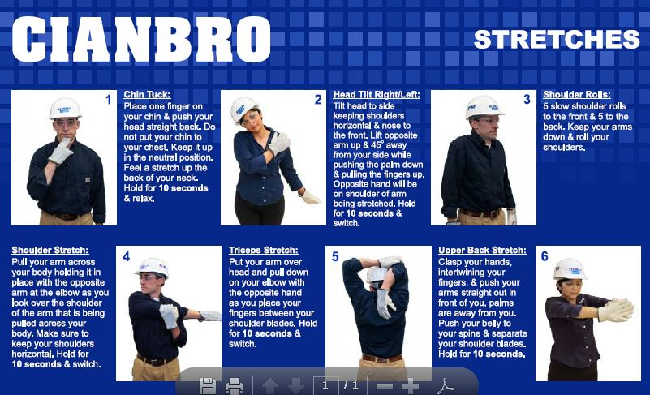
Preventing Musculoskeletal Injuries Module 5

Slide 8
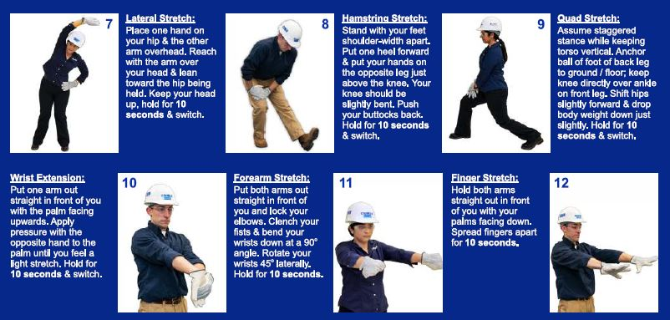
Preventing Musculoskeletal Injuries Module 5

Slide 9
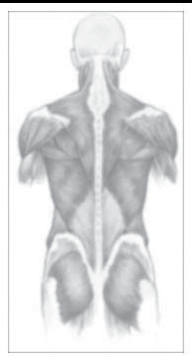
Preventing Musculoskeletal Injuries Module 5
What Are Musculoskeletal Disorders (MSDs)?
An injury or disorder of the muscles, nerves, tendons, joints, cartilage, and spinal discs.
They also include soft tissue and repetitive motion injuries and disorders.
Illustration sources Back Injury Prevention For the Landscaping and Horticultural Services Industry, K-State Research and Extension, Kansas State University, Manhattan, Kansashttps://www.osha.gov/dte/grant_materials/fy06/46g6-ht22/back_injury_prevention.pd
Notes:
Ask the class: What are examples of MSDs? (Instructor writes what students say on the flipchart).
Tell the class:
Carpal tunnel syndrome (CTS) - Carpal tunnel syndrome is pressure on the median nerve -- the nerve in the wrist that supplies feeling and movement to parts of the hand. It can lead to numbness, tingling, weakness, or muscle damage in the hand and fingers. Using tools that don’t fit your hand properly can cause this type of injury.
Tendinitis – this occurs when tendons rub against the bone and get swollen. Tendinitis refers to inflammation of the tendon. For example, swinging a sledge hammer repeatedly can cause tendinitis in the elbow.
Bursitis – this occurs when the fluid-filled sac (bursa) that lies between a tendon and skin, or between a tendon and bone, gets inflamed. Bursae are found in the knee, elbow, shoulder and wrist. The main symptom of bursitis is pain. In some cases, especially for shoulder bursitis, people may experience some restriction of movement and stiffness. For example, working in an awkward overhead position for extended periods of time can cause bursitis in the shoulder.
See handout: What are MSI’s? Constructive Ideas, Worksafe BC.

Slide 10
Preventing Musculoskeletal Injuries Module 5
MSD IMPACT
“Work related MSDs are among the most frequently reported causes of lost or restricted work time
In 2011, the Bureau of Labor Statistics (BLS) reported
the 387,820 MSD cases accounted for 33% of all
worker injury and illness cases in 2011.”
https://www.osha.gov/SLTC/ergonomics/
10

Slide 11
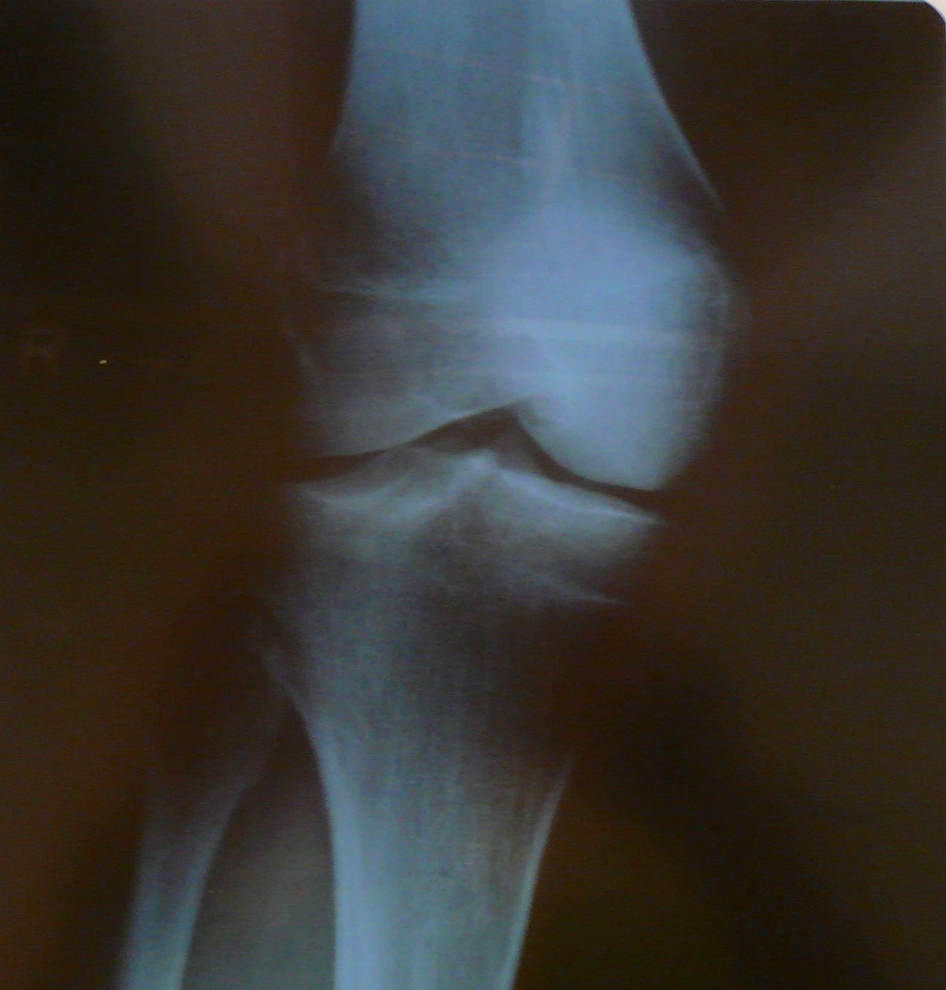
Preventing Musculoskeletal Injuries Module 5
MSDs Affect Many
Parts of the Body
“Back
Neck
Shoulders
Arms
Elbows
Wrists
Fingers”
Knees
Source CIANBRO
X Ray of knee with cartilage damage

Slide 12
Preventing Musculoskeletal Injuries Module 5
Symptoms:
“Soreness
Swelling
Skin Discoloration
Numbness
Tingling
Burning
Radiating Pain
Decreased Strength
Decreased Movement”
These usually develop gradually
but sometimes can appear suddenly
Source: CIANBRO
Notes:
Presenter’s Notes:
Early reporting of aches and pains can reverse or minimize soft tissue injury, with or without medical attention. Ergonomic safeguards can be put into action before the injury occurs, preventing the need for medical care in many cases. The longer a person works with an ache or pain, the longer it will take to recover.

Slide 13
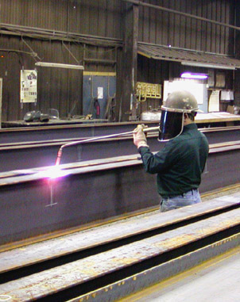
Preventing Musculoskeletal Injuries Module 5
Risk Factors for MSD Injuries?
Awkward postures
Improper lifting
Pulling-pushing-lifting
heavy loads
Repetition
Excessive force
Contact injuries
Static posture
Vibration
Unsuitable tools
Extreme temperature
Awkward motion demands
13
Notes:
Tell the class: A risk factor is anything that can increase your risk of injury. The more risk factors you have, the more likely you will be injured.
We are going to look at examples of each of these risk factors in the next slides.
See handout: Risk Factors for Ergonomic Injuries, WOSH Specialist Training.

Slide 14
Preventing Musculoskeletal Injuries Module 5
MSD Injury Factors
Intensity of exposure (How Much?)
Frequency of the exposure (How Often?)
Position and movement (How Positioned?)
Duration of the exposure (How Long?)
Keeping in mind that it could be a combination of all these factors.
Force + Repetition + Posture + Duration = Increased risk
of a MSD
Source CIANBRO
14

Slide 15
Preventing Musculoskeletal Injuries Module 5
Conditions Aggravated with:
“Age
Stress
Physical conditioning”
“Lack of exercise
Poor nutrition
Poor sleep
Generally unhealthy lifestyle habits
Injuries outside of work”
15

Slide 16
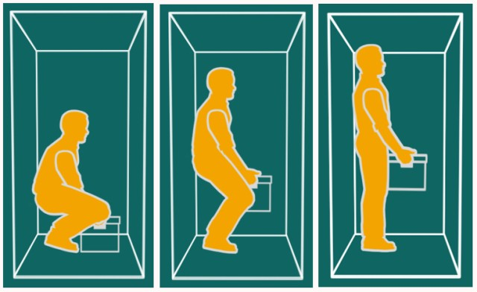
Preventing Musculoskeletal Injuries Module 5
Picture Perfect Lifting
Avoid torso twisting (rotation) while lifting
Source CIANBRO
16
Notes:
Presenter’s Notes:
Before you lift, look around your area. Decide where you will put the load. Check your path for obstructions. Then stand with your feet apart, one foot slightly ahead of the other. A wide stance helps your balance during lifting. Arch your back inward and lock it with your muscle power. Tuck your chin as in military attention, and stick out your chest to arch your back. Then squat down to load.
Grasp the load securely. Keep your chin tucked and lift smoothly with your legs. Do not lift with a quick pull or tug. Keep the load close. Holding the load close to your body reduces the stress to your back. Remember to maintain your locked back position as you put the load down. Lifting loads above chest level requires tightening your belly muscles as you lift to counteract the weight of the load.
Back injuries are caused not only by lifting (too much or improperly), but also by working with a back that has become stiff and weak from work, age, poor work habits, poor physical fitness and /or prior injuries.

Slide 17
Preventing Musculoskeletal Injuries Module 5
Back Injuries
“The back is the most frequently injured body part. Once
injured, the risk of recurrence doubles
Low back injuries represent over 90% of all injury claims
Second only to the common cold in lost work days
Back pain costs American businesses an estimated $30
billion each year
4 out of every 5 people will experience back pain
in their lifetime”

Slide 18
Preventing Musculoskeletal Injuries Module 5
Back
“The back supports the upper body, protects your spinal cord and allows flexibility”
“Most of the stress when lifting and bending is absorbed by the lower back
To take some pressure away from the spine, your abdominal and back muscles contract to give added support”

Slide 19
Preventing Musculoskeletal Injuries Module 5
“Causes of Back Injury
Improper lifting techniques
Overexertion
Poor posture
Medical factors (age, other disabilities, etc.)
Slips and falls
Excessive weight
Lack of exercise
Stress”
19

Slide 20
Preventing Musculoskeletal Injuries Module 5
“Symptoms of Back Injury
Pain
Stiffness
Numbness in the legs
Limited ability to sit or stand
Muscle weakness, spasms and strains
Decreased range of motion”
20

Slide 21
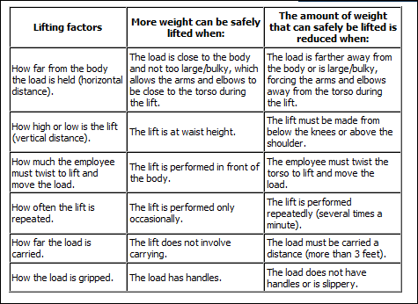
Preventing Musculoskeletal Injuries Module 5
Lifting Considerations
https://www.osha.gov/SLTC/etools/electricalcontractors/supplemental/hazardindex.html#vibration
21
Notes:
Presenter’s Notes:
Before you lift, look around your area. Decide where you will put the load. Check your path for obstructions. Then stand with your feet apart, one foot slightly ahead of the other. A wide stance helps your balance during lifting. Arch your back inward and lock it with your muscle power. Tuck your chin as in military attention, and stick out your chest to arch your back. Then squat down to load.
Grasp the load securely. Keep your chin tucked and lift smoothly with your legs. Do not lift with a quick pull or tug. Keep the load close. Holding the load close to your body reduces the stress to your back. Remember to maintain your locked back position as you put the load down. Lifting loads above chest level requires tightening your belly muscles as you lift to counteract the weight of the load.
Back injuries are caused not only by lifting (too much or improperly), but also by working with a back that has become stiff and weak from work, age, poor work habits, poor physical fitness and /or prior injuries.

Slide 22
Preventing Musculoskeletal Injuries Module 5
Plan your job lift
“Reduce the weights you lift
Reduce the distance you carry a load
Eliminate twisting
Reduce the frequency of lifting
Lift in a safe range
When Lifting…
Keep the load close to the body
Keep your feet apart for a stable stance
Position your feet prior to lifting to eliminate twisting
Don’t lift beyond your safe limit. Get help”!
Source: CIANBRO

Slide 23
Preventing Musculoskeletal Injuries Module 5
Improper vs. Proper Lifting
“See the force on the disk when bending at the waist vs. bending at the knees and lifting?”
Source: CIANBRO
Notes:
Presenter’s Notes:
We now know that our backs begin to weaken with deviation from the upright position of our spine. We are the strongest when we keep our spine in line.
“First we form habits then they form us”
Tip~ Push, rather than pull. It’s much easier on your back. Brace your hands on the object, set your back in an extended position, then do all the pushing and moving with your legs.

Slide 24
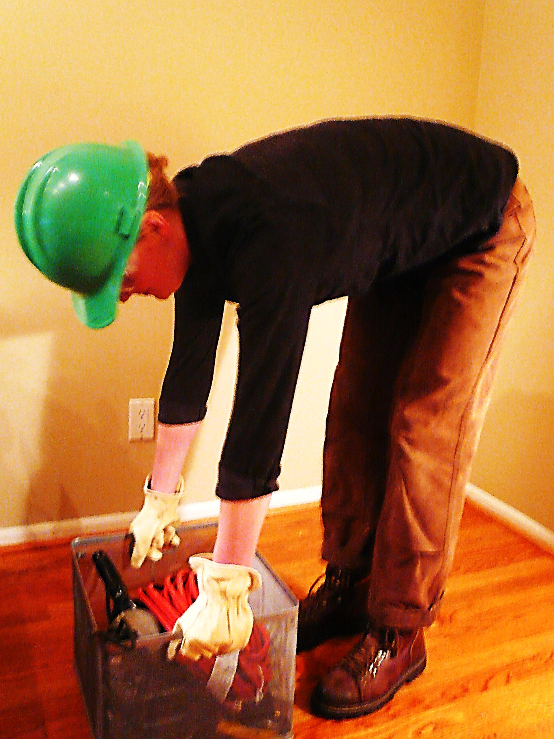
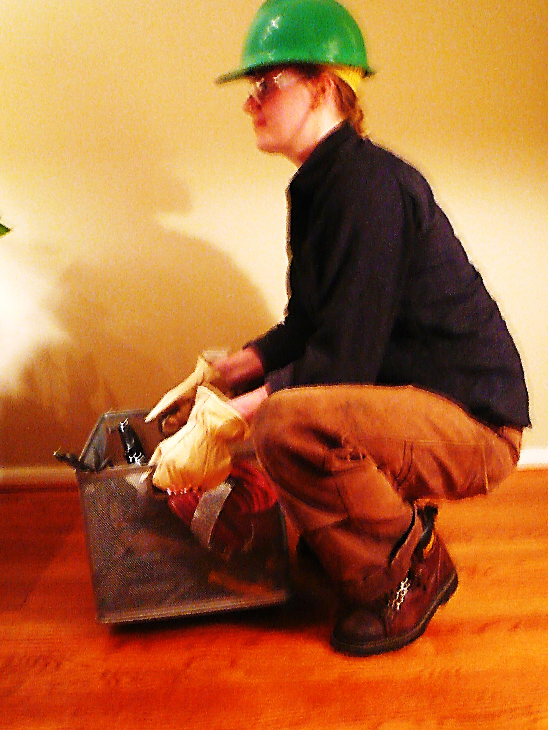
Preventing Musculoskeletal Injuries Module 5
Heads Up Not Butts Up
Bad
Good
Lifting with back
Lifting with legs
Source: CIANBRO
Notes:
Presenter’s Notes:
Suck your gut and butt in when lifting and keep your head up
TIP~ may be to put the loads on several pallets which would limit the lift.
Team members should not lift over 50 pounds alone. If a load is too heavy to lift alone, get a team member to help or use one of the many means available to move the load. Use mechanical assists whenever possible. We provide lifting/force aids from come-alongs, chain falls, to forklifts and overhead cranes, depending on the nature of the job. Proper lifting techniques are essential and are illustrated at the end of this bulletin. Individual lifts over 50 lbs will require additional planning and evaluation of the materials and/or individuals capabilities. Cianbro works team members within the doctor’s prescribed recommendations. Understand your back and take proper care of it. It’s the only one you’ll ever have!
Keep in mind that poor ergonomics is something that catches up with you over a period of time.

Slide 25
Preventing Musculoskeletal Injuries Module 5
Heads Up Not Butts Up
In Class Lifting Demonstration
Instructor Lead Class Lifting Demonstration
Select a volunteer-lift an object from the floor
Notes:
Presenter’s Notes:
Suck your gut and butt in when lifting and keep your head up
TIP~ may be to put the loads on several pallets which would limit the lift.
Team members should not lift over 50 pounds alone. If a load is too heavy to lift alone, get a team member to help or use one of the many means available to move the load. Use mechanical assists whenever possible. We provide lifting/force aids from come-alongs, chain falls, to forklifts and overhead cranes, depending on the nature of the job. Proper lifting techniques are essential and are illustrated at the end of this bulletin. Individual lifts over 50 lbs will require additional planning and evaluation of the materials and/or individuals capabilities. Cianbro works team members within the doctor’s prescribed recommendations. Understand your back and take proper care of it. It’s the only one you’ll ever have!
Keep in mind that poor ergonomics is something that catches up with you over a period of time.

Slide 26
Preventing Musculoskeletal Injuries Module 5
Vibration Exposure
“Whole body vibration (WBV) is a form of mechanical vibration transmitted through a supporting surface to the body. Like in equipment or a truck seat.
Vibration from hand tools can be dampened by anti-vibratory gloves, tool wraps or even by choosing tools that provide less vibration.”
Source; CIANBRO
26
Notes:
Presenter’s Notes:
Truck drivers sit for long periods of time (worse for the back than standing), the vibration of the vehicle. These vibrations are low frequency (4 to 6 Hz) cyclic motions like those caused by a vehicle's tires hitting the road.
Various Sources of Vibration:
Low-frequency vibration caused by tires and terrain
High-frequency vibration from engine and transmission
Shock from hitting potholes or obstacles
TIPS for Drivers~
Workers should avoid bending over or lifting immediately following driving.
Tell them to walk around for a few minutes first.
Drivers should frequently adjust their postures, for instance, by stretching.
Asymmetric postures or twisting while driving should be avoided.
Seating environments should be arranged so that not much bending to the side is required.
Make sure the seat back can recline 20 degrees or more from the vertical position.
The seat pan should have adjustable inclination. Arm rests should be used. Be sure the lumbar area is supported.
Decrease vibration as much as possible.

Slide 27
Preventing Musculoskeletal Injuries Module 5
Vibration in steel shops
Grinders
Sanders
Drills
Chipping hammers and chisels

Slide 28
Preventing Musculoskeletal Injuries Module 5
H.A.V.S. Symptoms (Hand-Arm Vibration Syndrome)
“Tingling or numbness in fingers and palm
Spasms in fingers
Blanching of the fingers
Chronic disorder usually irreversible
Can develop from repeated and prolonged exposure to
vibration
Damage to the blood vessels, nerves, and muscles
Half of the 1.5 million American workers who use
vibrating tools will develop some form of HAVS (NIOSH)
5% of the general population suffers from HAVS”

Slide 29
Preventing Musculoskeletal Injuries Module 5
H.A.V.S. Risk Factors
“Repeated and prolonged exposure
to hand-held vibrating tools
Improper tool use
Forceful tool grip
Aggravated by
Temperature - Cold
Damp environment
Smoking”
Vibration from grinding can be
minimized by the use of vibration
dampening tools and anti-vibration
gloves
Photo from Cianbro

Slide 30
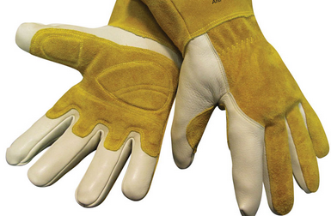
Preventing Musculoskeletal Injuries Module 5
H.A.V.S Control PPE
Wear full-fingered, certified anti-vibration gloves to
reduce exposure to vibration
Wear ANSI Compliant Gloves appropriate for the hazard
Anti vibration gloves

Slide 31
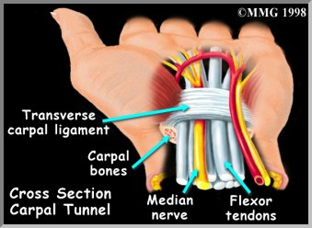
Preventing Musculoskeletal Injuries Module 5
Hands and wrist damage is a fast
growing class or worker’s
compensation claims
“Wrist injuries accounted for more
than half of all MSDs
5 million U.S. workers suffer from
repetitive stress injuries to the wrist
Occurs when the median nerve is compressed and inflamed.”

Slide 32
Preventing Musculoskeletal Injuries Module 5
Carpel Tunnel Syndrome
“Causes
Repetition
Sustained exertions
Awkward wrist and positions
Symptoms
Tingling and pain in the hand and
Numbness in wrist
Muscle atrophy at base of thumb”

Slide 33
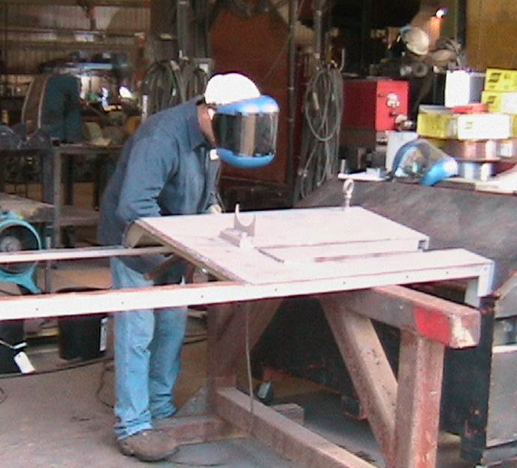
Preventing Musculoskeletal Injuries Module 5
What Is “Ergonomics?”
Fitting the job to the
Worker.
Elevate the work to avoid kneeling and reaching
Photo Source CIANBRO
Notes:
Ask the class: What does the term “ergonomics” mean? Is it a hazard, injury
or solution?
Tell the class: The word is used to describe the science of fitting the job to the worker, not the worker to the job. MSDs are the problem and ergonomics is the solution.
The term "ergonomics" comes from the Greek words "ergon," meaning work and "nomoi," meaning natural laws. Ergonomists study the relationship of the human body to the demands of a work environment.
Serious injuries can occur if tools, tasks, and equipment are poorly designed and don’t fit workers properly. This can put workers at increased risk of musculoskeletal disorders. Musculoskeletal disorders are among the most common job injuries, and are very costly for both workers and employers.

Slide 34
Preventing Musculoskeletal Injuries Module 5
What is Ergonomics?
“The science of adapting work-stations, tools, equipment, and job techniques to be compatible with human anatomy and physiology to reduce the risk of Musculoskeletal Disorder injuries due to Ergonomic Stressors.”
“Fit the job to the person” rather than the “person to the job.”
Notes:
Incorporating Engineering and administrative controls can have many positive benefits for employers. The following
Ergonomic goals should be considered.
Improve overall team member health
Reduction in injuries & illnesses
Increased productivity & quality
Increased job satisfaction
Reduction in absenteeism
Reduction in team member turn over

Slide 35
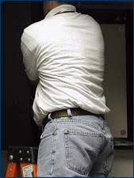
Preventing Musculoskeletal Injuries Module 5
Ergonomic Risk Factors
Poor body mechanics
Restrictive workstations
Awkward postures
Working overhead
Working below the knees
Hand tools that do not meet the requirements of the job
Photo source https://www.osha.gov/SLTC/etools/electricalcontractors/materials/heavy.html
Source CIANBRO
Notes:
Presenter’s Notes:
This would be a great place to stop and continue later if you have limited time.

Slide 36
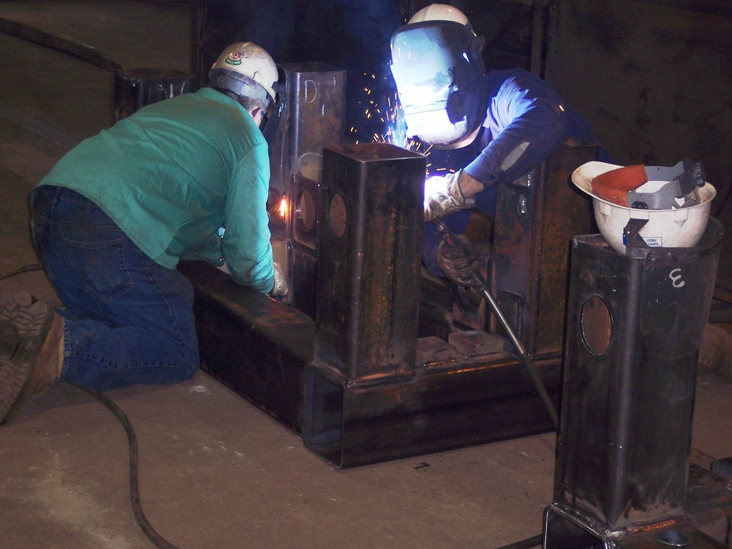
Preventing Musculoskeletal Injuries Module 5
What awkward postures do you work in?
Risks from above shoulders and below the knees work
Workers kneeling during fabrication
Photo from CIANBRO
Notes:
Ask the class: What awkward postures do you work in?
Awkward postures can include:
Bending
Working overhead
Kneeling
Twisting
Reaching far in front of you to pick up something
Working with a bent wrist.
Tell the class: The term awkward postures refers to any posture where the body parts are away from their comfortable, neutral position (e.g., a bent back, a bent wrist or arms raised above the head). Awkward postures are not always harmful. It is only when they are repeated frequently or performed for a long time.

Slide 37
Preventing Musculoskeletal Injuries Module 5
Ergo Tips-Reduce Bending Over to Work
Reduces the strain on your back from stooping
Reduces leg fatigue from holding a squatting position
Allows your feet to be flat on the floor with your ankles in their natural position instead of balancing on the balls of your feet and stretching the tendons at the backs of your ankles
Source: CIANBRO

Slide 38
Balanced Tool Belts
Preventing Musculoskeletal Injuries Module 5
Ergo Tips
Suspending Tools
Source: CIANBRO
Notes:
Presenter’s Notes:
Have you ever thought about balancing your tool belt?
Suspending Tools
Prevents back, arm and shoulder fatigue
All the effort goes into drilling of chipping, rather than carrying the weight of the tool
Reduces the stress on the shoulder and back, caused by supporting the equipment
If the drill bit binds, the safety sling helps to reduce effects of the kickback
Think about worn out drill bits and how they make you put more pressure to the job.

Slide 39
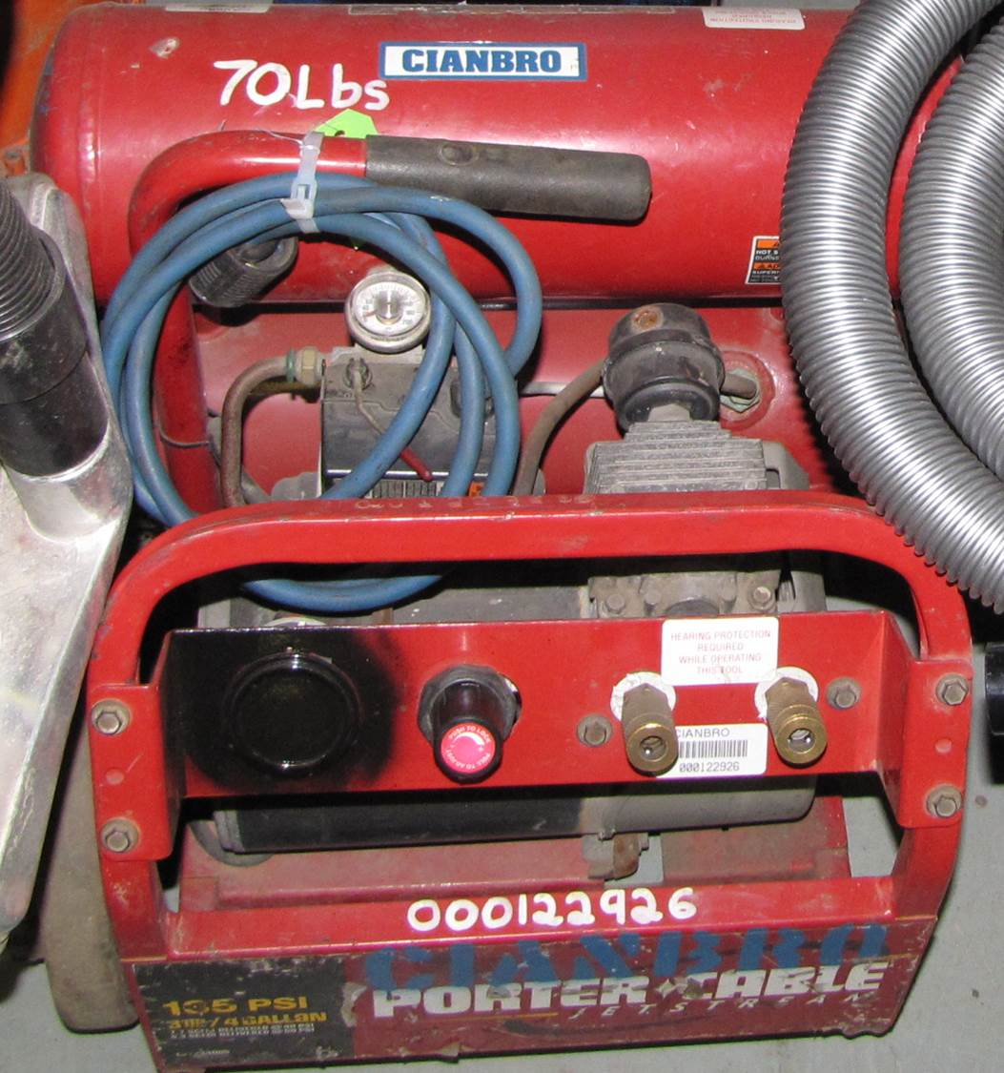
Preventing Musculoskeletal Injuries Module 5
Ergo Tips
Mark loads over 50 lbs to
warn workers of heavy loads
Marking lifting load
Photo from CIANBRO
Notes:
Presenter’s Notes:
Have you ever thought about balancing your tool belt?
Suspending Tools
Prevents back, arm and shoulder fatigue
All the effort goes into drilling of chipping, rather than carrying the weight of the tool
Reduces the stress on the shoulder and back, caused by supporting the equipment
If the drill bit binds, the safety sling helps to reduce effects of the kickback
Think about worn out drill bits and how they make you put more pressure to the job.

Slide 40
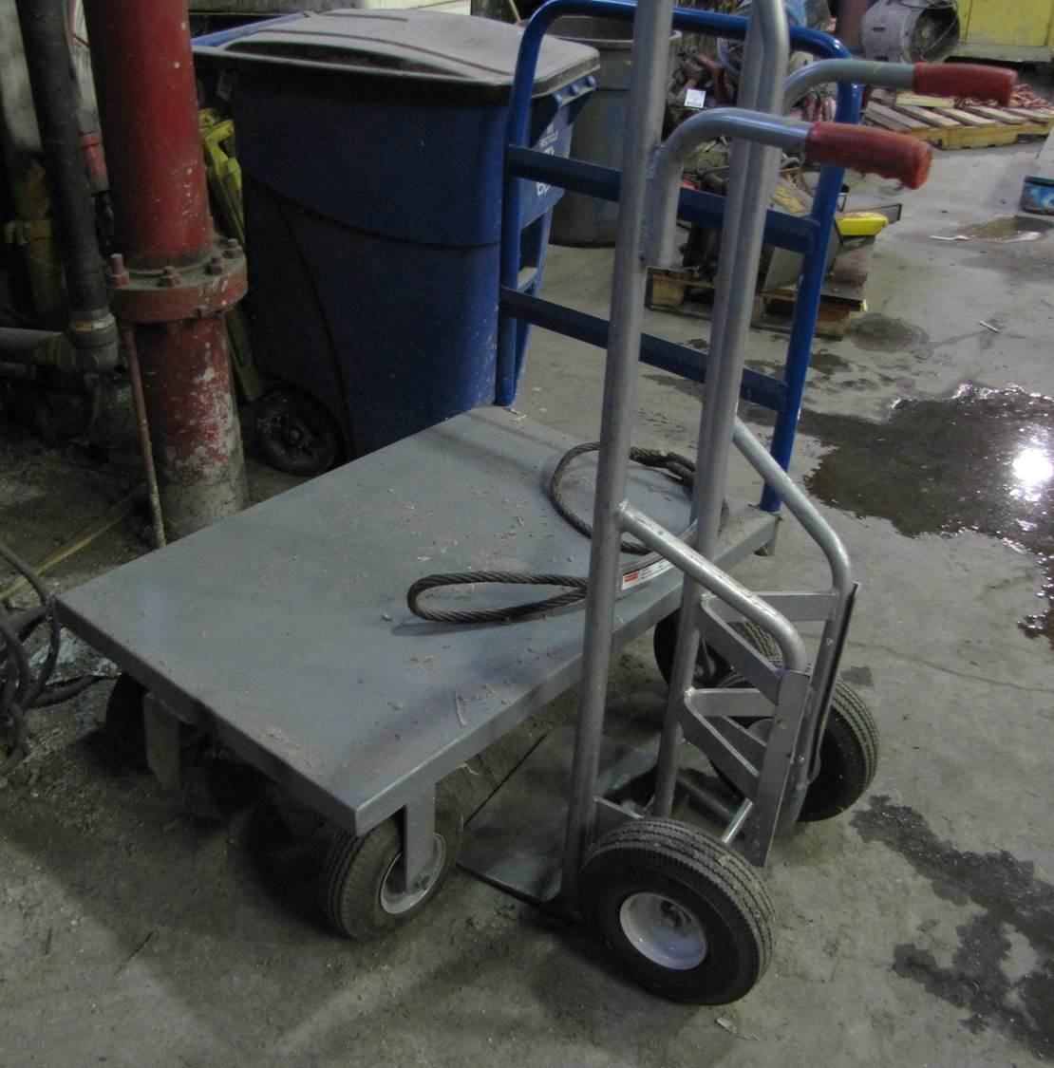
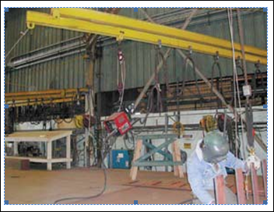
Preventing Musculoskeletal Injuries Module 5
Ergo Tips
Use equipment such as hoist balancers, jib cranes, carts or forklifts to decrease the need for lifting, pushing and pulling loads.
Hand Cart
Job Crane
Photo from CIANBRO
Photo form OSHA 3341-03N 2008
Notes:
Presenter’s Notes:
Have you ever thought about balancing your tool belt?
Suspending Tools
Prevents back, arm and shoulder fatigue
All the effort goes into drilling of chipping, rather than carrying the weight of the tool
Reduces the stress on the shoulder and back, caused by supporting the equipment
If the drill bit binds, the safety sling helps to reduce effects of the kickback
Think about worn out drill bits and how they make you put more pressure to the job.

Slide 41
Preventing Musculoskeletal Injuries Module 5
Job Rotation
“Job rotation is vital when conducting demanding repetitive tasks.
When planning out the job keep in mind that good job rotations are those that have team members using different muscle groups between tasks or at the very least less demanding tasks”.
Source: CIANBRO

Slide 42
Preventing Musculoskeletal Injuries Module 5
Early Reporting of MSD Symptoms
Addressing injuries early can help prevent them from becoming more serious.
Source: 3341-03N 2009
42

Slide 43
Preventing Musculoskeletal Injuries Module 5
Use of the General Duty clause
“OSHA will use the General Duty Clause to cite employers for ergonomic hazards. Under the OSH Act's General Duty Clause, employers must keep their workplaces free from recognized serious hazards, including ergonomic hazards. This requirement exists whether or not there are voluntary guidelines”
https://www.osha.gov/SLTC/ergonomics/faqs.html

Slide 44
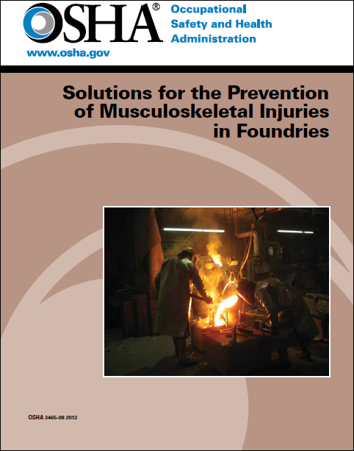
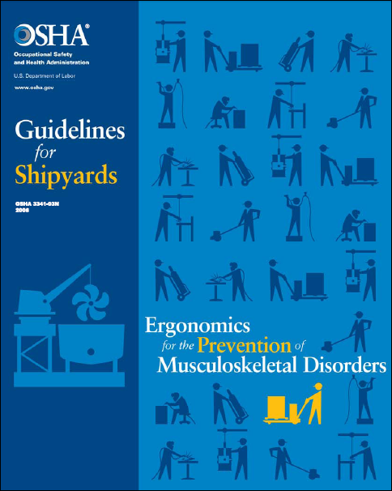
Preventing Musculoskeletal Injuries Module 5
OSHA Publishes several useful guides
for other industries that have parallels to steel fabrication companies and service centers.
OSHA 3465-08 2012
OSHA 3341-03N 2008

Slide 45
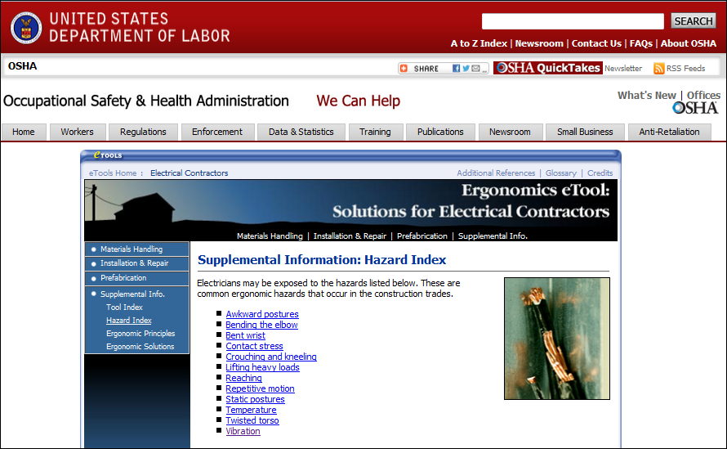
Preventing Musculoskeletal Injuries Module 5
OSHA Resources
https://www.osha.gov/SLTC/etools/electricalcontractors/supplemental/hazardindex.html#vibration

Slide 46
Preventing Musculoskeletal Injuries Module 5
Summary Key Points
“Use your brain, not your back.
Work smarter, not harder.
Fix the job, not the worker.
Use safe ergonomic habits at home”
Source: CIANBRO

Slide 47
Musculoskeletal Safety Module 5
Sources
https://www.osha.gov/dte/grant_materials/fy06/46g6-ht22/back_injury_prevention.pdf
https://www.osha.gov/SLTC/ergonomics/
https://www.osha.gov/SLTC/ergonomics/controlhazards.html
https://www.osha.gov/ergonomics/FAQs-external.html…
https://www.osha.gov/pls/oshaweb/owadisp.show_document?p_table=SPEECHES
https://www.osha.gov/Publications/osha3465.pdf
https://www.osha.gov/dte/grant_materials/fy10/sh-20835-10/jeopardy_game.pdf
https://www.osha.gov/dts/shib/shib072709.html
https://www.osha.gov/SLTC/etools/computerworkstations/more.html
https://www.osha.gov/SLTC/ergonomics/training.html
http://www.osha.gov/SLTC/trucking_industry/
lwww.safetyservicescompany.com/.../warehouse-safety-general-guide. OSHA
CIANBROSafety Bulletin-Ergonomics
Grandjean E. “Fitting the task to the Man”, Taylor & Francis London, 1988
Lauren Hebert, “Personal Ergonomic Guide material handling Low Back Tasks”
Construction Occupational Health Program, UMass

Slide 48
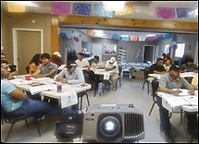
Musculoskeletal Safety Module 5
Questions?
Photo from OSHA 3686-09 2010

