Slide 1
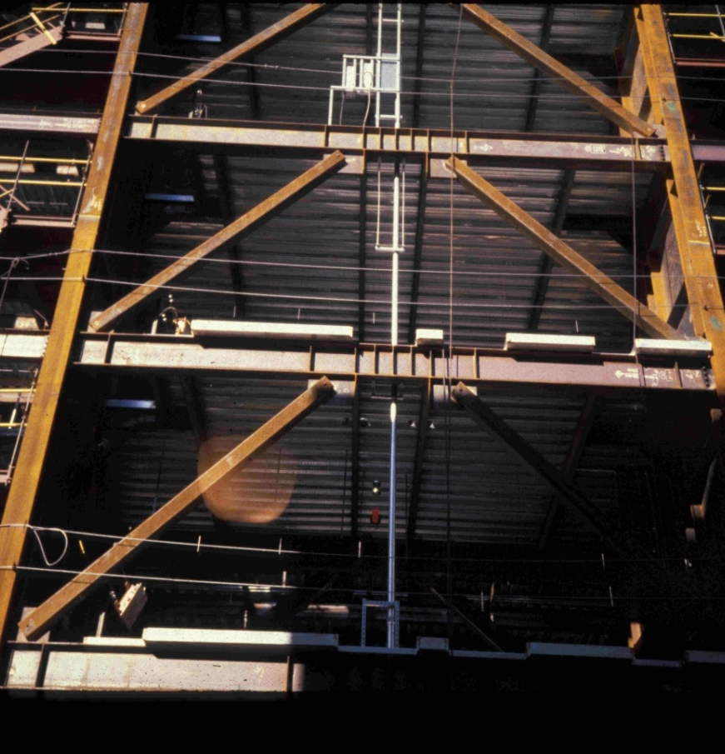
Design of
Seismic-Resistant Steel Building Structures
4. Eccentrically Braced Frames
Version 3 (December 2024)
Notes:
This series of PowerPoint presentations covers the fundamentals of the design of seismic-resistant steel building structures. The primary focus of the material is on ductile detailing of steel structures for seismic resistance, rather than on calculation of lateral forces, dynamic analysis, or other general topics on earthquake engineering. The material is intended primarily for use at the graduate level, although many portions of the presentations are appropriate for undergraduates.
The presentations are closely tied to the 2022 AISC Seismic Provisions for Structural Steel Buildings (referred to herein as the AISC Seismic Provisions). The presentations discuss basic principles of the behavior of seismic response of steel structures, and show how these principles are treated in the AISC Seismic Provisions. The presentations are most effective if the students have a copy of the AISC Seismic Provisions. A free copy can be downloaded from the AISC website, at: www.aisc.org.
For basic steel design topics, the presentation refers to the 2022 AISC Specification for Structural Steel Buildings (herein referred to as the AISC Specification). Both the 2022 AISC Seismic Provisions and AISC Specification are written in the combined LRFD - ASD format. These PowerPoint presentations, however, present only the LRFD format. For seismic-resistant design, the LRFD format is preferable, in that it more closely follows the element capacity concepts used seismic design.
For code related seismic-design topics not covered in the AISC Seismic Provisions (seismic design categories, R-factors, seismic overstrength factors, etc.), the presentations refer to ASCE 7-22 - Minimum Design Loads for Buildings and Other Structures.
For questions, comments, corrections, or suggestions on these presentations, please contact:
AISC University Programs
Email: universityprograms@aisc.org
Acknowledgments:
These presentations were originally prepared by Michael D. Engelhardt (University of Texas at Austin) with support from the AISC Educator Career Enhancement Award. The author also gratefully acknowledges contributions and review provided by the AISC Task Group for this project:
Mark Bowman - Purdue University
Steve Mahin - University of California at Berkeley
Brett Manning - PMB 200
Carol Pivonka - AISC
Larry Reaveley - University of Utah
Rafael Sabelli - Dasse Design, San Francisco
Tom Sabol - Englekirk & Sabol Consulting Engineers, Los Angeles
Chia-Ming Uang - University of California at San Diego
The module on Special Plate Shear Walls was prepared by Rafael Sabelli - Dasse Design, San Francisco. The contributions of Prof. Sharon Wood of the University of Texas at Austin to Module 1 are also gratefully acknowledged.
Version 2 (Updates to 2016 AISC Seismic Design Provisions):
Patricia Clayton – University of Texas at Austin
Larry Fahnestock – University of Illinois at Urbana-Champaign
Matthew Eatherton – Virginia Tech
Paul Richards – DuraFuse Frames

Slide 2
Design of Seismic-Resistant
Steel Building Structures
Introduction and Basic Principles
Moment Resisting Frames
Concentrically Braced Frames
Eccentrically Braced Frames
Buckling-Restrained Braced Frames
Special Plate Shear Walls
Notes:
This PowerPoint series is dividing into 6 modules. This is the Module No.4 on: “Eccentrically Braced Frames."

Slide 3
4 – Eccentrically Braced Frames (EBFs)
Description of Eccentrically Braced Frames
Basic Behavior of Eccentrically Braced Frames
AISC Seismic Provisions for Eccentrically Braced Frames

Slide 4
4 – Eccentrically Braced Frames (EBFs)
Description of Eccentrically Braced Frames
Basic Behavior of Eccentrically Braced Frames
AISC Seismic Provisions for Eccentrically Braced Frames
Notes:
We will begin this module with a description of Eccentrically Braced Frames (EBFs), and will illustrate common types of EBFs.

Slide 5
Eccentrically Braced Frames (EBFs)
Framing system with beam, columns and braces. At least one end of every brace is connected to isolate a segment of the beam called a link.
Resist lateral load through a combination of frame action and truss action. EBFs can be viewed as a hybrid system between moment frames and concentrically braced frames.
Develop ductility through inelastic action in the links.
EBFs can supply high levels of ductility (similar to MRFs), but can also provide high levels of elastic stiffness (similar to CBFs)
Notes:
This slide provides a basic definition for EBFs.
EBFs are braced frames, consisting of beams, columns, and braces. Unlike conventional concentrically braced frames, an intentional eccentricity is introduced in EBFs, so that the brace-beam-column centerlines do not meet at a single point. The framing is arranged so as to isolate a short segment of beam at one of each brace. This isolated beam segment is called a "link."
EBFs are designed so that inelastic action occurs within the links. The links, in turn, can be designed and detailed to provide very high levels of ductility. The braces, columns and beam segments outside of the links are designed to remain essentially elastic, by designing these elements to be stronger than the links.
A well designed EBF can combine high stiffness in the elastic range (similar to a concentrically braced frame), with high ductility in the inelastic range (similar to a moment resisting frame). Because of the high elastic stiffness of an EBF, beam and column sizes are generally much smaller than in a moment resisting frame.

Slide 6
e
Link
e
Link
Notes:
This is an example of an EBF. The links are located at mid-span of the beams. Link length, which is a critical design parameter in EBFs, is denoted by the letter "e."
The link is introduced in an EBF for improved seismic performance. However, an additional benefit of the link is that it permits larger frame openings for doors, windows, etc, and therefore can provide some additional architectural flexibility compared to a conventional concentrically braced frame.
A common feature of EBFs, shown in this slide, are the stiffeners located within the links. These stiffeners are provided to enhance the ductility of links by delaying shear buckling of the link webs. Stiffener requirements will be discussed later in this module.

Slide 7
e
Link
e
Link
Notes:
Another example of an EBF. In this case, the links are located adjacent to columns.

Slide 8
Some possible bracing arrangement for EBFS
e
e
e
e
e
Notes:
There are many possible framing arrangements for EBFs, as illustrated in this slide.
The next several slides are photos of actual EBFs.

Slide 9

Notes:
An EBF with the links at mid-span of the beams. This building is located in San Francisco.
Note the stiffeners in the link.
Note also that the brace connections are not detailed with "fold-lines" as required in SCBFs. The fold-lines are not needed, because braces are not expected to buckle in an EBF.

Slide 10
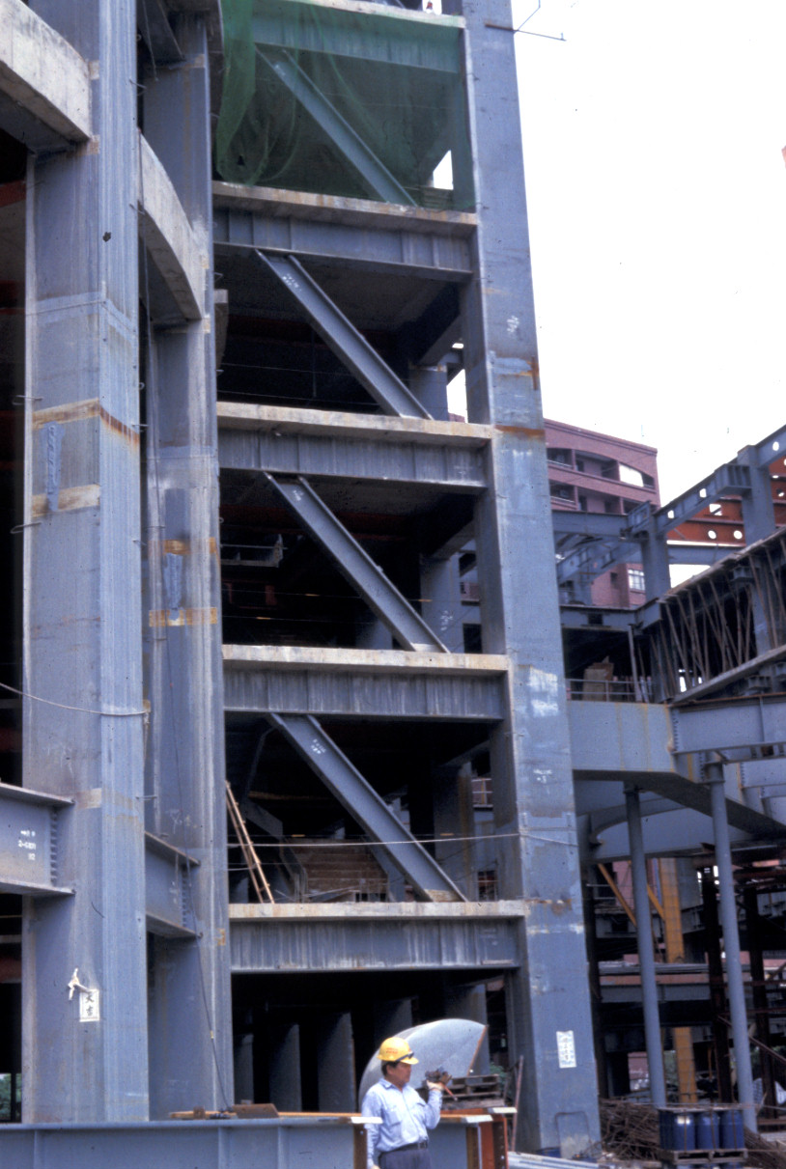
Notes:
An example of a single diagonal EBF is a high-rise steel office building located in Taipei, Taiwan. Columns are steel box sections.
A close-up of the link region of this frame is shown on the next slide.

Slide 11
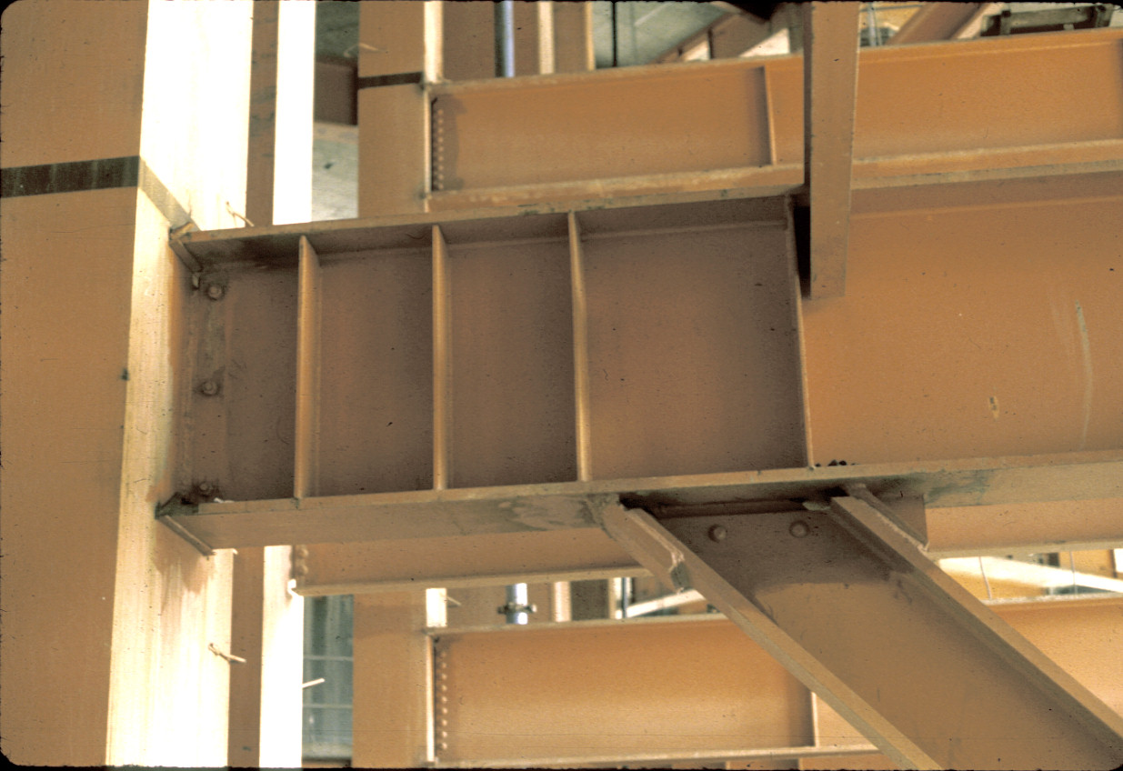
Notes:
The link is attached to the steel box column with a fully welded connection.

Slide 12
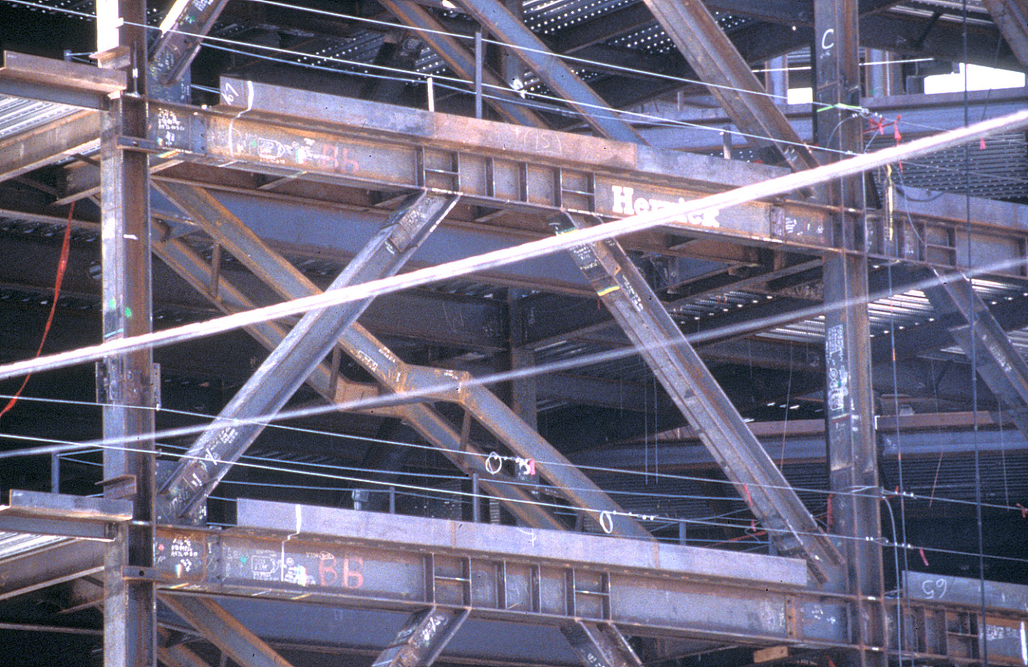
Notes:
An EBF with the links at mid-span of the beams. This building is located in the San Francisco area.
Note the brace to link connections for the wide flange braces. Small segments of the braces were shop welded to the bottom of the beam, with a welded splice provided in the field for connection of the remaining portion of the brace.
The adjoining bay to the right is also an EBF, with links attached to the columns.

Slide 13
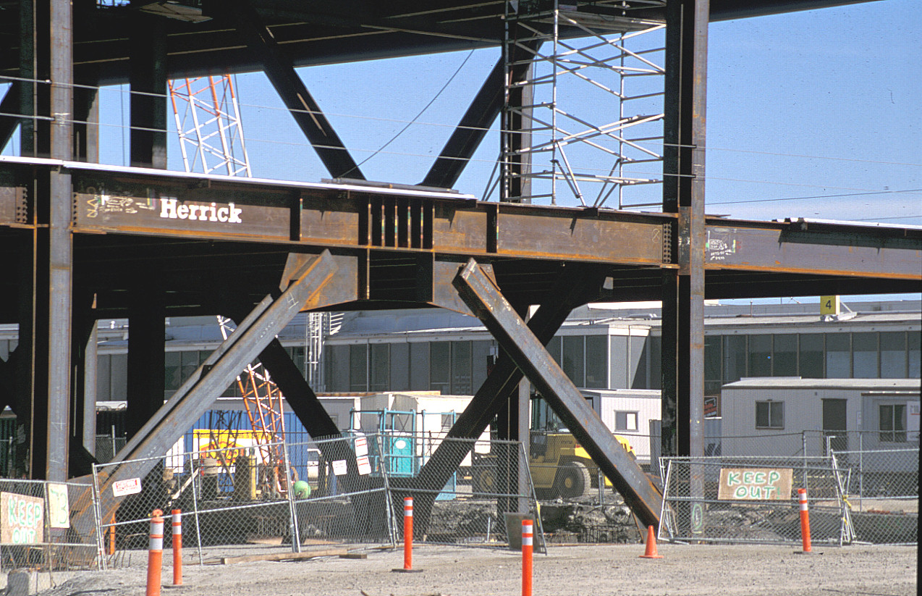
Notes:
An EBF with links at mid-span of the beams. This photo was taken during construction of the International Terminal at San Francisco airport.

Slide 14
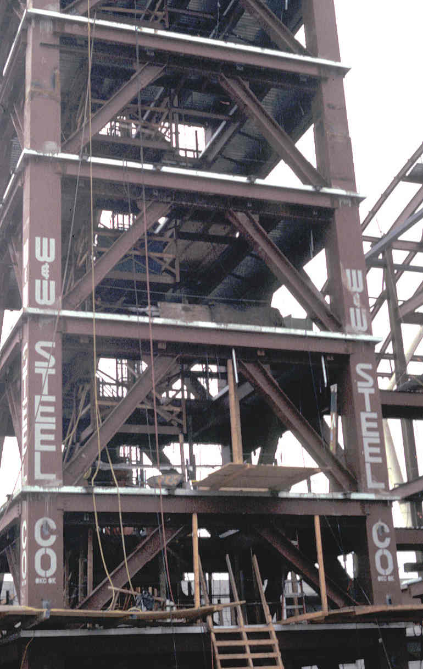
Notes:
Another EBF with links at mid-span. This is a control tower at Los Angeles airport.

Slide 15
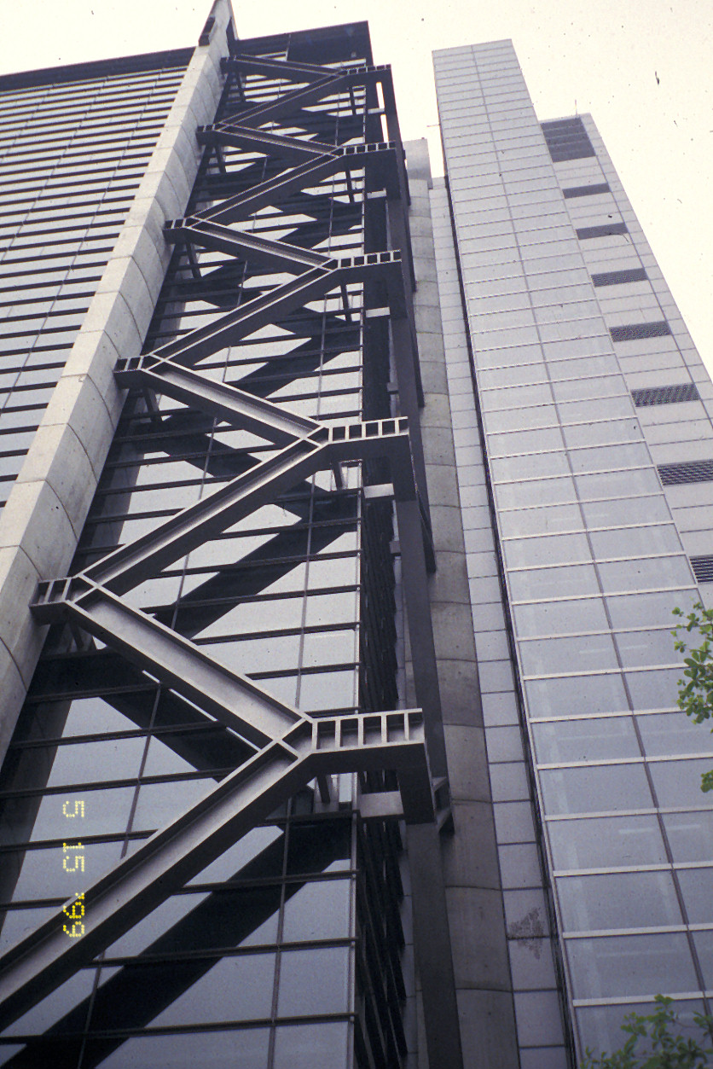
Notes:
This is a unique example of an EBF. The EBF is architecturally exposed, with unconventional framing in which there are intersecting links at the corner of the building.
This building is located in Taipei, Taiwan.

Slide 16
4 – Eccentrically Braced Frames (EBFs)
Description of Eccentrically Braced Frames
Basic Behavior of Eccentrically Braced Frames
AISC Seismic Provisions for Eccentrically Braced Frames
Notes:
In the next portion of this module, we will discuss the basic inelastic behavior of EBFs. We will start by looking at inelastic response of the entire frame, followed by a detailed discussion on the inelastic behavior of links.

Slide 17
Inelastic Response of EBFs
Notes:
The next several slides illustrate the intended inelastic response of an EBF under lateral loading. Inelastic deformation patterns are shown in the form of a rigid-plastic mechanism.

Slide 18
Inelastic Response of EBFs
Notes:
Yielding is an EBF is intended to occur within the links. The braces, columns, and beam segments outside of the links are intended to remain essentially elastic.

Slide 19
Inelastic Response of EBFs
Notes:
Loading in the reverse direction.

Slide 20
Inelastic Response of EBFs
Notes:
The next three slides show inelastic deformations for a single diagonal EBF with the link attached to the column.

Slide 21
Inelastic Response of EBFs
Notes:
Yielding is again restricted to the link.
For an EBF with links attached to columns, the link-to-column connection must accommodate very large inelastic deformation demands, as suggested by this slide.

Slide 22
Inelastic Response of EBFs
Notes:
Loading in the reverse direction.

Slide 23
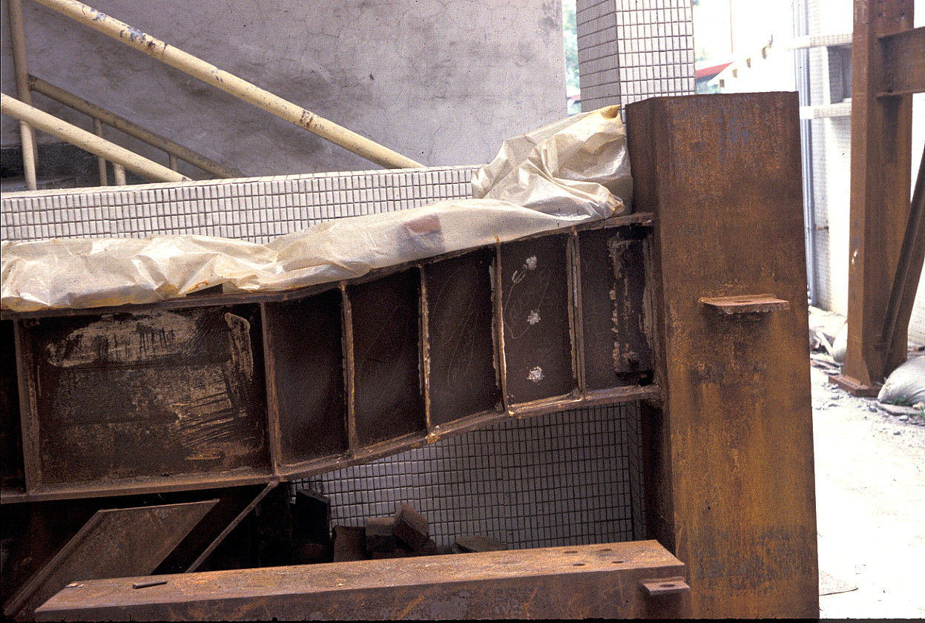
Notes:
This is a portion of an EBF test specimen that was subjected to severe cyclic inelastic loading. The very large localized inelastic deformations within the link are apparent (similar to the pattern shown on the previous slide). The column in this EBF test specimen is a steel box section.
Photo courtesy of K.C. Tsai, National Taiwan University.

Slide 24
MRF
CBF
EBF
Energy Dissipation Mechanisms
Notes:
A comparison of energy dissipation mechanisms and "fuse" locations in EBFs, CBFs and MRFs.

Slide 25
Design of EBFs - General Approach
Design frame so that inelastic behavior is restricted to links.
  Links are "fuse" elements of frame.
  Links are weakest element of frame. All other frame elements (braces, columns, beam segments outside of link, connections) are stronger than links.
Detail links to provide high ductility (stiffeners, lateral bracing).
Notes:
An overview of the basic design approach for seismic-resistant EBFs:
The links are the "fuse" elements of the frame and are designed for code level earthquake forces. All other frame members (braces, columns and beam segments outside of links) and connections are designed to be stronger than the links. Thus, the other frame members and connections are not designed for code level earthquake forces. Rather they are designed for the maximum forces generated by the fully yielded and strain hardened links, i.e., to develop the capacity of the links.
The links are detailed to provide high levels of ductility under cyclic loading. Obtaining high ductility from links involves proper choice of link length, stiffening of the link, and lateral bracing of the link.

Slide 26
EBFs – Link Behavior
Link plastic rotation angle
Forces in links
Shear vs flexural yielding links
Link nominal strength
Post-yield behavior of links
Examples of experimental performance of links
Notes:
The next portion of this module provides an in-depth discussion on link behavior.
Links are the critical element of an EBF, and a good understanding of link behavior is needed for proper EBF design.

Slide 27
Inelastic Response of EBFs
γ_{p}
γ_{p} = inelastic angle between link and the beam outside of link (rad)
Notes:
This slide defines the link plastic rotation angle. The symbol γ_{p} is used to denote the link plastic rotation angle.
The plastic rotation angle γ_{p} is the primary kinematic variable used to characterize inelastic deformation demands on a link. γ_{p} is defined as the inelastic angle between the link and adjoining beam, in a rigid-plastic EBF mechanism, as shown in the slide.
The link plastic rotation angle is expressed in units of radians.
Note that within the literature, the symbol γ rather than γ_{p} is sometimes used to denote link plastic rotation angle.

Slide 28
Inelastic Response of EBFs
γ_{p}
γ_{p} = inelastic angle between link and the beam outside of link (rad)
Notes:
This slide illustrates the link plastic rotation angle for a single diagonal EBF.

Slide 29
Link Behavior: Forces in Links
e
e
M
V
P
Notes:
The next series of slides discuss the strength and inelastic response of links.
This slide qualitatively illustrates the forces generated in a link, when an EBF is subjected to lateral load. Two cases are illustrated: a single diagonal EBF (left) and an EBF with links at mid-span (right). The forces generated in the links are very similar in each case.
As shown, links generally see very high shear, which is constant along the length of the link.
Links also see very large bending moments. Links are subject to reverse curvature bending, with high end moments of opposite sign.
Finally, links generally see very low axial forces. Research has shown that high axial forces can be detrimental to both the strength and ductility of links. Consequently, it is best to avoid EBF arrangements that require large axial forces to be transferred through the links.

Slide 30
Link Behavior: Shear vs Flexural Yielding Links
e
M
M
V
V
Will link plastic strength be controlled by shear or flexure?
V
Link length "e" is key parameter that controls inelastic behavior
M
M
Notes:
As noted on the previous slide, links carry both large shear force and large end moments. Consequently, as a link is loaded beyond its elastic range, it is possible to have either shear yielding or flexural yielding occur.
The designer can control if a link will yield in shear, in flexure, or combined shear and flexure. The link length e is a key parameter that controls inelastic behavior. Inelastic response of short links is dominated by shear, whereas the inelastic response of longer links is dominated by flexure.
Understanding how link length can be used to control inelastic behavior can be approached by examining a free-body diagram of a link, as shown in this slide. Shear force V is constant along the length of the link. The link is also subjected to equal and opposite end moments M.
A simplifying assumption is made that the link end moments are equal in magnitude. This is not completely accurate, but is a reasonable simplifying assumption. It is also assumed that axial force in the link is small, and can be neglected.

Slide 31
Link Behavior
e
M
M
Shear yielding occurs when:
V
V
V = V_{p} = 0.6 F_{y} (d - 2t_{f} ) t_{w}
V
Shear yield stress of steel
web area of link
M
V_{p} = fully plastic shear capacity of link section
M
Notes:
Shear yielding of a link will occur when the shear force reaches the fully plastic shear capacity V_{p} of the link section. Note that shear yielding in a wide-flange section occurs primarily in the web. V_{p} can be computed by simply multiplying the web area of the section by the yield stress in shear.

Slide 32
Link Behavior
e
M
M
V
V
Flexural yielding occurs when:
M = M_{p} = Z F_{y}
V
M_{p} = fully plastic moment of link section
M
M
Notes:
Flexural yielding will occur at the link ends when the end moment reaches M_{p} of the link section.

Slide 33
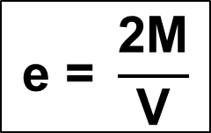
Link Behavior
e
M
M
V
V
Static equilibrium of link: Ve = 2M or:
Notes:
There is a relationship between link shear, link end moments, and link length that must be satisfied based on static equilibrium of the link. By summing moments for the free body diagram of the link, the relationship that
e = 2M/V can be derived. This simple equation is a key element in understanding link behavior.

Slide 34
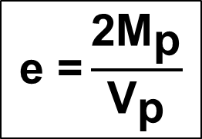
Shear vs. Flexural Yielding Links:
e
M_{p}
M_{p}
V_{p}
V_{p}
Shear and flexural yielding occur simultaneously
when V = V_{p} and M = M_{p}
or, when:
Notes:
To determine the value of link length for which shear and flexural yielding occur simultaneously, we draw a free body diagram with a link shear equal to V_{p} and link end moments equal to M_{p}. From static equilibrium of the link, we can derive that shear and flexural yielding will occur simultaneously at a link length of e = 2M_{p} /V_{p}.

Slide 35
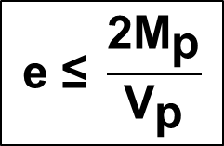
shear yielding of web along entire length of link
e
M
M
V_{p}
V_{p}
Shear yielding will occur when V = V_{p} and M < M_{p}
V =V_{p}
or, when:
M < M_{p}
Notes:
For links with e < 2M_{p} /V_{p}, the link shear will reach V_{p} before the end moments reach M_{p}, and the link will yield in shear. This can be demonstrated by choosing any arbitrary link length that is less than 2M_{p} /V_{p}, applying a link shear equal to V_{p}, and then computing the end moment from static equilibrium of the link. You will find that the link end moment is less than M_{p} .
For example, take e = 1.0 M_{p} /V_{p} and take the link shear equal to V_{p}. From equilibrium of the link, the end moments must equal 0.5 M_{p}.
Note that for a shear yielding link, web yielding occurs along the entire depth of the web (because shear stress is relatively uniform over the depth of the web in the inelastic range), and along the entire length of the section (because shear force is constant along the length of the link). A key reason why shear yielding links provide high levels of ductility is because a large portion of the link yields in a relatively uniform manner.

Slide 36
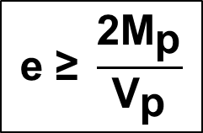
flexural yielding at link ends
e
M_{p}
M_{p}
V
V
V <V_{p}
Flexural yielding will occur when M = M_{p} and V < V_{p}
M = M_{p}
or, when:
M = M_{p}
Notes:
For links with e > 2M_{p} /V_{p}, the link end moments will reach M_{p} before the link shear reaches V_{p}, and the link will yield in flexure. This can be demonstrated by choosing any arbitrary link length that is greater than 2M_{p} /V_{p}, applying link end moments equal to M_{p}, and then computing the link shear from static equilibrium of the link. You will find that the link shear is less than V_{p} .
For example, take e = 3.0 M_{p} /V_{p} and take the link end moments equal to M_{p}. From equilibrium of the link, the link shear must equal 2/3 V_{p}.
Note that for a flexural yielding link, flexural yielding occurs only at the link ends. Because of the high moment gradient in a link (high shear = high moment gradient), flexural yielding is normally concentrated within a very short length at the link ends. A key reason why flexural yielding links provide lower levels of ductility is because only a relatively small portion of the link yields.

Slide 37
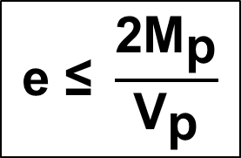
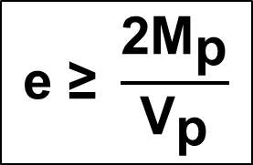
Shear vs. Flexural Yielding Links
Simple Plastic Theory
(assumes no strain hardening and no shear - flexure interaction)
SHEAR YIELDING LINK:
FLEXURAL YIELDING LINK:
Notes:
This slide summarizes the results obtained so far. For e < 2M_{p} /V_{p}, the link will yield in shear. For e > 2M_{p} /V_{p}, the link will yield in flexure. For e = 2M_{p} /V_{p}, the link will yield both in shear and flexure.
These simple results are based on simple plastic theory, and assume there is no shear-flexure interaction and no strain hardening in the link.
The assumption of no shear-flexure interaction implies that V_{p} is not affected by the presence of moment, and that M_{p} is not affected by the presence of shear. While this is theoretically incorrect, experiments have shown there is, in fact, little shear-flexure interaction at the yield limit state of the link. That is, experiments have shown that a link can develop a shear of V_{p} even in the presence of very high end moments. Similarly, a link can develop a moment of M_{p}, even in the presence of very high shear.
Consequently, from a design perspective, we normally ignore shear flexure interaction when computing the plastic strength of a link.
As noted above, we have also ignored strain hardening within the link. Experiments have shown that links experience very high degrees of strain hardening. For example, in shear yielding links, ultimate shear forces on the order of 1.25 to 1.5 × V_{p} are observed in experiments. Similarly, in flexural yielding links, end moments on the order of 1.25 to 1.5 × M_{p} are observed in experiments.
Consequently, the effects of strain hardening must be considered when evaluating inelastic behavior of links. This will be discussed in greater detail later.

Slide 38
Link Nominal Shear Strength, V_{n}
Basis for sizing links
Based on link shear at first significant yield if link
(in shear or flexure)
Based on simple plastic theory
(neglects shear-flexure interaction)
Notes:
The next several slides discuss the approach taken by the AISC Seismic Provisions for computing the link nominal shear strength, V_{n}.
V_{n} is the link shear that will result in first significant yield of the link, in either shear or flexure. That is, V_{n} defines the plastic strength of the link, and is the basis for sizing links. (Links are chosen so that φV_{n} is at least equal to the shear in the link under factored code-specified loads).
The computation of V_{n} neglects shear-flexure interaction. As discussed on the previous slide, experiments have shown it is reasonable to neglect shear-flexure interaction for the yield limit state of the link, i.e., for defining the plastic strength of the link.

Slide 39
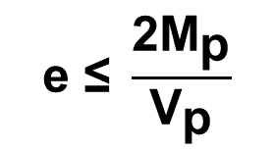
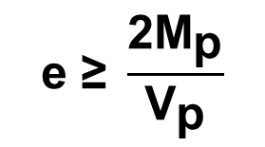

Link Nominal Shear Strength, V_{n}
V_{p}
controls for:
V_{n} = lesser of
2M_{p} / e
controls for:
Notes:
Shown here are the equations for computing link nominal shear strength.
For e < 2M_{p} /V_{p}, link nominal shear strength will be controlled by shear yielding, and V_{n} = V_{p}.
For e > 2M_{p} /V_{p}, link nominal shear strength will be controlled by flexural yielding at the link ends, and V_{n} = 2 M_{p}/ e. In this case, the link nominal shear strength represent the value of link shear when the end moments reach M_{p}.
Note that when sizing a link for strength, all computations are done in terms of shear, regardless of whether link strength is controlled by shear yielding or by flexural yielding. For the case where link strength is controlled by flexural yielding, the equation for link nominal shear strength given in this slide automatically takes care of checking flexure.

Slide 40


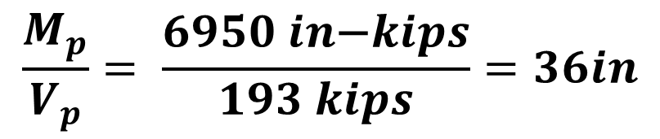
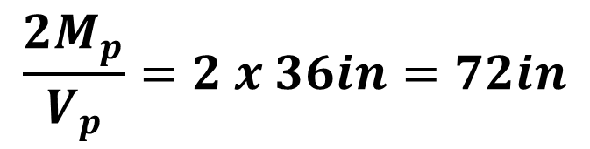
Example: W14x82 A992
Notes:
The next three slides provide a simple example of computing link nominal shear strength, for a W14x82 link of A992 steel
Shown in this slide is the calculation of M_{p}, V_{p}, M_{p}/V_{p}, and 2 M_{p}/V_{p.}
Note that M_{p}/V_{p} has units of length.

Slide 41

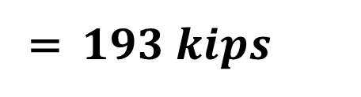
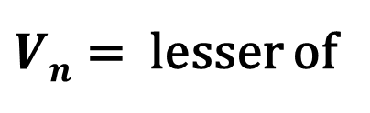

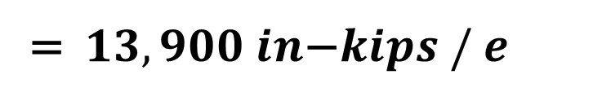
Example: W14x82 A992
Link nominal shear strength:
Notes:
Shown here is the value of link nominal shear strength for an A992 W14x82 link. V_{n} = V_{p} = 193 kips will control when e ≤ 72" (2 M_{p}/V_{p} ).
V_{n} = 2 M_{p} /e = 13900^{in-k} /e will control when e ≥ 72" (2 M_{p}/V_{p} ).

Slide 42
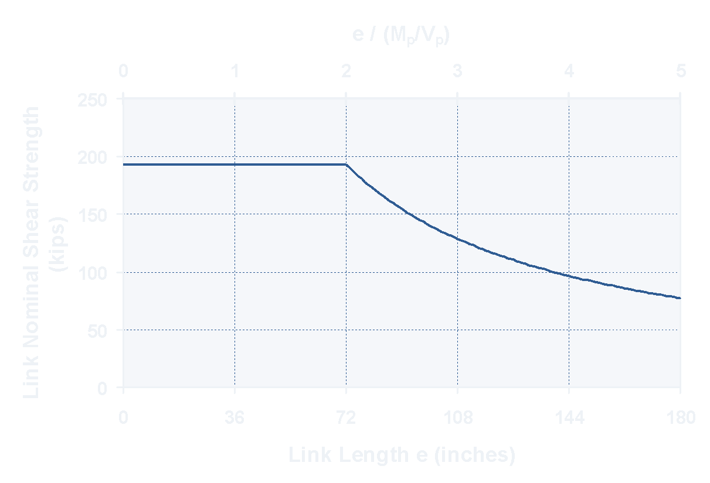
Example: W14x82 A992
Link nominal shear strength:
V_{n}=V_{p}
V_{n}=2M_{p} /e
Notes:
This is a plot of the nominal shear strength of an A992 W14x82 link.
Note that the maximum strength of a link is achieved when shear yielding controls. That is, shear yielding links provide greater link strength (and therefore greater lateral frame strength for an EBF) than flexural yielding links.

Slide 43
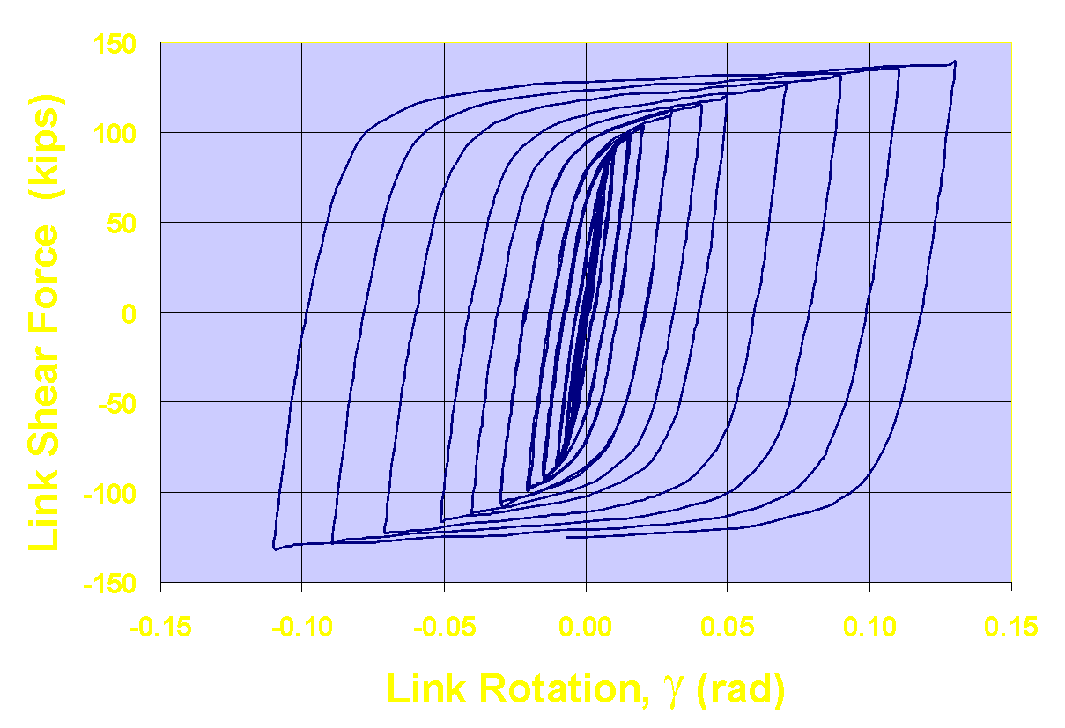

Post-yield behavior of links
Strain hardening
V_{ult}
V_{n}
Notes:
As described earlier, links experience a high degree of strain hardening.
The plot in this slide shows the result of a cyclic loading experiment on a shear yielding link (This is a W10x33 A992 link with a length e = 1.1 M_{p}/V_{p}).
The vertical axis plots the shear force applied to the link. The horizontal axis plots the link rotation angle γ. (Note that in this plot, γ includes both the elastic and plastic portions of the link rotation).
The value of V_{n} (link nominal shear strength) shown in the plot represents the shear at first significant yield of the link. Note that after first significant yield, the link shear continued to increase due to strain hardening. By the end of the test, the link shear V_{ult} is substantially greater than V_{n}. Experiments have shown that V_{ult} ≈ 1.25 to 1.5 V_{n} for both shear and flexural yielding links.

Slide 44
Post-yield behavior of links
Effects of Strain Hardening:
At large inelastic deformations, link shear resistance will significantly exceed V_{n}
V_{ult} ≈ (1.25 to 1.5) × V_{n}
Combined shear and flexural yielding will occur over a range of link lengths.
Notes:
An important effect of strain hardening is that both shear and flexural yielding will occur over a range of link lengths. A link length of e = 2 M_{p} / V_{p} represents the theoretical dividing line between shear yielding and flexural yielding links, and is used as a basis for computing link nominal shear strength (i.e. link shear at first significant yield). However, once the link has achieved its nominal strength, the link shear will continue to increase due to strain hardening. As a result, a link that initially yielded in shear may still experience flexural yielding, as the link shear (and therefore link end moment) continue to increase. Similarly, a link that initially yielded in flexure may still experience shear yielding, as the link end moments (and therefore the link shear) continue to increase due to strain hardening.
As an example, consider a link with e = 1.8M_{p}/V_{p}. This link will initially yield in shear, and V_{n} = V_{p}. At this point, the link shear will equal V_{p} and link end moments will be less than M_{p}. Due to strain hardening, say that the link ultimately achieves a shear strength of V_{ult} = 1.5 V_{p}. At this point, the link end moments must equal (by static equilibrium of the link): M_{ult} = (e×V_{ult})/2 = [(1.8M_{p}/V_{p}) × (1.5 V_{p})]/2 = 1.35 M_{p}. Thus, even though this link initially yielded in shear, it ultimately also experiences flexural yielding.
As another example, consider a link with e = 2.3M_{p}/V_{p}. This link will initially yield in flexure, and V_{n} = 2 M_{p} /e = 2 M_{p} / (2.3M_{p}/V_{p}) = 0.87 V_{p}. At this point, the link end moments will be equal to M_{p,} and the link shear will be less than V_{p}. Due to strain hardening, say that the link end moments ultimately achieve M_{ult} = 1.5 M_{p}. At this point, the link shear must equal (by static equilibrium of the link): V_{ult} = (2 M_{ult})/ e = ( 2 × 1.5 M_{p}) / (2.3M_{p}/V_{p}) = 1.3 V_{p}. Thus, even though this link initially yielded in flexure, it ultimately also experienced shear yielding.
Thus, whereas e = 2 M_{p} / V_{p} represents the dividing line between shear and flexural yielding links from the point of view of first significant yield, after first yield a combination of shear and flexural yielding will occur over a rather wide range of link lengths.

Slide 45
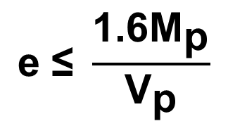
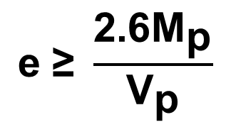
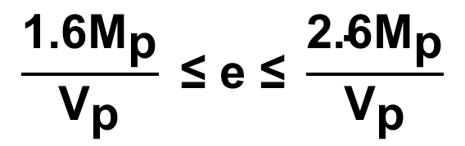
Post-yield behavior of links
PREDOMINANTLY SHEAR YIELDING LINK:
PREDOMINANTLY FLEXURAL YIELDING LINK:
COMBINED SHEAR AND FLEXURAL YIELDING:
Notes:
As noted in the previous slide, as a result of strain hardening, shear and flexural yielding will occur over a range of link lengths.
Experiments have shown that to obtain a link that yields predominantly in shear (with little flexural yielding even after strain hardening), the link length should be kept below about 1.6 M_{p}/V_{p.} To obtain a link whose inelastic behavior is dominated by flexural yielding (with little shear yielding even after strain hardening), the link length should be greater than about 2.6 M_{p}/V_{p.}
For link lengths between 1.6 and 2.6 M_{p}/V_{p}, the link will experience significant degrees of both shear and flexural yielding as it strain hardens under inelastic cyclic loading.
The choice of link lengths of 1.6 M_{p}/V_{p.} and 2.6 M_{p}/V_{p} for demarcating zones of inelastic link behavior is somewhat arbitrary, as there are no sharply defined boundaries between shear and flexural yielding as link length is varied. Nonetheless, these value appear reasonable based on experimental observations of link behavior.
The links lengths of 1.6 M_{p}/V_{p.} and ( e ≤ 1.6 M_{p}/V_{p.}), are also used by the AISC Seismic Provisions to divide links into three ranges of inelastic behavior: predominantly shear yielding ( e ≤ 1.6 M_{p}/V_{p.}), predominantly flexural yielding ( e ≥ 2.6 M_{p}/V_{p.}), and combined shear and flexural yielding (1.6 M_{p}/V_{p.} < e < 2.6 M_{p}/V_{p.}).
Designers can use these length limits to control the inelastic behavior of links.

Slide 46
Example: W14x82 A992
Notes:
The next two slides show the length limits for an A992 W14x82 link to obtain shear yielding, flexural yielding, or combined shear and flexural yielding.
For the W18x40 section, M_{p}/V_{p} = 36". This is independent of the yield stress of the steel, since F_{y} appears in both the numerator and the denominator when computing M_{p}/V_{p}.

Slide 47
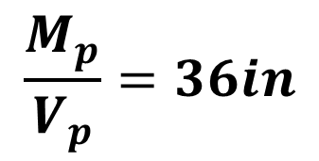
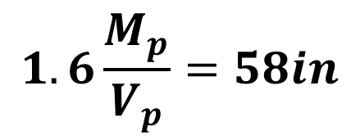
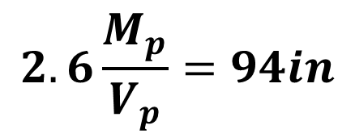
Example: W14x82 A992 (continued)
Link post-yield behavior
Notes:
As indicated in the slide, to obtain predominantly shear yielding behavior from a W14x82 link, the length should be less than about 58."
To obtain predominantly flexural yielding behavior from a W14x82 link, the length should be greater than about 94".
For lengths between 58" and 94", the W14x82 link will experience significant degrees of both shear and flexural yielding.

Slide 48
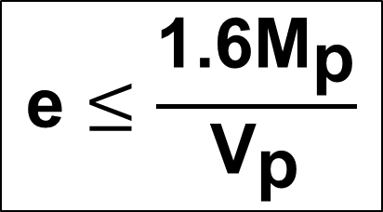
Shear Yielding Links
Provide best overall structural performance for:
strength
stiffness
ductility
Notes:
The previous slides described how link length can be used to control whether a link will yield primarily in shear, primarily in flexure, or in combined shear and flexure.
The next question is which mode of yielding is preferred. The answer to this question is clear from both experimental and analytical evidence: shear yielding links provide for the best overall strength, stiffness and ductility of an EBF. So, in general, for good seismic performance, EBFs with shear yielding links ( e ≤ 1.6 M_{p}/V_{p.}) are preferred.

Slide 49
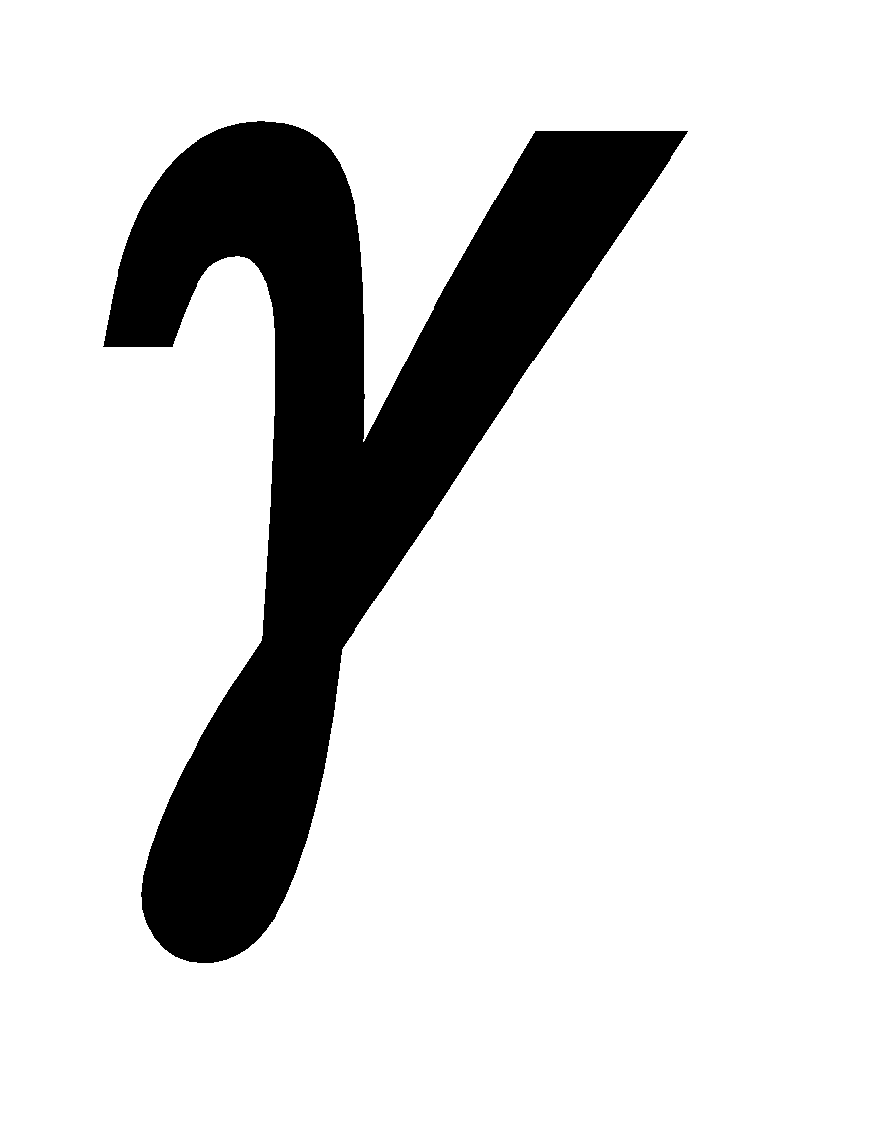
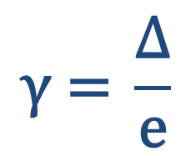
Experimental Performance of Shear Links
V
Δ
e
Link Deformation:
(radian)
Notes:
To illustrate the superior ductility of shear yielding links, the next few slides show results of cyclic loading experiments on links.
This slide shows, in a schematic fashion, how links are typically tested in the laboratory. The ends of the links are restrained against rotation (either complete rotational restraint, or a restraint that provides limited rotational flexibility that simulates rotational restraint provided by an adjoining beam or column). The link is then subject to a cyclic shear forces, as shown.
Link deformation is normally characterized by the link rotation angle γ. The value of γ is normally computed simply by taking the relative end deflection of the link, and dividing by the link length.
The link rotation angle γ includes both elastic and inelastic contributions. The elastic portion of the link rotation (resulting from elastic link deformations or elastic rotations of the link ends) can be subtracted from the total rotation γ to obtain the link plastic rotation angle γ_{p}.

Slide 50
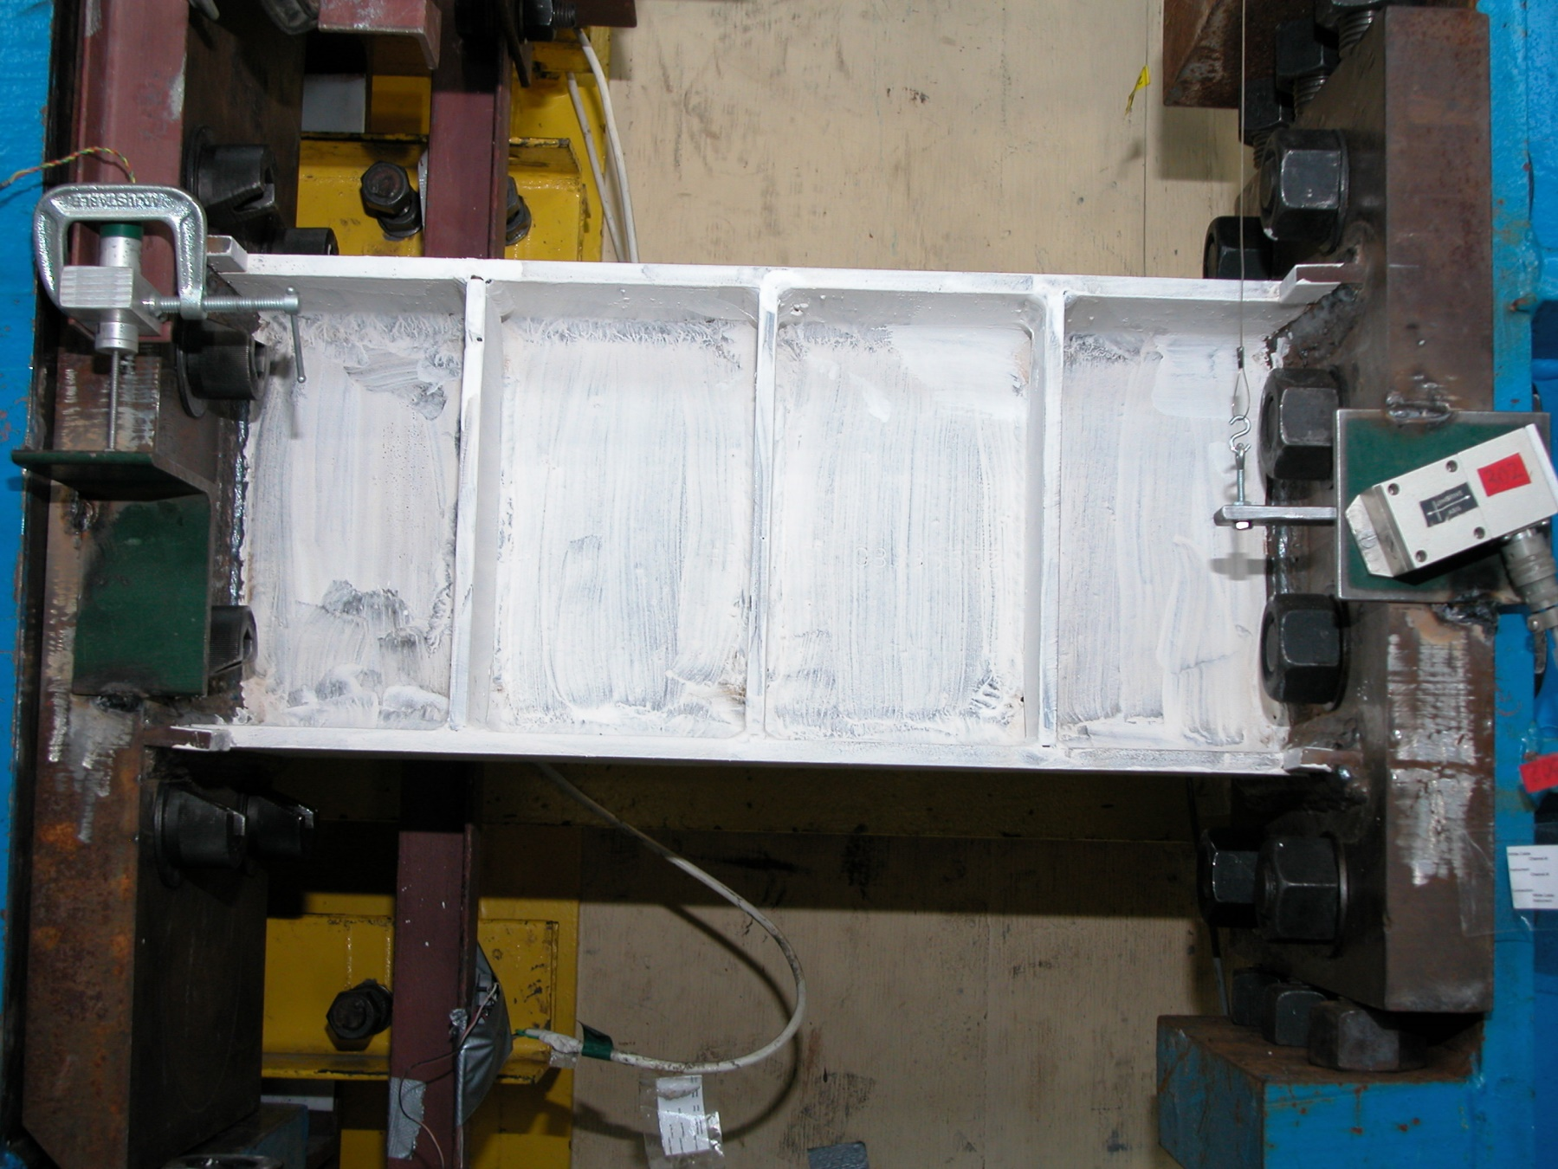
Experimental Performance of a Shear Link
W10x33 (A992) e = 23" = 1.1 M_{p}/V_{p}
Notes:
The following slides show the experimental response of a shear yielding link. The link specimen is a W10x33 section with e = 23" = 1.1 M_{p}/V_{p}.
This link length is well below the limit of 1.6 M_{p}/V_{p} . Consequently, this link will be controlled very strongly by shear yielding.

Slide 51
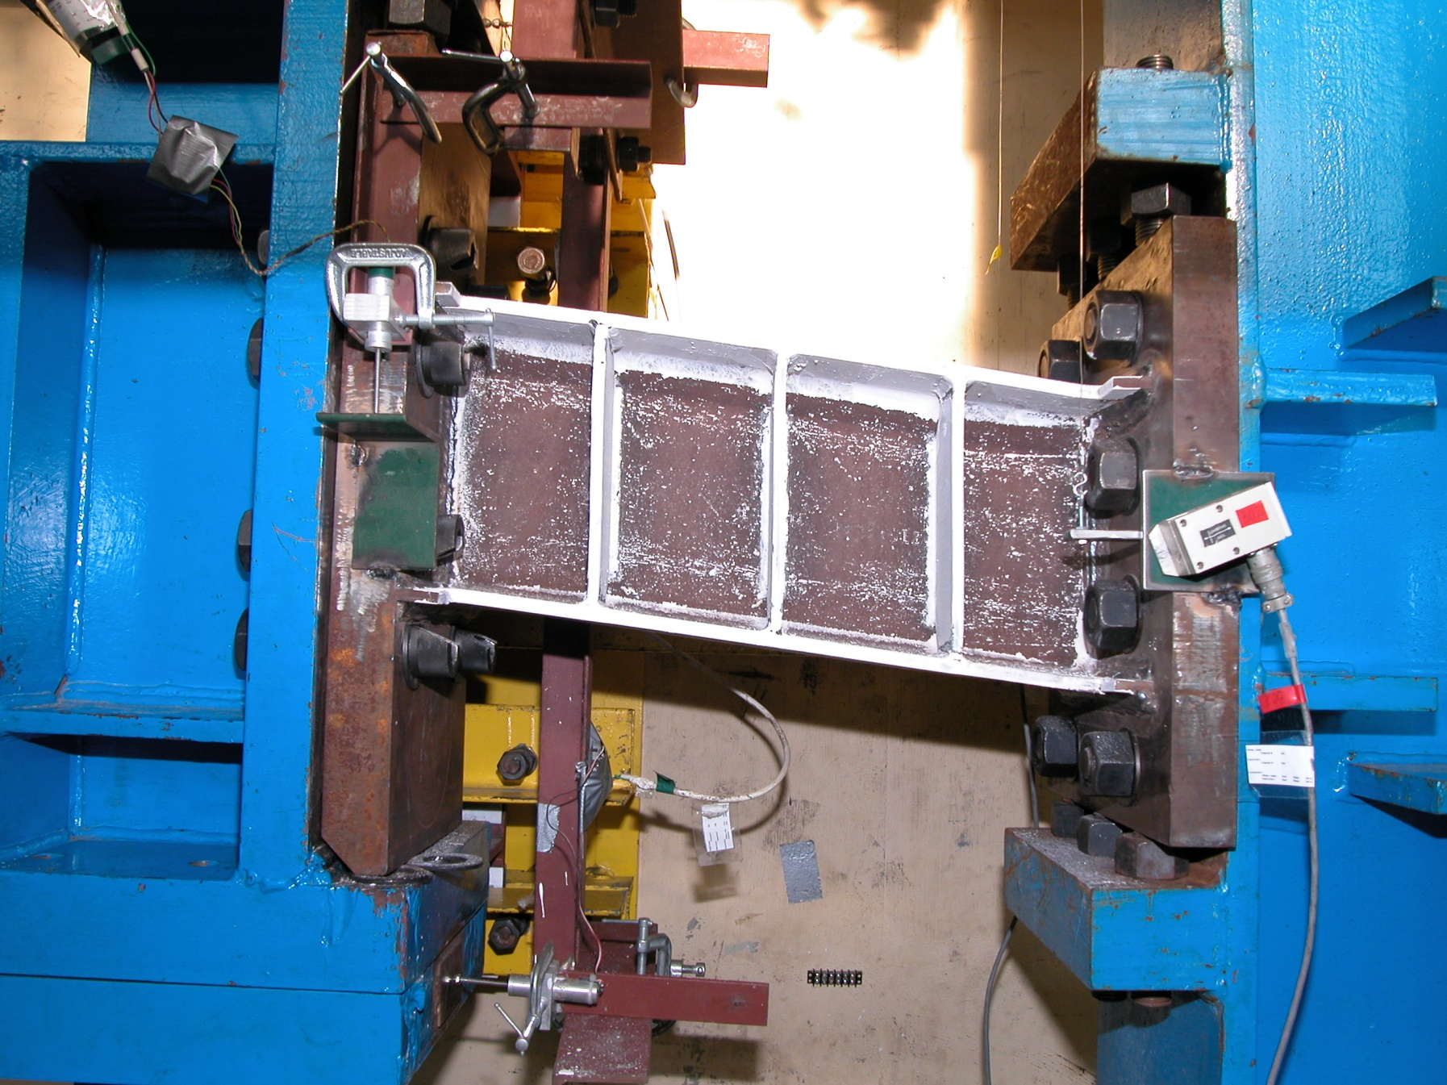
Experimental Performance of a Shear Link
W10x33 (A992) e = 23" = 1.1 M_{p}/V_{p}
Notes:
This photo shows the link at a very large rotation angle of about γ = 0.10 radians. The whitewash that has flaked off of the link web is indicative of the shear yielding that has occurred over the entire depth of the web and the entire length of the link. The parallelogram shape of the yielded link is characteristic of shear yielding.

Slide 52
Experimental Performance of a Shear Link
W10x33 (A992) e = 23" = 1.1 M_{p}/V_{p}
Notes:
This slide shows a plot of the measured response of the W10x33 link specimen. This plot shows link shear force versus link rotation angle γ. The link rotation angle plotted here is the total link rotation, and includes both elastic and inelastic contributions to link deformations. (This link was tested using the loading sequence specified in Section K2 of the 216 AISC Seismic Provisions)
Note the excellent cyclic ductility of this shear yielding link. The link sustained numerous cycles of inelastic loading with no deterioration in strength. This outstanding cyclic ductility is a characteristic of shear yielding links, and a key reason why shear yielding links are preferred in EBFs.
This link ultimately failed during the loading cycle at γ = ± 0.13 rad. Failure occurred by tearing of the link web. Ultimate failure of a well stiffened shear link generally occurs by inelastic shear buckling of the web, followed by fracture of the web. In some cases, as for this W10x33 link, web fracture occurred prior to web buckling. In either case, excellent cyclic ductility is normally achieved by a shear yielding link prior to ultimate failure by link web fracture.

Slide 53
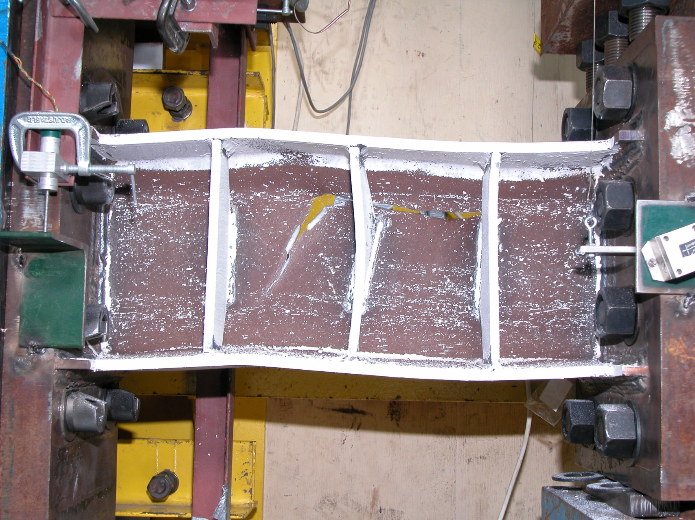
Experimental Performance of a Shear Link
W10x33 (A992) e = 23" = 1.1 M_{p}/V_{p}
Notes:
This photo shows the ultimate failure of the W10x33 shear link by link web fracture.

Slide 54
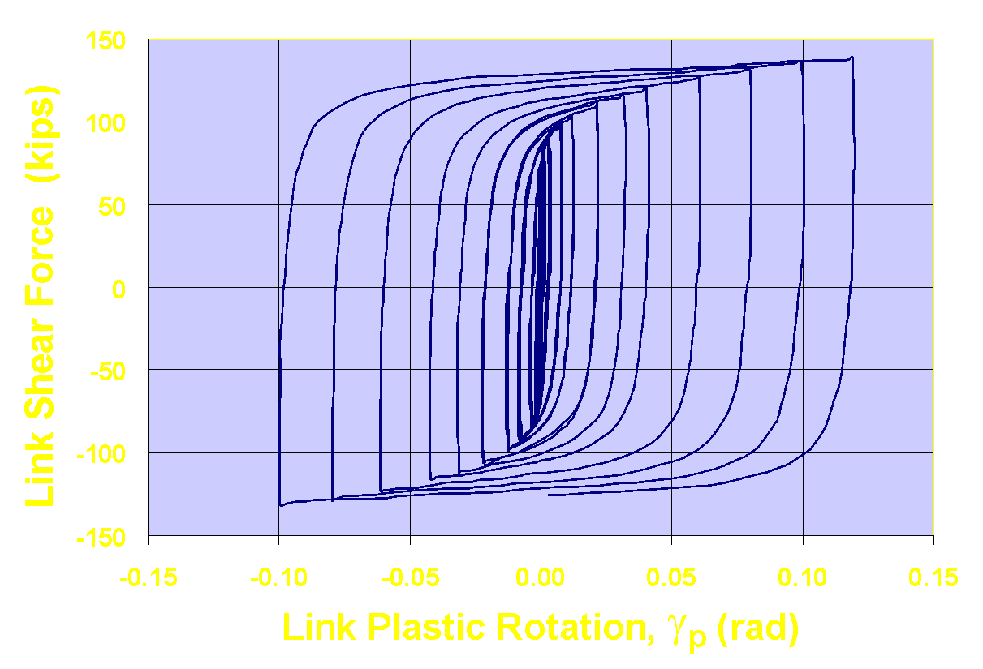
Experimental Performance of a Shear Link
W10x33 (A992) e = 23" = 1.1 M_{p}/V_{p}
γ_{p} = ± 0.10 rad
Notes:
For the W10x33 shear link specimen, this plot shows the plastic rotation angle γ_{p} for the link. This is similar to the previous plot for this link, except that the elastic portion of the link rotation angle has been subtracted from the measured total link rotation angle γ.
Prior to failure by link web fracture, this shear link achieved a plastic rotation capacity of ± 0.10 rad. (The final half cycle of loading is not included in the plastic rotation capacity because the cycle was not completed prior to failure).

Slide 55
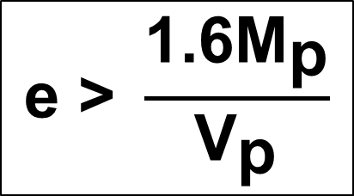
Longer Links
Longer links provide less strength, stiffness and ductility
Use longer links only when needed for architectural constraints
Notes:
Links with a length beyond 1.6 M_{p}/V_{p} are no longer predominantly shear yielding links, and generally result in EBFs will less strength, stiffness and ductility, as compared to EBFs with shear links.
Consequently, these longer links should be avoided in EBFs. Nonetheless, longer links are sometimes needed in EBFs to satisfy architectural constraints that call for large frame openings (to accommodate a door, window, etc), or other non-structural constraints.
The AISC Seismic Provisions permit EBFs to be designed with any length of link, and appropriate detailing provisions and rotation limits are provided for each length range (shear yielding, flexural yielding, combined shear and flexural yielding). Nonetheless, it should be kept in mind that shear yielding links are preferred for best structural performance of an EBF.

Slide 56
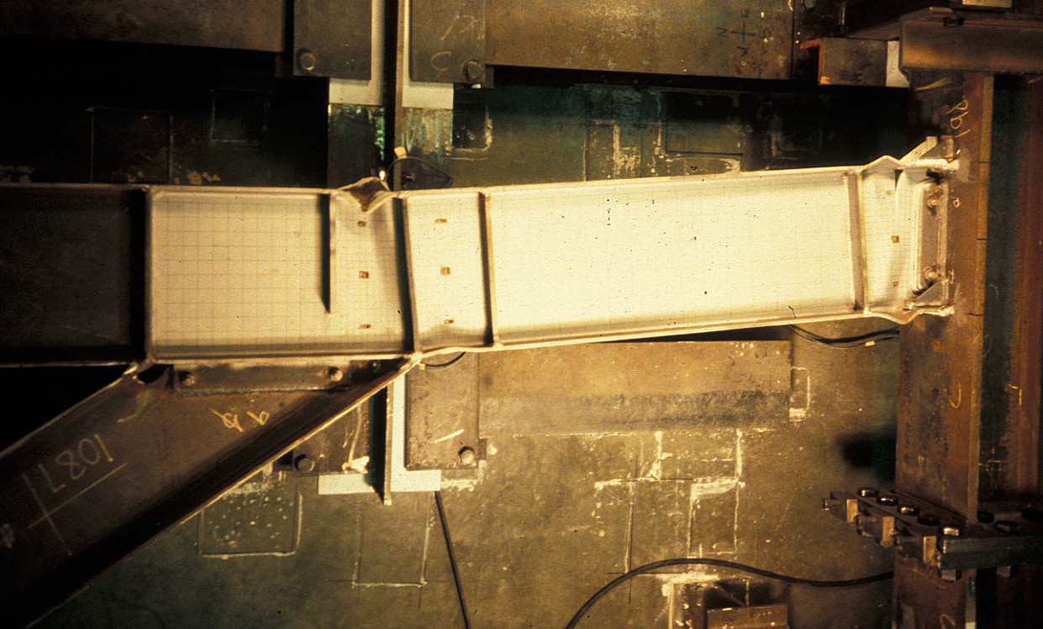
Experimental Performance of a Flexural Yielding Link
W12x16 (A36) e = 44" = 3.4 M_{p}/V_{p}
Notes:
This slide shows an experiment on a very long flexural yielding link. This is a W12x16 A36 link with e = 44" = 3.4 M_{p}/V_{p}. Note that damage is concentrated at the link ends (and just outside of the link in this case). Ultimate failure of flexural yielding links typically occurs in the form of strength degradation due to local flange and web flexural buckling at the link ends and/or lateral torsional buckling of the link.
This specimen exhibited severe local buckling at the link ends, and also experienced fracture at the link-to-column connection.

Slide 57
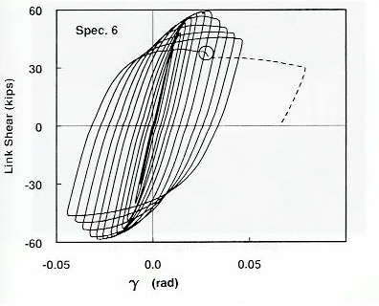
Experimental Performance of a Flexural Yielding Link
W12x16 (A36) e = 44" = 3.4 M_{p}/V_{p}
Notes:
This slide shows the plot of link shear versus link rotation angle for the W12x16 flexural yielding link. Compared to the shear link specimen shown previously, this flexural yielding link exhibited significant strength degradation in the inelastic range (due to local buckling at the link ends), and developed substantially smaller total and plastic rotations.

Slide 58
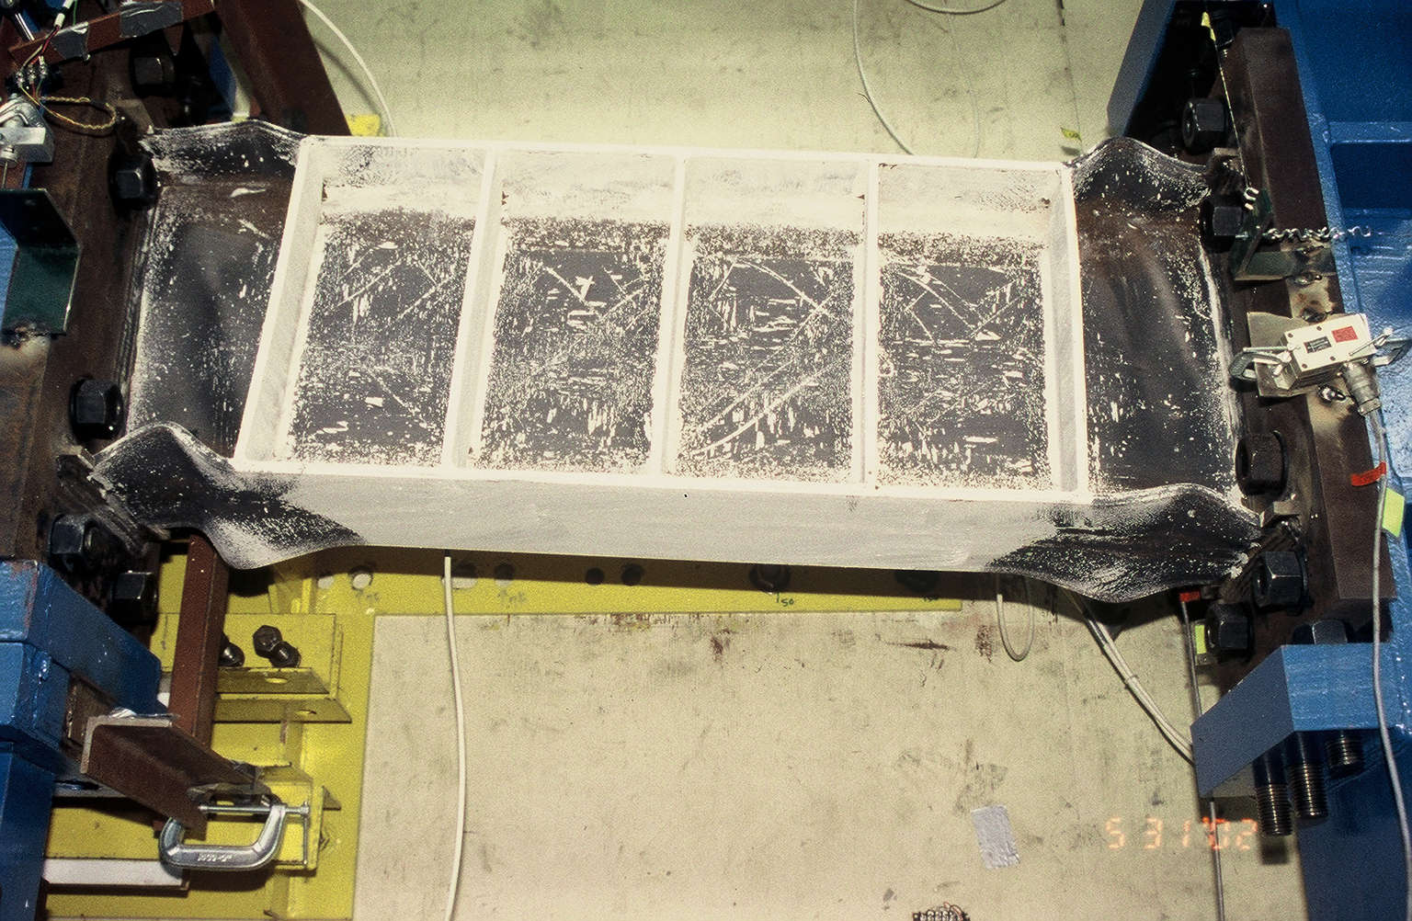
Experimental Performance of an Intermediate (Shear & Flexural Yielding) Link
W12x16 (A36) e = 48" = 3.4 M_{p}/V_{p}
Notes:
This slide shows a photo of a combined shear-flexural yielding link after laboratory testing. This is a W16x36 A992 link with a length e = 2 M_{p}/V_{p}.
This exhibited shear yielding of the web (as evidenced by flaking of whitewash in the web), and flexural yielding of the link ends (as evidenced by yielding of the flanges at the link ends).
This link ultimately failed by strength degradation from combined shear and flexural buckling at the link ends, followed by tearing of the link web in the end panels.

Slide 59
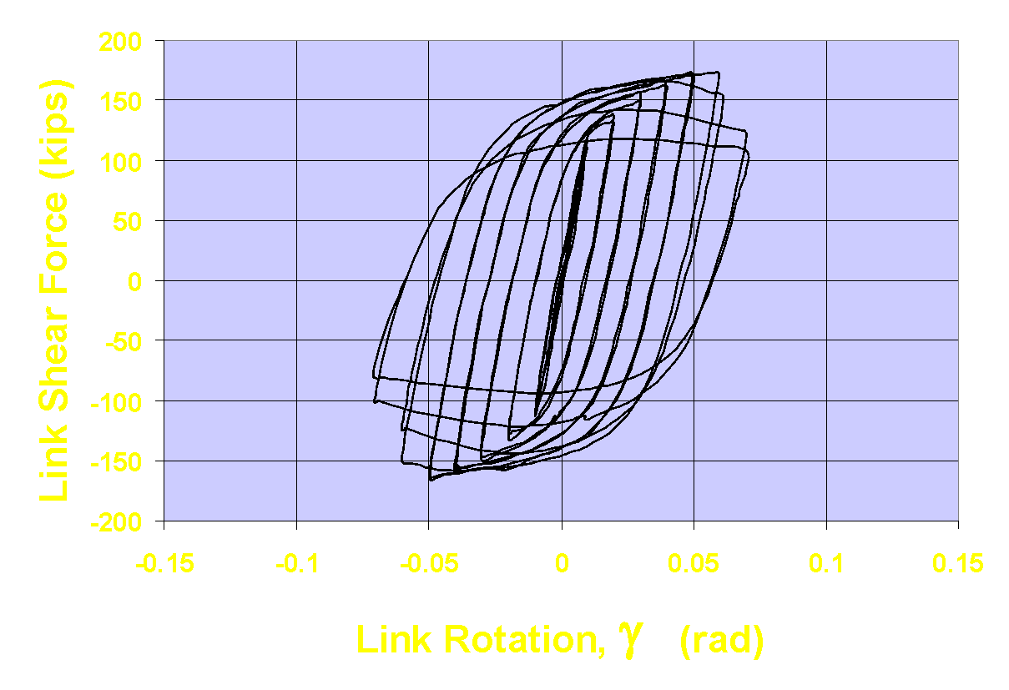
Experimental Performance of an Intermediate (Shear & Flexural Yielding) Link
W16x36 (A992) e = 48" = 2 M_{p}/V_{p}
Notes:
This slide shows the plot of link shear versus link rotation angle for the W16x36 combined shear-flexural yielding link. Compared to the shear link specimen shown previously, this link exhibited significant strength degradation in the inelastic range (due to combined shear and flexural local buckling at the link ends), and developed substantially smaller total and plastic rotations.

Slide 60
Experimentally Determined Link Plastic Rotation Capacities
0.12
0.08
Link Plastic Rotation Capacity: γ_{p} (rad)
0.04
Shear + Flexure
Shear Yielding
Flexural Yielding
0
0
1
2
3
4
5
Link Length: e/ (M_{p}/ V_{p})
Notes:
This slide shows the results of many cyclic loading experiments on links. Each point in this plot represents the result of one link test, and shows the plastic rotation achieved by each link specimen prior to ultimate failure by fracture or by excessive strength degradation resulting from local shear or flexural buckling.
This plot shows a clear trend that predominantly shear yielding links ( e ≤ 1.6 M_{p}/V_{p.}) develop that largest plastic rotations, and that plastic rotation capacity tends to decrease as link length increases. This plot provides clear evidence of why shear yielding links are preferred in EBFs.
As an additional note of explanation....
A number of the points in this plot for shear yielding links show plastic rotation capacities as low as 0.06 radian. These points are for shear link specimens tested to determine stiffening requirements, and are for specimens that do not satisfy the current stiffening requirements for shear links in the AISC Seismic Provisions. Shear link specimens detailed in accordance with present requirements of the AISC Seismic Provisions consistently show plastic rotation capacities of γ_{p} = ± 0.10 radian or better.

Slide 61
EBF Rigid-Plastic Kinematics
e
L
Notes:
The last item related to EBF behavior that we will examine is the rigid-plastic kinematics of EBFs. The geometry of rigid-plastic mechanisms of EBFs can be used to relate link plastic rotation angle to the frame plastic interstory drift angle. This relationship is needed to estimate link plastic rotation demands in the AISC Seismic Provisions.

Slide 62
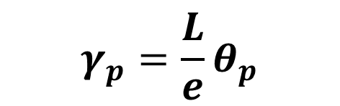
e
γ_{p}
θ_{p}
L
Notes:
This slide shows the relationship between link plastic rotation angle γ_{p} and frame plastic interstory drift angle θ_{p} for an EBF with the link at mid-span of the beam.
For this type of EBF, γ_{p} is obtained by multiplying θ_{p} by L/e.
L is the span length, and e is the link length. Thus, as L/e increases, deformation demands on the link will increase, for a given θ_{p}.

Slide 63
e
L
Notes:
Next, we will examine a single diagonal EBF.

Slide 64
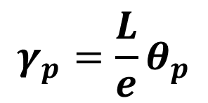
e
γ_{p}
θ_{p}
L
Notes:
For the single diagonal EBF, the relationship between link plastic rotation angle γ_{p} and frame plastic interstory drift angle θ_{p} is the same as for the EBF with a link at mid-span.

Slide 65
e
e
L
Notes:
Finally, we will examine an inverted V-braced EBF.

Slide 66
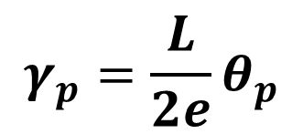
e
γ_{p}
e
γ_{p}
θ_{p}
L
Notes:
For the inverted V-braced EBF, the link rotation demand is one-half of that for the previous two types of EBF.
For other EBF configurations, the relationship between link plastic rotation angle γ_{p} and frame plastic interstory drift angle θ_{p} can usually be easily determined from the geometry of a rigid-plastic mechanism.

Slide 67
Design of EBFs
General Approach
Size links for code level forces
Size all other members and connections for maximum forces that can be generated by links
Estimate ductility demand on links; check that links can supply the required ductility
Detail links to supply high ductility (stiffeners and lateral bracing)
Notes:
This slide, in a simplified manner, summarizes the key design steps for an EBF. These steps are covered in the EBF design and detailing requirements in the AISC Seismic Provisions, and will be examined in detail in the remainder of this module.

Slide 68
4 – Eccentrically Braced Frames (EBFs)
Description of Eccentrically Braced Frames
Basic Behavior of Eccentrically Braced Frames
AISC Seismic Provisions for Eccentrically Braced Frames
Notes:
The previous slides looked at some basic concepts on the design and behavior of EBFs. The remainder of this module will look at how these concepts are implemented in the AISC Seismic Provisions.

Slide 69
2022 AISC Seismic Provisions
Section F3. Eccentrically Braced Frames (EBF)
F3.1 Scope
F3.2 Basis of Design
F3.3 Analysis
F3.4 System Requirements
F3.5 Members
    F3.5a Basic Requirements
    F3.5b Links
    F3.5c Protected Zones
F3.6 Connections
Notes:
EBF detailing requirements are covered in Chapter F3 of the Seismic Provisions. The remaining slides in this module will cover selected key highlights of Chapter F3.

Slide 70
AISC Seismic Provisions - EBF
Scope and Basis of Design
F3.1 Scope
Eccentrically braced frames (EBF) of structural steel shall be designed in conformance with this section.
F3.2 Basis of Design
EBF designed in accordance with these provisions are expected to provide significant inelastic deformation capacity primarily through shear or flexural yielding in the links.
Notes:
Section F3.2 is a scope statement for EBF. This section states that EBF are expected to withstand significant inelastic deformations, which means the detailing provisions for EBF are intended to result in a ductile system.

Slide 71
AISC Seismic Provisions - EBF
Analysis
F3.3 Analysis
The required strength of diagonal braces and their connections, beams outside links, and columns shall be determined using the capacity-limited seismic load effect.
The capacity-limited seismic load effect, E_{cl}, shall be taken as the forces developed in the member assuming the forces at the ends of the links correspond to the adjusted link shear strength. The adjusted link shear strength shall be taken as R_{y} times the nominal shear strength of the link, V_{n}, multiplied by 1.25 for I-shaped links and 1.4 for box links.
Exception: An additional 0.88 factor is permitted to be applied for the design of beams outside links.
Notes:
The diagonal braces, columns, and beams outside the link are not intended to yield, so they are proportioned using capacity design. Section F3.3 provides guidance on how to compute the maximum forces that are expected to be generated within the yielding link. The 1.25 and 1.4 factors account for strain hardening that occurs in the link as it deforms.
The exception is based on experiments that show acceptable performance when limited yielding occurs in the beam outside of the link.

Slide 72
F3.3 Analysis - Diagonal Brace and Beam Outside of Link
Beam outside of link
Diagonal Brace
Notes:
This figure shows the diagonal braces and beam segments out side of the link that are covered by Section F3.3.

Slide 73
F3.3 Analysis - Diagonal Brace and Beam Outside of Link
V_{ult}
V_{ult}
M_{ult}
M_{ult}
V_{ult}
V_{ult}
M_{ult}
M_{ult}
Notes:
This figure shows the intent of Section F3.3. V_{ult} and M_{ult} represent the ultimate shear and end moment that can be generated by a fully yielded and strain hardened link. These ultimate link end forces must then be imposed on the remainder of the framing system, as shown in the figure. The forces generated in the diagonal braces and beam segments outside of the link by V_{ult} and M_{ult} must then be determined. These are the forces for which the diagonal braces and beam segments outside of the link are designed.

Slide 74
F3.3 Analysis - Diagonal Brace and Beam Outside of Link
Determining Link Ultimate Shear and End Moment for design of diagonal brace and beam outside of link
Link Length = e
V_{ult}
V_{ult}
M_{ult}
M_{ult}
For design of diagonal brace (I-shaped link): V_{ult} = 1.25 R_{y} V_{n}
For design of beam outside of link (I-shaped link): V_{ult} = (0.88)1.25 R_{y} V_{n}
V_{n} = link nominal shear strength = lesser of V_{p} or 2 M_{p} / e
Notes:
For the design of the diagonal braces, Section F3.3 specifies that the link ultimate shear force should be taken as V_{ult} = 1.25 R_{y}V_{n} for I-shaped links.
For design of the beam segments outside of the link, Section F3.3 specifies that the link ultimate shear force should be taken as V_{ult} = (0.88)1.25 R_{y}V_{n} for I-shaped links.
In these equations, V_{n} is the nominal shear strength of the link. R_{y}V_{n} represents the expected shear strength of the link. The factors of 1.25 (for brace design) and (0.88)1.25 (for beam design) account for strain hardening of the link.
Experimental data on links subjected to cyclic loading show a range of strain hardening values. A recent study on links constructed of A992 steel (Okazaki, T., Arce, G., Ryu, H., and Engelhardt, M.D., “Experimental Study of Local Buckling, Overstrength and Fracture of Links in EBFs,” Journal of Structural Engineering, ASCE, Vol. 131, No. 10, pp 1526-1535, October 2005) showed strain hardening factors in links varying from 1.2 to 1.45, with a mean value of about 1.30.
Consequently, the link strain hardening factor of 1.25 specified in Section F3.3 for the design of the brace is close to the mean strain hardening factor measured in experiments. A larger strain hardening factor is not used to avoid being excessively conservative in the design of the brace, since the R_{y} factor is used to compute V_{ult} but is not used to compute brace strength, and the normal resistance factor is used to design the brace.
A link strain hardening factor of (0.88)1.25 is used for the design of the beam segment outside of the link. Clearly, the brace and beam segment outside of the link must see the same ultimate link end forces. Consequently, it may seem somewhat nonsensical to assume different degrees of link strain hardening for the beam and for the brace. However, the lower link strain hardening factor of (0.88)1.25 for beam design is specified in Section F3.3 indirectly accounts for the fact that a limited amount of beam yielding will likely not be detrimental to EBF performance, and that beam strength and stability will likely benefit from the presence of a concrete floor slab. Further, if a more realistic link strain hardening factor of 1.25 were to be specified for the beam, then beam design becomes highly problematic in many practical cases.
When computing the design strength of the beam segment outside of the link, the yield stress of the steel may be taken as R_{y}F_{y} since the beam and the link are the same member. That is, whatever material overstrength is present in the link (which increases link ultimate strength and therefore increases the required strength of the beam) is also present in the beam (which increases the ability of the beam to resist the link ultimate end forces). Consequently, the R_{y} factor essentially cancels out when checking the beam segment outside of the link.

Slide 75
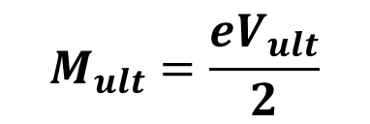
F3.3 Analysis - Diagonal Brace and Beam Outside of Link
Determining Link Ultimate Shear and End Moment for design of diagonal brace and beam outside of link
Link Length = e
V_{ult}
V_{ult}
M_{ult}
M_{ult}
Given V_{ult} , determine M_{ult} from link equilibrium:
(assumes link end moments equalize)
Notes:
Once a value of link ultimate shear is established (1.25R_{y}V_{n} for brace design; (0.88)1.25R_{y}V_{n} for beam design), then the ultimate link end moment can be computed from static equilibrium of the link.
The equation for M_{ult} given in this slide assumes link end moments are equal when the link achieves its ultimate strain hardened strength. This is a reasonable assumption when the link is located at mid-span of the beam, since the stiffness of the adjoining members is the same at each end of the link.
However, in cases where the link is attached to a column, the rotational stiffness of the adjoining members may be significantly different at the two ends of the link. That is, one of the link is attached to a column, while the other end is attached to a beam and brace. Typically, the column provides a greater rotational stiffness, and therefore attracts more moment to the column end of the link.
Experiments have shown that for shear yielding links (e ≤ 1.6 M_{p}/V_{p}) connected to columns, link end moments do not equalize when the link achieves its ultimate strain hardened strength. Thus, for this case, the computation of ultimate link ends moments must account for these unequal end moments. Equations for computing ultimate link end moments for the case of shear links attached to columns are given in the Commentary to Section F3.3.

Slide 76
F3.3 Analysis - Diagonal Brace and Beam Outside of Link
P
M
V
P
M
V
Notes:
This figure qualitatively illustrates the forces generated in the diagonal brace and beam segment outside of the link.
The beam segment is normally subjected to very high axial force and very high bending moment. The brace is normally subjected to high axial force, and small to moderate levels of bending moment.
In general, both the beam segment outside of the link and the diagonal brace are subjected to simultaneous axial force and bending, and should be treated as beam-columns in design.
In EBF configurations in which the angle between the brace and the beam is very small, excessively large axial forces will be generated in the beam when the link reaches its ultimate strength. In these cases, calculating that the beam segment outside of the link remains essentially elastic when the link has achieved its ultimate strength becomes highly problematic. Thus, it is preferable to keep the angle between the brace and the beam on the order of about 40 to 45-degrees. Very shallow brace-beam angles may result in the need to strengthen the beam segment outside of the link with cover plates or other reinforcement. It is also beneficial in beam design to keep links very short (say 1.0 to 1.2 M_{p}/V_{p}). This reduces the ultimate link end moments (M_{ult} = e V_{ult}/2.......smaller e results in smaller M_{ult}) which in turn reduces the moment generated in the beam. Further suggestions for beam design are provided in the Commentary to Section F3.3.

Slide 77
AISC Seismic Provisions - EBF
Analysis
F3.3 Analysis – Required Strength of Columns
The required strength of …columns shall be determined using the capacity-limited seismic load effect.
Notes:
Section F3.3 covers requirements for the design of the columns in an EBF. Following the capacity design philosophy for EBFs, columns are designed to be stronger than the links. That is, columns should be designed to resist the forces generated by the fully yielded and strain hardened links.

Slide 78
F3.3 Analysis - Required Strength of Columns
V_{ult}
V_{ult}
Column Required Strength =
forces generated in column when all links above level under consideration have developed their ultimate shear resistance (V_{ult}) and their ultimate flexural resistance (M_{ult}).
Take V_{ult} = 1.25 R_{y} V_{n} for each link.
M_{ult}
M_{ult}
V_{ult}
V_{ult}
M_{ult}
M_{ult}
V_{ult}
V_{ult}
Required strength need not exceed the lesser of:
Forces corresponding to foundation uplift
Forces from nonlinear analysis (C3).
M_{ult}
M_{ult}
Notes:
Columns are to be designed for the forces generated when all links above the level under consideration are assumed to have achieved an ultimate shear force of V_{ult} = 1.25 R_{y}V_{n}, where V_{n} is the link nominal shear strength for I-shaped links. The corresponding link ultimate end moments can be computed from the link ultimate shear based on static equilibrium of the link, as discussed for Section F3.3.
This approach assumed simultaneous yielding and hardening of all of the links. As buildings get taller than 3 stories, simultaneous yielding and hardening of the links becomes less and less probable, and the approach shown becomes more and more conservative. For taller buildings, non-linear analysis can likely be used to justify lower column demands.

Slide 79
AISC Seismic Provisions - EBF
System Requirements
F3.4a Link Rotational Angle
The link rotation angle is the inelastic angle between the link and the beam outside of the link when the story drift is equal to the design story drift, Δ.
The link rotation angle shall not exceed the following values:
0.08 radians for: e ≤ 1.6 M_{p} / V_{p}
0.02 radians for: e ≥ 2.6 M_{p} / V_{p}
a value determined by linear interpolation between the above values for: 1.6 M_{p} / V_{p} < e < 2.6 M_{p} / V_{p}
Notes:
These are the compactness requirements for links.
Shear links ( e ≤ 1.6 M_{p}/V_{p.}) need only be compact, not seismically compact. Shear yielding links generally do not exhibit flexural instability modes (local flange and flexural web buckling and lateral torsional buckling) and therefore need not meet seismically-compact local buckling requirements.
Longer links ( e > 1.6 M_{p}/V_{p.}) exhibit flexural instability modes, and must be seismically compact to limit strength degradation resulting from these instability modes.

Slide 80
F3.4a Link Rotation Angle
Design Approach to Check Link Rotation Angle, γ_{p}
Compute elastic story drift under code specified earthquake forces: Δ_{E}
Compute Design Story Drift: Δ = C_{d} × Δ_{E}
(C_{d} = 4 for EBF)
Estimate Plastic Story Drift: Δ_{p} ≈ Δ
Compute plastic story drift angle θ_{p}
θ_{p} ≈ Δ_{p} / h where h = story height
Compute link rotation angle γ_{p} based on EBF kinematics
γ_{p} = (L / e) θ_{p} for common EBFs
Check link rotation limit per F3.4a
Notes:
This slide summarizes the approach for checking the link rotation angle.
Note that Step 3 contains a conservative simplification. In Step 3, the plastic story drift angle is taken equal to the design story drift angle. In reality, the design story drift Δ contains both an elastic and a plastic component. Taking the plastic story drift equal to the design story drift provides some additional conservatism in the EBF design procedure. As an alternative approach, the plastic story drift could more accurately be estimated as: Δ_{p} ≈ (C_{d} -1) Δ_{E}.
By using (C_{d} - 1), the elastic portion of the story drift is removed in an approximate manner.
Note that the plastic story drift angle θ_{p} is intended to be an estimate of the plastic story drift that may occur in an EBF in a major earthquake, i.e., in the design earthquake.
Once the plastic story drift angle θ_{p} has been estimated, the corresponding link plastic rotation angle γ_{p} is estimated based on the geometry of a rigid-plastic mechanism of an EBF. This value of γ_{p} is intended to be an estimate of the maximum plastic rotation that will be imposed on the link in a major earthquake.
Finally, in Step 6, link plastic rotation demand is checked against an estimate of link plastic rotation capacity.

Slide 81
F3.4a Link Rotation Angle
e
e
γ_{p}
γ_{p}
θ_{p}
θ_{p}
L
L
e
γ_{p}
e
γ_{p}
θ_{p}
L
Notes:
This slide reviews the EBF rigid-plastic kinematics for several common types of EBFs. The most common EBF configurations are the two EBFs shown at the top of the slide, for which γ_{p} = (L/e) θ_{p}.

Slide 82
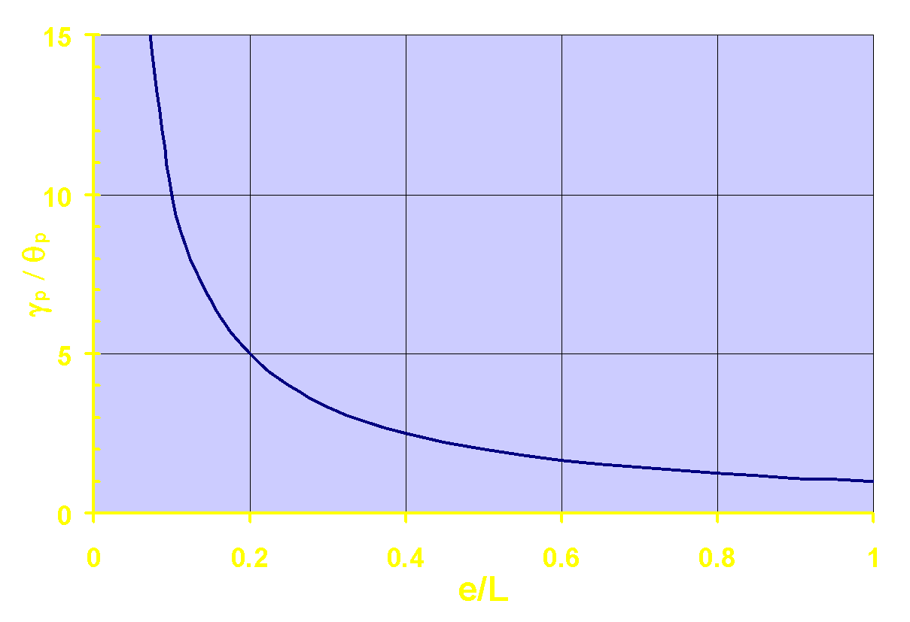
F3.4a Link Rotation Angle
e
γ_{p}
θ_{p}
L
Notes:
This slide shows how link rotation demand is related to the ratio of span length to link length (L/e) for an EBF with the link at mid-span, where γ_{p} = (L/e) θ_{p} or γ_{p}/θ_{p} = 1/(e/L). The same relationship holds for the single diagonal EBF.
This plot shows that if e/L is too small, the link plastic rotation demands may become excessive, and may exceed link plastic rotation capacity. That is, it may be difficult to satisfy the requirements of Section F3.4a if e/L is too small.
As discussed earlier, shear yielding links are preferred in EBFs for best overall strength, stiffness and ductility. Providing for shear yielding links generally requires that links be kept short. On the other hand, if the links become too short, then e/L may become too small, and the link plastic rotation angle may become too large. Consequently, EBF design requires a balance between these competing requirements: keep links short enough to stay in the shear yielding range (e ≤ 1.6 M_{p}/V_{p}) but not so short that link plastic rotation demand exceeds link plastic rotation capacity.

Slide 83
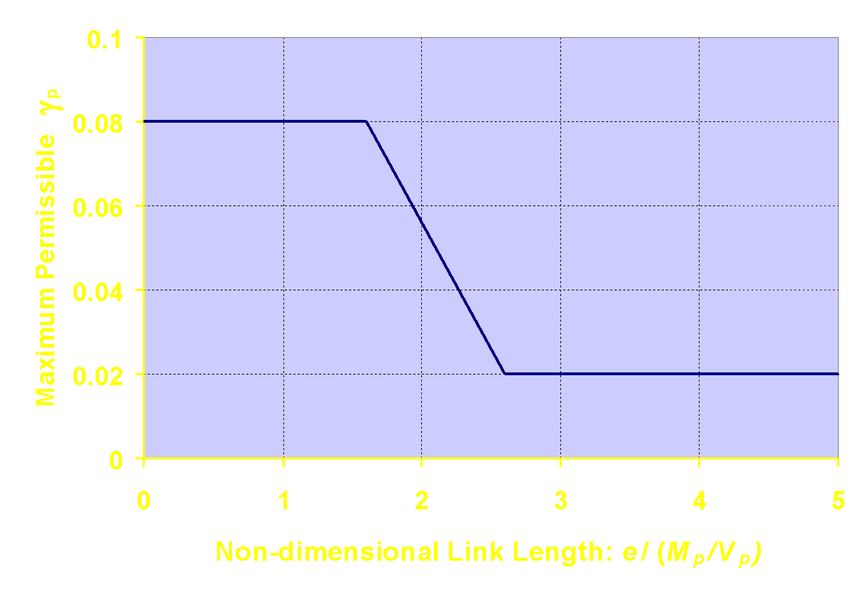
F3.4a Link Rotation Angle
Shear + Flexure
Shear Yielding
Flexural Yielding
1.6
2.6
Notes:
This slide provides a graphical representation of link plastic rotation capacities given in Section F3.4a. Link plastic rotation capacities are based on the results of cyclic loading experiments on links. Note that shear yielding links have substantially greater rotation capacities than longer links.
If the plastic rotation capacities shown above are compared to experimentally determined plastic rotation capacities for well detailed links, it will be seen that the AISC Seismic Provisions are somewhat conservative. For example, experiments show that well detailed shear links consistently achieve plastic rotations on the order of γ_{p} = ± 0.10 radian or better. However, the AISC Seismic Provisions limit shear links to γ_{p} = ± 0.08 radian. Considering the numerous uncertainties in predicting both link rotation demand and supply, some conservatism appears well justified.

Slide 84
F3.4b Lateral Bracing of Link
Lateral bracing required at top and bottom link flanges at link ends
Link Length = e
Notes:
This figure shows the locations when link end lateral bracing is required.

Slide 85
AISC Seismic Provisions - EBF
System Requirements
F3.4b Bracing of Link
Bracing shall be provided at both the top and bottom link flanges at the ends of the link for I-shaped sections.
Bracing shall have an available strength and stiffness as required for expected plastic hinge locations by Section D1.2c.
Notes:
Link bracing is required to maintain stability after the link yields.

Slide 86
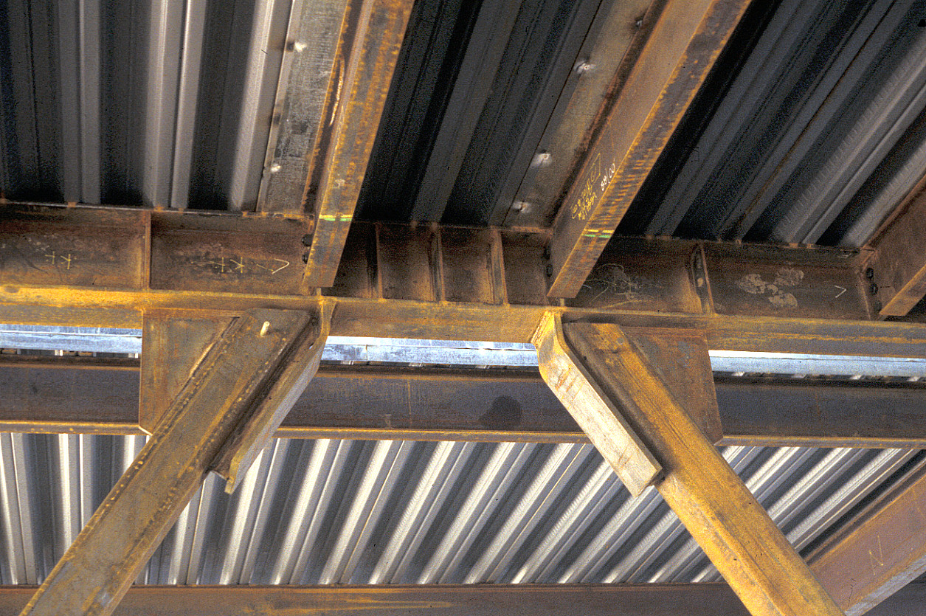
Notes:
An example of link end lateral bracing.

Slide 87
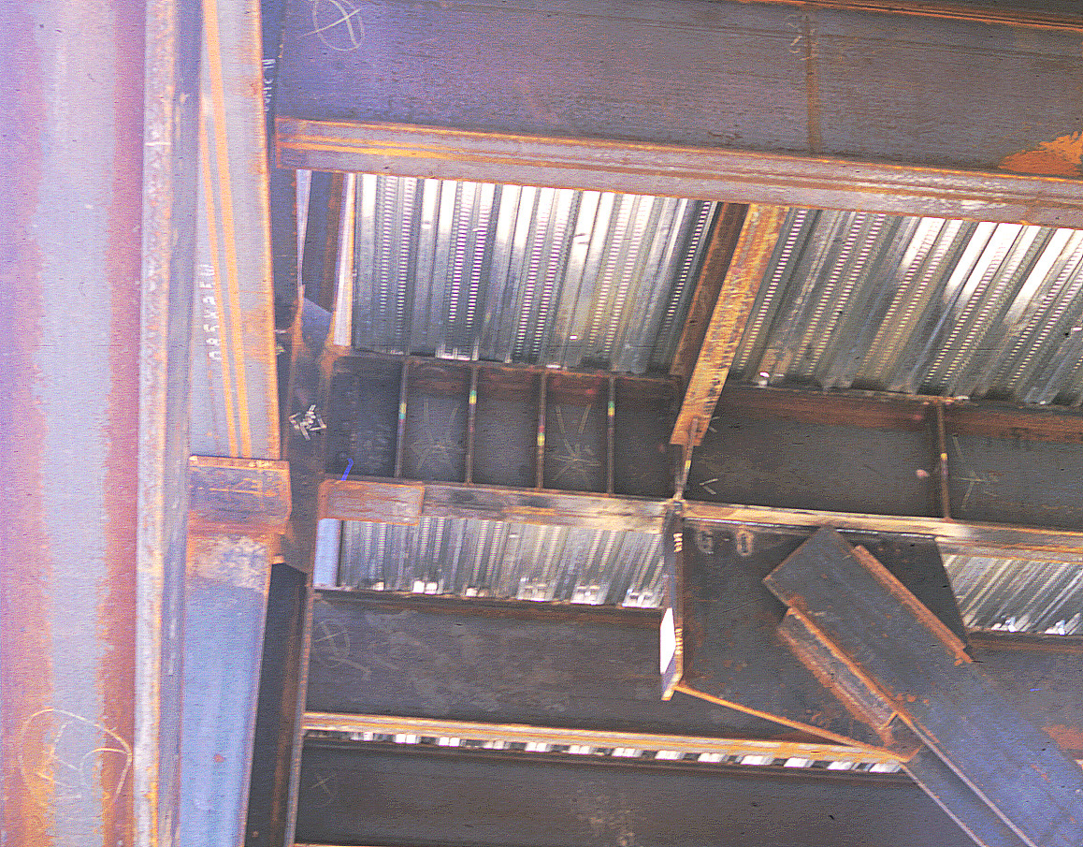
Notes:
Another example of link end lateral bracing.

Slide 88
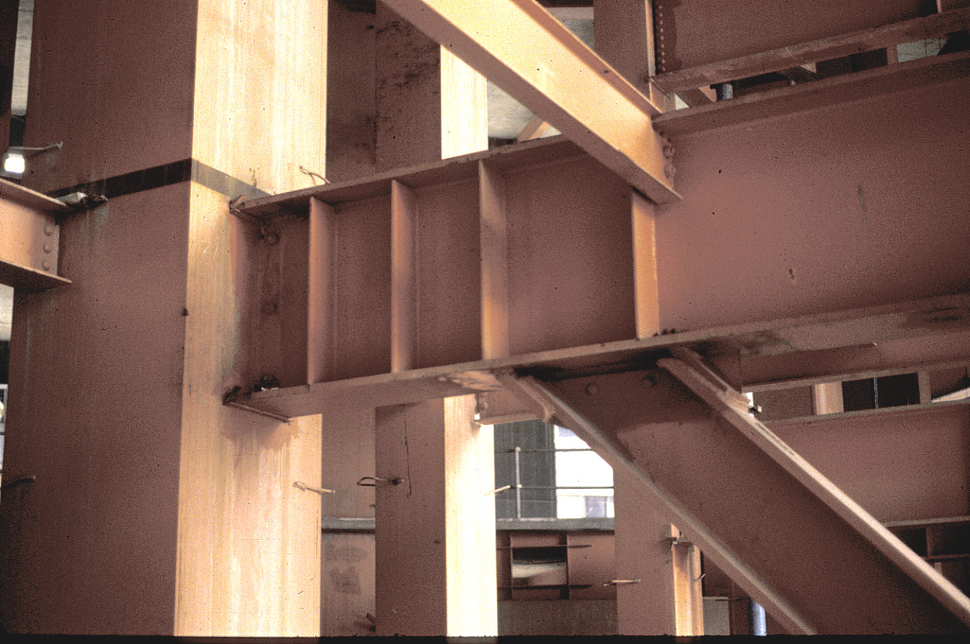
Notes:
This is an example of a link end lateral brace. However, lateral bracing for this link would be improved by moving the top flange brace to the link end, and by providing another brace at the link end bottom flange.

Slide 89
AISC Seismic Provisions - EBF
Members
F3.5a Basic Requirements
Brace members shall satisfy width-to-thickness limitations in Section D1.1 for moderately ductile members (λ_{md})
Column members shall satisfy width-to-thickness limitations in Section D1.1 for highly ductile members (λ_{hd})
Where beam outside of the link is a different section from the link, the beam shall satisfy width-to-thickness limitations in Section D1.1 for moderately ductile members (λ_{md})
Notes:
Even though the braces and columns are not expected to experience significant yielding, width-thickness requirements are specified to ensure that they would have ductile response if yielding were to occur.

Slide 90
F3.5a Basic Requirements
Beam outside of link
Column Member
Column Member
Brace Members
Notes:
This figure shows the diagonal braces and beam segments out side of the link that are covered by Section F3.5a.

Slide 91
AISC Seismic Provisions - EBF
Members
F3.5b.1 Link Limitations
Links shall be I-shaped cross section (rolled wide-flange sections or built-up sections), or built-up box sections.
HSS sections shall not be used as links.
Links shall satisfy the requirements of Section D1.1 for highly ductile members (λ_{hd}).
  Exceptions: for e ≤ 1.6M_{p}/V_{p} flanges of I-shaped links, and webs of all links are permitted to satisfy the requirements for moderately ductile (λ_{md}).
Notes:
Links are generally required to satisfy the width-thickness requirements for highly ductile members. However, an analytical study by Richards and Uang (2005) indicated that links can achieve design rotations without satisfying the width-thickness requirements for highly ductile members.
The exception in F3.5b.1 reflects that findings of that study, and the engineering judgement that links that are primarily yielding in shear have relatively low flange strains.

Slide 92
AISC Seismic Provisions - EBF
Members
F3.5b.1 Link Limitations
The web shall be single thickness. Doubler-plate reinforcement and web penetrations are not permitted.
For links made of built-up sections, complete-joint-penetration groove welds shall be used to connect the web (or webs) to the flanges.
Links with built-up box sections shall have a moment of inertia, I_{y}, limited to I_{y} > 0.67 I_{x} where I_{x} is the moment of inertia about an axis perpendicular to the plane of the EBF.
Notes:
F3.5b.1 outlines some limitations on the use of built-up links.

Slide 93
AISC Seismic Provisions - EBF
Members
F3.5b.2 Shear Strength
Link design shear strength = φ V_{n}
φ = 0.9
V_{p}
V_{n} = lesser of
2M_{p} / e
Notes:
Section F3.5b.2 defines the link nominal shear strength V_{n}.
As discussed earlier in this module, V_{n} is the link shear that will result in first significant yield of the link, in either shear or flexure. That is, V_{n} defines the plastic strength of the link, and is the basis for sizing links in EBFs.
For e < 2M_{p} /V_{p}, link nominal shear strength will be controlled by shear yielding, and V_{n} = V_{p}.
For e > 2M_{p} /V_{p}, link nominal shear strength will be controlled by flexural yielding at the link ends, and V_{n} = 2 M_{p}/ e. In this case, the link nominal shear strength represent the value of link shear when the end moments reach M_{p}.
When sizing a link for strength, all computations are done in terms of shear, regardless of whether link strength is controlled by shear yielding or by flexural yielding. For the case where link strength is controlled by flexural yielding, the equation for link nominal shear strength given in this slide automatically takes care of checking flexure.
When defining the link design strength, φV_{n}, the AISC Seismic Provisions takes φ=0.9. This is a departure from the main AISC Specification, which permits φ=1.0 for design shear strength of most wide-flange shapes.
The use of φ=0.9 in the AISC Seismic Provisions reflects the importance of the link in EBF behavior. The lateral strength of an EBF is directly related to the link nominal shear strength, so it is believed that using φ=1.0 would be unconservative and inappropriate.

Slide 94
AISC Seismic Provisions - EBF
Members
F3.5b.2 Shear Strength
Sizing Link:
V_{u} ≤ φ V_{n}
V_{u} = shear force in link under code specified forces:
1.2D + 1.0E + 0.5L + 0.15S
0.9D + 1.0E
φ V_{n} = link design shear strength
Notes:
To size the links in an EBF:
1. Determine the required shear strength of the link V_{u} based on the LRFD load combinations with code specified earthquake and gravity loads. The shear force in the link can be determined from elastic frame analysis.
2. Choose a link section with a design strength equal to or greater than the required strength.
When choosing a link section, it is often advantageous to choose sections that would commonly be used for column applications: W10's, W12's and W14's. This is because the beam segment outside of the link (which is the same section as the link) is subjected to very high axial forces for most EBF configurations. The use of column-like sections helps to resist these very large axial forces.

Slide 95



AISC Seismic Provisions - EBF
Members
F3.5b.3 Link Length
When the axial force ratio, α_{s}P_{r}/P_{y}, is greater than 0.15, there are additional limitations on link length.
when ρ’ ≤ 0.5
when ρ’ > 0.5

Slide 96
AISC Seismic Provisions - EBF
Members
F3.5b.4 Link Stiffeners for I-Shaped Cross Sections
Full-depth web stiffeners shall be provided on both sides of the link web at the diagonal brace ends of the link.
These stiffeners shall have a combined width not less than (b_{f} -2t_{w}) and a thickness not less than 0.75 t_{w} or 3/8-inch, whichever is larger.
Notes:
Stiffeners are required for stable yielding of the links. All links are required to have stiffeners at the ends, on boths sides of the web.

Slide 97
F3.5b.4 Link Stiffeners
Link Length = e
Full depth stiffeners on both sides
Notes:
This drawing shows the location of the required link end stiffeners. The figure also shows stiffeners outside of the link at the far end of the brace connection. These stiffeners are not specifically called out in the AISC Seismic Provisions, but are often provided in EBFs, and may be beneficial in resisting concentrated forces entering the beam at the end of the gusset plate, and may also be beneficial in marinating the stability of the beam segment outside of the link.

Slide 98
AISC Seismic Provisions - EBF
Members
F3.5b.4 Link Stiffeners for I-Shaped Cross Sections
Links shall be provided with intermediate web stiffeners as follows:
Links of length e ≤ 1.6 M_{p} / V_{p}
Provide equally spaced stiffeners as follows:
spacing ≤ 30 t_{w} - d /5 for γ_{p} = 0.08 radian
spacing ≤ 52 t_{w} - d /5 for γ_{p} = 0.02 radian
interpolate for 0.02 < γ_{p} < 0.08 radian
Notes:
In addition to the end stiffeners, intermediate stiffeners are required on one side of the web. The spacing of the stiffeners is based on the design rotation for the link.

Slide 99
F3.5b.4 Link Stiffeners
e ≤ 1.6 M_{p} / V_{p}
(Shear Yielding Links)
Link Length = e
s
s
s
s
s
30 t_{w} - d /5 for γ_{p} = 0.08 radian
s ≤
52 t_{w} - d /5 for γ_{p} = 0.02 radian
interpolate for 0.02 < γ_{p} < 0.08 radian
t_{w} = link web thickness d = link depth
Notes:
This figure illustrates the intermediate link web stiffener requirements for shear links, as given in Section F3.5b.4(a).

Slide 100

Notes:
This is a photo of a shear yielding link without adequate web stiffening. Inelastic shear buckling of the web causes premature loss of strength and plastic rotation capacity of the link. The stiffening requirements in Section F3.5b.4(a) are intended to delay the onset of this type of buckling to permit the development of large link plastic rotations without degradation in strength.

Slide 101

Notes:
This is a photo of a shear link with intermediate web stiffeners provided in accordance with the requirements of Section F3.5b.4(a). This link has developed very large cyclic plastic rotations without shear buckling of the web.

Slide 102

Notes:
A typical shear link in an actual EBF. Note the closely spaced intermediate web stiffeners provided per Section F3.5b.4(a) of the AISC Seismic Provisions.

Slide 103
AISC Seismic Provisions - EBF
Members
F3.5b.4 Link Stiffeners for I-Shaped Cross Sections
Links shall be provided with intermediate web stiffeners as follows:
Links of length 2.6 M_{p} / V_{p} < e < 5 M_{p} / V_{p}
Provide stiffener at a distance of 1.5b_{f} from each end of link
Notes:
Link stiffener requirements are different for long links that experience flexural hinging at the ends.

Slide 104
F3.5b.4 Link Stiffeners
2.6 M_{p} / V_{p} < e < 5 M_{p} / V_{p}
(Flexural Yielding Links)
Link Length = e
1.5 b_{f}
1.5 b_{f}
b_{f} = link flange width
Notes:
This figure illustrates the intermediate link web stiffener requirements for flexural yielding links, as given in Section F3.5b.4(b).

Slide 105

Notes:
This is an example of a flexural yielding link with intermediate web stiffeners located at 1.5b_{f} from each end.

Slide 106

Notes:
Another example of a flexural yielding link test specimen with stiffeners located at 1.5b_{f} from each end. Note the concentration of yielding and buckling at each of the link.
This specimen is an A992 W10x19 link, with e = 48" = 3.8 M_{p}/V_{p}

Slide 107
AISC Seismic Provisions - EBF
Members
F3.5b.4 Link Stiffeners for I-Shaped Cross Sections
Links shall be provided with intermediate web stiffeners as follows:
Links of length 1.6 M_{p} / V_{p} < e < 2.6 M_{p} / V_{p}
Provide stiffeners meeting the requirements of both (a) and (b)
For links of length e > 5 M_{p} / V_{p} no intermediate web stiffeners shall be required.
Notes:
Intermediate link must satisfy the stiffener requirements for both short links and long links.

Slide 108
F3.5b.4 Link Stiffeners
1.6 M_{p} / V_{p} < e < 2.6 M_{p} / V_{p}
(Shear and Flexural Yielding Links)
Link Length = e
1.5 b_{f}
1.5 b_{f}
s
s
s
s
30 t_{w} - d /5 for γ_{p} = 0.08 radian
s ≤
52 t_{w} - d /5 for γ_{p} = 0.02 radian
interpolate for 0.02 < γ_{p} < 0.08 radian
Notes:
This figure illustrates the intermediate link web stiffener requirements for shear links, as given in Section F3.5b.4(a).

Slide 109

Notes:
An example of a combined shear-flexural yielding link test specimen. This specimen is an A992 W10x33 link with e = 48" = 2.3 M_{p}/V_{p}. Note that there is web shear yielding along the entire length of the link as well as concentrated flexural yielding and local buckling at the link ends.

Slide 110
AISC Seismic Provisions - EBF
Members
F3.5b.5 Link Stiffeners for Box Sections
Full-depth web stiffeners shall be provided on one side of each link web at the diagonal brace connections.
These stiffeners are permitted to be welded to the outside or inside face of the link webs.
These stiffeners shall each have a width not less than b/2, where b is the inside with of the box section and a thickness not less than 0.75 t_{w} or 1/2-inch, whichever is larger.
Notes:
Links that are made from Box sections also require end stiffeners and intermediate stiffeners.

Slide 111

AISC Seismic Provisions - EBF
Members
F3.5b.5 Link Stiffeners for Box Sections
Box links shall be provided with intermediate web stiffeners as follows:
For links of length e ≤ 1.6 M_{p} / V_{p} and h/t_{w} ≥
Provide full-depth web stiffeners on one side of each link web at intervals not exceeding 20t_{w} – (d - 2t_{f})/8.

Slide 112

AISC Seismic Provisions - EBF
Members
F3.5b.5 Link Stiffeners for Box Sections
Box links shall be provided with intermediate web stiffeners as follows:
b) For links of length e ≤ 1.6 M_{p} / V_{p} and h/t_{w} <
No intermediate web stiffeners are required
c) For links of length e > 1.6 M_{p} / V_{p}
No intermediate web stiffeners are required

Slide 113
AISC Seismic Provisions - EBF
Members
F3.5c Link Protected Zone
Links in EBF are protected zones and shall meet the requirements of Section D1.3 (I2.1).
no shear studs
no deck attachments that penetrate beam flange
no welded, bolted, screwed or shot in attachments for perimeter edge angles, exterior facades, partitions, duct work, piping, etc.
Protected Zones
Notes:
Since significant inelastic deformation is expected in the links, so they are designated at protected zone. It is felt that welding, bolting, and penetrations may increase the probability of premature failure in the links.

Slide 114
AISC Seismic Provisions - EBF
Connections
F3.6a Demand Critical Welds
The following welds are demand critical welds and shall meet the requirements of Sections A3.4b and I2.3:
Groove welds at column splices
Welds at column-to-base plate connections
Welds at beam-to-column connections conforming to Section F3.6b(c)
Where links connect to columns, welds attaching the link flanges and the link web to the column
In built-up beams, welds within the link connecting the webs to the flanges
Notes:
Demand critical welds must satisfy additional requirements pertaining to the electrode and welding procedures. Many of the welds in EBFs are required to be “demand critical”.

Slide 115
AISC Seismic Provisions - EBF
Connections
F3.6b Beam-to-Column Connections
Where a brace of gusset plate connects to both members at a beam-to-column connection, the connection shall conform to one of the following:
The connection assembly is a simple connection meeting the requirements of Specification Section B3.4a where the required rotation is taken to be 0.025 rad; or

Slide 116
AISC Seismic Provisions - EBF
Connections
F3.6b Beam-to-Column Connections
(b) The connection is designed to resist a moment equal to the lesser of the following:
  a moment corresponding to 1.1R_{y}M_{P}/α_{s} at the potential plastic hinge location in the beam
  a moment corresponding to the sum of the expected column flexural strengths multiplied by 1.1 and divided by α_{s.}
(c) The beam-to-column connection satisfies the requirements of Section E1.6b(c)

Slide 117
F3.6b Beam-to-Column Connections
Notes:
This figure highlights the beam-to-column connections away from the links.
In most cases, the beam-to-column connections away from the link will also have a brace framing in, as shown in the figure. Because of the very large forces that must be transmitted through this connection, as well as large drag forces that may be entering the EBF through this connection, an all-welded beam-to-column connection detail may be advisable (welded flanges and welded web).

Slide 118
AISC Seismic Provisions - EBF
Connections
F3.6c Brace Connections
When oversized holes are used, the required strength for the limit state of bolt slip need not exceed the seismic load effect determined using the overstrength seismic load.
Connections of braces designed to resist a portion on the link end moment shall be designed as fully restrained.

Slide 119
F3.6c Bracing Connections
V_{ult}
M_{ult}
Bracing Connections
Design for forces (P and M) generated in brace by V_{ult} and M_{ult} of link
Also check for axial compression force of 1.1 R_{y} P_{n} of brace
No need to provide "fold line," since braces are not designed to buckle, as in SCBF
Notes:
This figure illustrates brace connection design requirements in Section F3.6c, as discussed in the previous slide.

Slide 120

Bracing Connections - Typical Details
Notes:
This drawing shows some typical brace-to-link connections, when HSS braces are used.
Note that there is no fold-line provided in the gusset plate. The ends of the braces are located close to the underside of the beam, in order to minimize the unsupported area of the gusset that may be prone to buckling.
Research has shown that the edge of the gusset that faces the link may be prone to buckling, primarily due to bending stresses developed at this edge by the link end bending moment. Consequently, it is advisable to stiffen the edge of the gusset that faces the link, as shown. The back edge of the gusset that faces the beam generally does not need stiffening.

Slide 121

Notes:
An example of a stiffened gusset connection for an HSS brace, from a laboratory experiment.

Slide 122

Notes:
Another example of a stiffened gusset connection for an HSS brace, from a laboratory experiment.

Slide 123
Notes:
An example of a stiffened gusset connection for an HSS brace, from an actual EBF.
Note also the beams framing in at the link ends, serving as link end lateral braces.

Slide 124

Notes:
Another example of a stiffened gusset connection for an HSS brace, from an actual EBF.

Slide 125

Notes:
The use of wide-flange bracing members can be advantageous in EBF design. The large strong-axis moment of inertia of a wide-flange brace can be used to draw a considerable amount of bending moment away from the beam segment outside of the link, which can help satisfy the capacity design requirement for the beam.
When using a wide-flange diagonal brace, a fully welded brace-to-link connection, as shown, may be needed for the large simultaneous axial force and moment that will be developed at the end of the brace. When initially sizing the link, it is advisable to choose a section with a relatively wide flange, so that the width of the wide-flange brace can be matched to the width of the link flange, to facilitate design and fabrication of the brace-to-link connection.
This figure also shows an all-welded link-to-column connection. This was the link-to-column connection detail that was specified in the AISC Seismic Provisions, prior to the 1994 Northridge Earthquake. Testing has shown that this all-welded detail cannot satisfy the performance requirements for link-to-column connections specified in the AISC Seismic Provisions. Thus, the link-to-column connection shown in this figure should not be used.

Slide 126

Notes:
An example of a fully welded brace-to-link connection for a wide-flange brace, from a laboratory experiment.

Slide 127

Notes:
An example of a fully welded brace-to-link connection for a wide-flange brace, from an actual EBF.

Slide 128

Notes:
An example of a gusseted brace-to-link connection for a wide-flange brace, for an actual EBF. The brace will be field-bolted to the brace stubs that have been shop welded to the beam and link.

Slide 129

Notes:
This is the same EBF shown in the previous slide, after the brace members have been connected at the field-bolted splices.

Slide 130

AISC Seismic Provisions - EBF
Connections
F3.6d Column Splices
Column splices shall comply with the requirements of Section D2.5. Where groove welds are used to make the splice, they shall be CJP. Column splices shall be designed to develop at least 50% of the lesser plastic bending moment of the connected members, divided by α_{s} .
The required shear strength shall be
Notes:
As with other ductile systems, there are column spice requirements for EBFs to ensure good performance of the columns as the building experiences inelastic drifts.

Slide 131
AISC Seismic Provisions - EBF
Connections
F3.6e Link-to-Column Connections
Link-to-column connections shall be fully restrained (FR) moment connections and shall meet the following requirements:
(a) The connection shall be capable of sustaining the link rotation angle specified in Section F3.4a.
(b) The shear resistance of the connection, measured at the required link rotation angle, shall be at least equal to the expected shear strength of the link, R_{y}V_{n}.
(c) The flexural resistance of the connection, measured at the required link rotation angle, shall be at least equal to the moment corresponding to the nominal shear strength of the link, V_{n}.
Notes:
Link-to-column connections must be able to accommodate the expected yielding in the link, without failing.

Slide 132
F3.6e Link-to-Column Connections
e
Link-to-column connections
Must be capable of sustaining:
γ_{p} ≥ ± 0.08 rad. for e ≤ 1.6 M_{p} / V_{p}
e
γ_{p} ≥ ± 0.02 rad. for e ≥ 2.6 M_{p} / V_{p}
interpolate for
1.6 M_{p} / V_{p} < e < 2.6 M_{p} / V_{p}
Notes:
This slide graphically illustrates the plastic rotation performance requirements for link-to-column connections.

Slide 133
F3.6e Link-to-Column Connections
To demonstrate conformance with link-to-column connection performance requirements:
Use a connection prequalified for EBF in accordance with Section K1.
- or -
Provide qualifying cyclic test results in accordance with Section K2. Results of at least two cyclic connection tests shall be provided
Exception for short links when yielding is not expected at the connection (four specific conditions).
Notes:
Link-to-column connection requirements for EBFs are similar to beam-to-column connection requirements for SMFs. Connection performance must be verified by large-scale testing following the requirements of Section K2, or a connection must be used that has been very thoroughly tested and reviewed so as to be deemed prequalified in accordance with the requirements of Section K1.

Slide 134
F3.6e Link-to-Column Connections (continued)
Comments:
Currently no prequalified link-to-column connections
FEMA 350 or AISC 358 prequalified SMF moment connections not necessarily suitable for link-to-column connections
Suggest avoiding EBF configurations with links attached to columns until further research available on link-to-column connections
Notes:
At the time this module was prepared (early 2007) and also when it was updated (2019 and 2024), development of link-to-column connections for EBFs is still an active area of research. At this time, there are no link-to-column connections that have been deemed to be prequalified, and essentially no link-to-column connections that have shown consistent satisfactory performance under cyclic testing conducted in accordance with Section K.
Further, designers are cautioned that connections that perform well in SMFs (such as the beam-to-column connections prequalified for SMF in FEMA 350 - Recommended Seismic Design Criteria for New Steel Moment-Frame Buildings or in AISC 358 - Prequalified Connections for Special and Intermediate Steel Moment Frames for Seismic Applications) may not necessarily perform well as link-to-column connections in EBFs. The force and deformation environment experienced by a link-to-column connection in an EBF is substantially different, and generally more severe, than that experienced by a beam-to-column connection in an SMF. Thus, designers should not adopt SMF connections for use in EBFs, without first testing these connections specifically for the demands on a link-to-column connection as specified in Section K.
As noted in this slide, it is recommended that designers avoid EBF configurations with links attached to columns (such as the single diagonal EBF) until further research is available on link-to-column connections.
Additional discussion on link-to-column connections is provided in the Commentary of the AISC Seismic Provisions.
Information on recent research on link-to-column connections can be found in the following reference:
Okazaki, T., Engelhardt, M.D., Nakashima, M. and Suita, K., “Experimental Performance of Link-to-Column Connections in Eccentrically Braced Frames,” Journal of Structural Engineering, ASCE, Vol. 132, No. 8, pp 1201-1211, August 2006.

Slide 135


Notes:
This slide, and the next slide, shows photos from experimental research on link-to-column connections. Each of these photos shows a link-to-column connection that has failed under cyclic load testing conducted per Section K2 of the AISC Seismic Provisions.
The various failures shown in these photos reflect the extreme force and deformation demands that occur at link-to-column connections, and the challenge of identifying satisfactory link-to-column connections that perform well (meeting the performance requirements of Section F3.6e) and as practical and economical to construct.
These photos are from research reported in the reference cited on the previous slide.

Slide 136


Notes:
More photos of link-to-column connections that failed in laboratory cyclic load testing.

Slide 137
F3.6e Link-to-Column Connections
Exception:
The link-to-column connection need not be prequalified or be qualified by testing if all of the following are met:
the connection is reinforced to preclude yielding within the reinforced section of the link,
the strength of the reinforced section and connection equals or exceeds the required strength based up adjusted link shear strength (F3.3)
link length e ≤ 1.6 M_{p} / V_{p}
full depth stiffeners are provided at interface of link and reinforced section
Notes:
Section F3.6e provides an exception wherein a link-to-column connection can be used in an EBF, without the need for prequalification nor the need for qualifying cyclic tests.
This exception requires that a heavily reinforced link-to-column connection be used that precludes yielding within the connection region. This exception is permitted only for shear yielding links.

Slide 138

F3.6e Link-to-Column Connections
Reinforced Link-to-Column Connection
Notes:
This figure illustrates the type of heavily reinforced connection that is envisaged in the exception in Section F3.6e.

Slide 139
2022 AISC Seismic Provisions
Section F3. Eccentrically Braced Frames (EBF)
F3.1 Scope
F3.2 Basis of Design
F3.3 Analysis
F3.4 System Requirements
F3.5 Members
    F3.5a Basic Requirements
    F3.5b Links
    F3.5c Protected Zones
F3.6 Connections
Notes:
EBF detailing requirements are covered in Section F3 of the Seismic Provisions.

