Slide 1
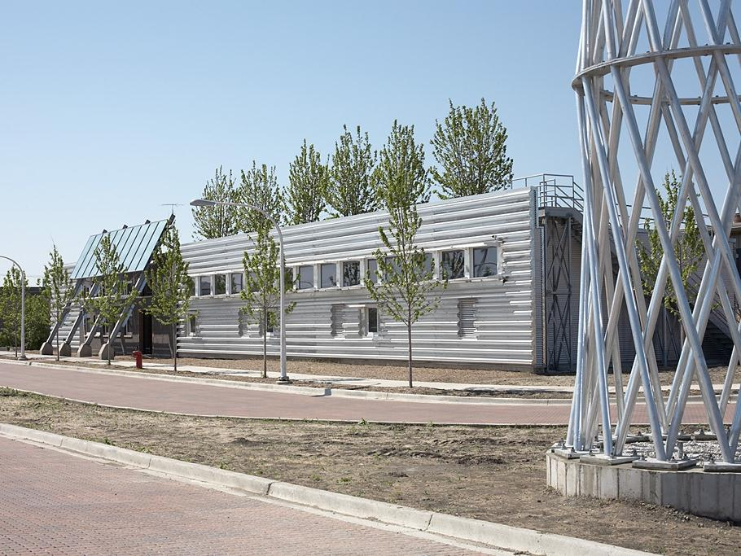
Structural Steel & Sustainability
Prepared by:
John Cross, PE, LEED AP
Vice President
American Institute of Steel Construction
Tim Mrozowski, A.I.A.
Construction Management Program
School of Planning Design and Construction
Michigan State University
Lawrence F. Kruth, PE Vice President
Douglas Steel Fabricating Corp
March 2015

Slide 2
The information presented in this publication has been prepared in accordance with recognized engineering principles and is for general information only. While it is believed to be accurate, this information should not be used or relied upon for any specific application without competent professional examination and verification of its accuracy, suitability, and applicability by a licensed professional engineer, designer, or architect. The publication of the material contained herein is not intended as a representation or warranty on the part of the American Institute of Steel Construction or of any other person or entity named herein, that this information is suitable for any general or particular use or of freedom from infringement of any patent or patents. Anyone making use of this information assumes all liability arising from such use.
Caution must be exercised when relying upon specifications and codes developed by other bodies and incorporated by reference herein since such material may be modified or amended from time to time subsequent to the printing of this edition. The Institute bears no responsibility for such material other than to refer to it and incorporate it by reference at the time of the initial publication of this edition.

Slide 3
Course Description
The course is presented in three parts. Part 1 presents a comprehensive view of the cradle-to-cradle structural steel supply chain from a sustainability perspective. Part 2 provides an overview of the rating systems, codes and standards related to sustainable design and practice as it relates to structural steel buildings. Part 3 provides a brief introduction to the concepts and details related to thermal bridging for structural steel.
Notes:
3

Slide 4
Additional Resources
AISC provides a number of teaching aids for free downloads by students and faculty which provide background on structural steel construction.
Visit www.aisc.org and http://www.aisc.org/teachingaids to view and download these helpful resources.

Slide 5
Note to Presenter
Narrative speaker notes are available for this presentation by clicking on the “Notes Page” icon in the “View” tab.
This symbol ☞ on a slide indicates a note. You can right click your mouse to end a slide presentation and see the student/faculty notes in the bottom window pane. You can restart the slides from the current slide to restart the presentation.

Slide 6
Structural Steel & Sustainability
This presentation is Part 2 of 3 on Structural Steel & Sustainability titled Structural Steel & Sustainability 201: Codes, Standards & Rating Systems. Parts 1 and 3 of the presentation are covered in the following separate presentations on the AISC Teaching Aids website:
Part 1 of 3 - Structural Steel & Sustainability 101: Introduction to Sustainability and Structural Steel
Part 3 of 3 - Structural Steel & Sustainability 301: Structural Steel & Thermal Considerations

Slide 7
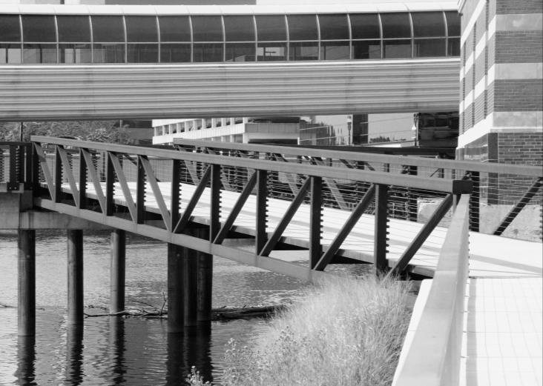
Structural Steel & Sustainability
Part 2 of 3
Codes, Standards & Rating Systems
Prepared by:
John Cross, PE, LEED AP
Vice President
American Institute of Steel Construction
Tim Mrozowski, A.I.A.
Construction Management Program
School of Planning Design and Construction
Michigan State University
Lawrence F. Kruth, PE Vice President Douglas Steel Fabricating Corp

Slide 8
Learning Objectives
At the end of the this course, participants will be able to:
Identify the material requirements for each of the major sustainability codes, standards and rating systems.
Understand the reporting requirements for documenting structural steel’s contribution to these requirements.
Understand the role of their organization, be it a material producer, service center, fabricator, erector or structural engineer, in meeting these requirements.
Notes:
8

Slide 9
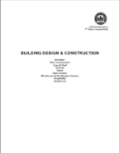
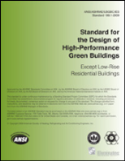
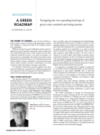
Codes, Standards and Rating Systems
LEED 2009
IgCC
LIVING BUILDING
LEED V4
ASHRAE 189.1
Green Globes
For more information, download A Green Roadmap in February 2013 issue of Modern Steen Construction magazine. (http://www.modernsteel.com/Uploads/Issues/February_2013/022013_econ)
☞
Notes:
The growing influence of sustainability concerns in the building design and construction marketplace has spawned an increasing number of codes, standards and rating systems that impact how projects are designed and constructed.

Slide 10
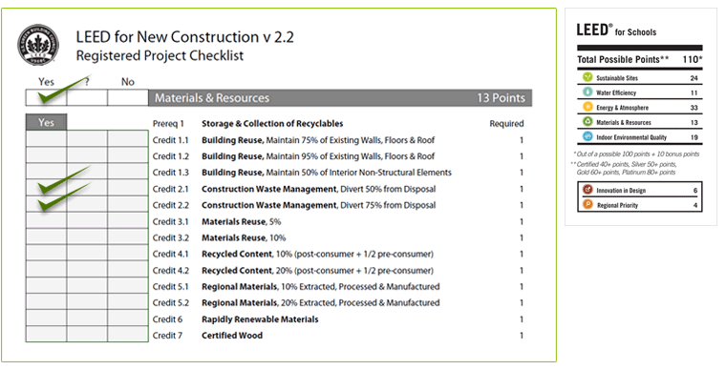
Life used to be easy!
☞
Notes:
LEED is a rating system designed to incentivize, measure and reward green design and construction practices. For its part, it provided a simple series of checklists of credits that if achieved would grant a certain LEED rating.

Slide 11
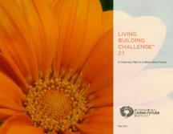
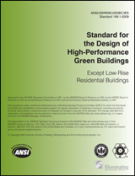
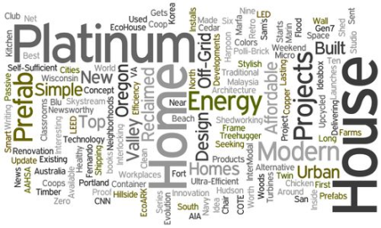
But the world has changed!
☞
Notes:
Now with the development of codes, standards and rating systems, there are many resources and guidelines for sustainable structures and design requirements for the designer to consider.

Slide 12
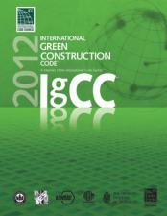
Rating Systems
Standards
Codes
Paradigm shift!
☞
Notes:
These documents can be classified into different groups: 1) those that are rating systems and 2) those that are standards and codes that could be adopted by authorities having jurisdiction. It is therefore critical that structural engineers and structural steel fabricators understand the additional expectations and requirements that are being placed on their disciplines as a result of the increasing demand for green buildings.

Slide 13
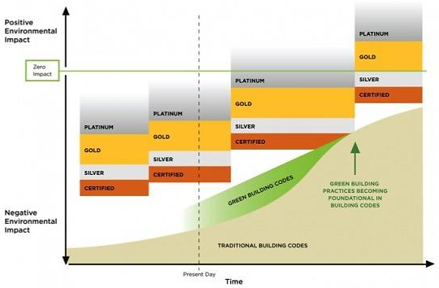
The Relative Position of Codes, Standards and Rating Systems
☞
Notes:
The green codes, standards and rating systems are measures above what is required by traditional building codes. However, as the traditional building codes start to incorporate some of these green measures into their standards and requirements, then the level of green measures in the green codes, standards and rating systems will further advance the design to a zero impact effect from the building.

Slide 14
FACT:
The optimization of a green building is a function of the designer and builder, not a rating system, standard or code.

Slide 15
In this presentation….
Rating Systems
LEED 2009
LEED V4
Green Globes
Living Building Challenge
Standards
ASHRAE 189.1-2011/2014
Codes
IgCC
The Impact on Material Production & Selection
Available Documentation
☞
Notes:
In this presentation we will cover some of the green ratings, standards and codes.

Slide 16
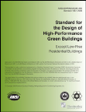
Rating Systems
Voluntary by project owner
Incentivizes Performance
Tiered structure
Does not have to be consensus based
Implemented contractually or jurisdictionally
“Industry” based requirements
Compliance based on mandated provisions
Prescriptive or Performance options
ANSI Consensus Process
Adopted into law by Jurisdiction
Compliance based on mandated provisions
Prescriptive or Performance based
Input into Model Code development
Can be modified at jurisdictional level
Standards
Codes
☞
Notes:
Here we show the differences between what is considered a rating system, a standard and a code. We will go into further detail on each subject.

Slide 17
1993 USGBC founded
1998 LEED V1.0 Pilot Program
2000 LEED V2.0
2005 LEED V2.2
2009 LEED 2009 (V3.0)
2013 LEED V4
Multiple Categories:
Building Design & Construction
Interior Design & Construction
Operations & Maintenance
Neighborhood Development
Home Design & Construction
5 Major Divisions
Sustainable Sites
Water Efficiency
Energy & Atmosphere
Materials & Resources
Indoor Environmental Quality
Rating Systems
LEED
Point Based Certification
(2009)
Platinum 80+
Gold 60-79
Silver 50-59
Certified 40-49
☞
Notes:
This slide shows the history of the development of the LEED rating system. It also shows the breakdown in requirements for LEED.

Slide 18
LEED Versions
Version | Status | Registration Opened | Registration Closed | Application Sunset Date
LEED v4 | Registration Open | Nov 1, 2013 | TBD | TBD
NC 2009 | Registration Open | Apr 27, 2009 | Oct 15, 2016 | June 1, 2021
NC v2.2 | Registration Closed | Nov 15, 2005 | June 27, 2009 | June 27, 2015
NC v2.1 | Sunset Date Passed | Nov 13, 2002 | Dec 31, 2005 | Dec 15, 2011
NC v2.0 | Sunset Date Passed | March 2000 | Nov 13, 2002 | Dec 31, 2009
☞
Notes:
LEED rating system has undergone changes through the years. This table shows the dates of applicability for applying to achieve LEED accreditation through one of the LEED rating systems.
Registration = “I might submit the documents necessary to qualify this project for LEED certification and pay fee”
Application = “Here are the required documents necessary for LEED certification.”

Slide 19
Intl Living Future Institute - Seattle
------- Initial program created by KC architectural firm BNIM 2006 Brought to Cascadia GBC (USGBC & CGBC)
First building certified
2013 Total of 6 buildings certified
7 Major Performance Areas
Sites
Water
Energy
Health
Materials
Equity
Beauty
Viewed as green controlled
“Harder” than LEED
Rating Systems
Living Building Challenge
Performance Based
Certification All
Petals at least 3 categories
☞
Notes:
This slide shows the history of the development of the Living Building Challenge rating system. It also shows the breakdown in requirements for the Living Building Challenge.

Slide 20
Green Building Initiative
GBI acquired rights to Canadian Green Globes
Developed ANSI consensus based assessment tool
Accepted by GSA as alternative to LEED
8 Major Divisions
Project Management (50)
Sites (115)
Energy (390)
Water (110)
Materials & Resources (125)
Emissions (50)
Indoor Environment (160)
Viewed as industry controlled
“Easier” than LEED
Rating Systems
Green Globes
Point Based Certification
1000 points
>85% 4 globes
70% to 84% 3 globes
55% to 69% 2 globes
35% to 54% 1 globe
☞
Notes:
This slide shows the history of the development of the Green Globes rating system. It also shows the breakdown in requirements for the Green Globes.

Slide 21
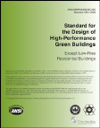
Process driven by American Society of Heating, Refrigeration and Air-Conditioning Engineers (ASHRAE)
Co-sponsors are USGBC, IES & ICC
Driven by desire to achieve energy improvement in buildings beyond Standard 90.1
2006 Balanced committee formed
12/2009 Approved for publication
12/2011 Minor Update
2014 Major Update
Written in mandatory language
In addition to LEED categories it addresses Construction and Plans for Operation
Adopted in limited jurisdictions and US DOD
Accepted as alternative path to IgCC
Standards
ASHRAE 189.1
☞
Notes:
Now let’s look at the green standards. The most recognized green standard for commercial buildings is ASHRAE 189.1. This slide shows the breakdown of the requirements.

Slide 22
Driven by International Code Council
Partnered with USGBC, IES, ASHRAE, ASTM, AIA
Task groups proposed language
Appointment of review committees
Includes ASHRAE 189.1 path
2010 & 2011 Public Hearings
11/2011 ICC Vote
03/2012 Publication
04/2014 Hearing on Changes
2015 New Version
Major Categories
Life Cycle Assessment
Site development
Material resource conservation
Energy conservation
Water resource conservation
Indoor environmental quality
Commissioning, operation and maintenance
Existing buildings
Codes
International Green Construction Code
☞
Notes:
A recent memo of understanding (MOU) between ASHRAE and ICC noted that for the next version of IgCC, ASHRAE 189 will be the sole standard instead of an optional path of compliance. ICC will administer ASHRAE through IgCC, but the IgCC “native” path is going away in favor of only using ASHRAE.
LCAs are an optional compliance path in IgCC. The adoption of the IgCC will require structural engineers to document the anticipated contribution of structural materials to the recycled and regional material content of the building during plan review in order for building permits to be issued. These estimates will be made using typical industry averages for the recycled content of construction materials, typical sourcing options relative to regional content and the associated portion of delivered material costs to the overall structure cost. At the same time documentation of anticipated material recovery rates and any use of recovered material will need to be made to verify that the required thresholds of the IgCC will be reached.

Slide 23
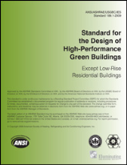
IgCC
Project Selection
ASHRAE 189.1
IgCC Native
☞
Notes:
Is this project being constructed in a jurisdiction that has adopted the IgCC? If so, is the native IgCC or ASHRAE 189.1 compliance path being followed? ASHRAE 189.1 and native IgCC have slightly different requirements for sustainability.

Slide 24
Coordination of ASHRAE 189.1, IgCC and LEED
LEED V4
Prerequisite
IgCC
☞
Notes:
But things are changing. A memo of understanding has been entered into by USGBC, ASHRAE, ICC and AIA to consolidate and coordinate ASHRAE 189.1, IgCC and LEED. The goal is that ASHRAE 189.1 will be the basis of the technical content of the IgCC with ICC providing the administrative language for local jurisdictions. At the same time compliance with IgCC will become a prerequisite for LEED certification independent of whether the jurisdiction where the project is built has adopted the IgCC or not.

Slide 25
So which do I follow?
Has the jurisdiction adopted the IgCC?
If yes…has the project owner selected the ASHRAE 189.1 or native IgCC option?
You must follow that option
Has the project owner specified that the project is intended to receive LEED, Green Globes or Living Building Challenge certification?
If yes…you must follow that one in addition to any jurisdictional requirements
☞
Notes:
To simply say “this is a LEED project” does not define material sourcing requirements or the level of detail or completeness of material documentation.

Slide 26
Federal Projects
Individual agencies may have their own standards to follow for sustainability, for example the Department of Defense (DOD).
GSA accepts either LEED Silver or 2 Green Globes.
☞
Notes:
GSA recommends that agencies use either LEED 2009 or the Green Building Initiative’s (GBI) Green Globes 2010 — with a minimum goal of achieving LEED Silver or 2 Green Globes certification levels for new buildings.

Slide 27
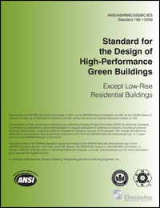
Attainment
Rating System
Points gained through compliance with individual credit categories
Must meet mandatory and prescriptive or performance based requirements
Mandatory requirements and jurisdictional and project electives
ASHRAE 189.1
IgCC
☞
Notes:
While all three of these documents focus on similar topics, the requirements and methodologies vary significantly between them. The IgCC is written in code language designed to be adopted by local jurisdictions as either part of their base building code or as incremental requirements for projects required to be sustainable, or in order to obtain certain incentives by opting to be sustainable. There are multiple compliance paths within the IgCC. The first is what is referred to as “native” IgCC, which spells out specific project requirements. However, in place of meeting the requirements of the native IgCC language, a project owner can opt to comply with either the requirements of ASHRAE 189.1.

Slide 28
How does this apply to my project with respect to materials?
LEED 2009
ASHRAE 189.1
LEED V4
GREEN GLOBES
IgCC
LIVING BLDG
☞
Notes:
Does the contract simply require the fabricator to document the recycled content and source of materials or does it specify compliance thresholds for the materials used on the project (i.e., “the average recycled content of all products delivered to the project site shall be 50% and all products shall be sourced from within 500 miles of the project site”)? What materials must be separately reported (sections, connection material, bolts, deck, joists, etc.)? Contract provisions and project specifications control the requirements for the material a fabricator acquires as well as the documentation that must be provided.

Slide 29
Design for Recycling
LEED 2009
MRp1: dedicated area required
MRp1: dedicated area required
9.3.4: Required – Provide dedicated area for recyclable and reusable materials (residential)
504.1: Dedicated space + reusables (residential)
LEED V4
ASHRAE 189.1
IgCC
☞
Notes:
A spreadsheet template including the appropriate calculations is available at www.aisc.org/sustainability. It is important to recognize that while the recycled content of a material is based on mass, the contribution of that material to the overall recycled content of the building is based on cost. The contribution of a structural steel frame to the recycled content of the building is the recycled content of the material (mass-based) multiplied by the cost of the structural steel package excluding erection. This value is then added to the contributions of other materials and divided by 45% of the project’s construction cost to determine the recycled content attainment level of the building.

Slide 30
Construction Waste Management
LEED 2009
MRc2: Divert 50%/75% from landfill (1 or 2 pts)
Weight or volume
Exclude soil and land clearing debris
MRc5: Divert 50%/75% from landfill (1 or 2)
Or generate < 2.5 psf (2)
9.3.1: Divert 50% from landfill (weight/volume)
Exclude soil and land clearing debris
Total waste < 42 yd³ or 12,000 lb per 10,000 ft²
503.1: Divert 50% from landfill (weight/volume)
Exclude soil and land clearing debris
Waste management plan
302.1 Jurisdiction elective: 50%/65%/75%
A105.1/A105.2: Project elective: +20% or total waste < 4 psf
LEED V4
ASHRAE 189.1
IgCC

Slide 31
Building Reuse
LEED 2009
MRc1.1:
Maintain 55%/75%/95% of structure (1, 2 or 3)
Maintain 50% of interior non-structural (1)
MRc1: Reuse historic building (5)
Renovate abandoned building (5)
Reuse percentage of building (1 to 4)
Not addressed
A105.6: Existing Building Reuse: Project Elective
A105.7: Historic Building Reuse – Project elective
LEED V4
ASHRAE 189.1
IgCC

Slide 32
Material Selection
LEED 2009
LEED V4
ASHRAE 189.1
IgCC
☞
Notes:
It is very possible that a single project may be required to meet the requirements of IgCC (native or ASHRAE 189.1) and document contributions to LEED thresholds, so each of the three methodologies may need to be evaluated. So what do each require for material selection.

Slide 33
Material Selection
LEED 2009
MRc3: Used Materials – based on cost
>5% 1 point
>10% 2 points
MRc4: Recycled Materials – based on cost
>10% 1 point
>20% 2 points
content based on weight
post-consumer + 0.5* pre-consumer
MRc6: Bio-based – based on cost
>2.5% 1 point
<10 year maturity cycle
MRc5: Regional Materials – based on cost
>10% 1 point
>20% 2 points
extracted/harvested/recovered and manufactured within 500 miles of project site
☞
Notes:
In the past the domestic industry average recycled content for steel produced from EAF and BOF was accepted by all programs as sufficient documentation. As of November 2012, LEED no longer accepts industry average documentation but rather requires producer specific documentation of the average recycled content of their products.

Slide 34
Material Selection
LEED 2009
Steel Products:
Recycled Content – default value 25% unless documented by producer (not industry)
Regional calculation – methodologies:
Mill and fabricator within 500 miles of project site
Fabricator and proportion of scrap originating within 500 miles of project site
Travel distance – mill to service center to fabricator to project less than 500 miles where rail divided by 3, barge divided by 2 and seagoing ship divided by 15
☞
Notes:
As of July 2012, LEED-NC 2009 MR-4 recognizes two methods for calculating regional material. The first requires the point of extraction/recovery of feedstock material and manufacture to be within 500 miles of the project site. USGBC considers the point of manufacture for recycled material products to be the location of the final finished product manufacturer—which is the steel fabricator. The second tracks the actual transportation distances of the material from extraction/recovery to the mill to the service center to the fabricator to the project site, with adjustments made for the mode of transportation. Distances involving rail transport are divided by 3, inland barge by 2 and ocean shipping by 15.

Slide 35
Material Selection
LEED v4
MRc2: Environmental Product Declarations
20 products from at least 5 manufacturers (1)
Product declaration: counts ¼
Industry EPD: counts ½
Product EPD: counts 1
50% of products by cost selected below industry average impacts (1)
<100 miles counts double
structure & enclosure no more than 30% of compliant cost
☞
Notes:
Under LEED the definition of the point of extraction for iron ore and coke is the location of the mine, while the definition of the point of extraction/recovery of scrap can be the recycling facility, scrap yard, depository or stockpile. This allows for two methodologies: a proportional methodology based on that percentage of mining or scrap sourcing that occurs within 500 miles of the project site, or an all or nothing approach that considers the mill location as the recycling facility. Either approach can be taken but it must be used consistently for all materials.

Slide 36
Material Selection
LEED V4
MRc3: Raw Material Sourcing
20 products from at least 5 manufacturers (1)
extract locations identified
ecological commitment statement
impact reduction commitment
meet standards for responsible sourcing
self declared = ½
25% of products by cost selected (1)
extended producer responsibility +
bio-based +
FSC wood +
reused +
recycled
< 100 miles counts double & s/e 30%
☞
Notes:
If specific producer documentation is not available, then a default recycled content value of 25% can be used for steel products. The producer letter should distinguish the two different types of recycled content and indicate the percentage of each. The first type is post-consumer recycled content, which includes any material being recycled after it has recovered from a product used by a consumer (i.e., an automobile).

Slide 37
Material Selection
LEED V4
MRc4: Ingredient Disclosure (max 2)
20 products from at least 5 manufacturers (1)
ingredients disclosed to 1000 ppm
or published Health Product Declaration
or cradle-to-cradle certified
-and/or-
25% of products by cost selected (1)
GreenScreen Benchmarked
Cradle-to-cradle certified (credit varies)
REACH optimized
< 100 miles counts double & s/e 30%
-and/or-
25% of products by cost selected (1)
99% disclosure by weight
3rd party supply chain verification of disclosure and “quality process”
< 100 miles counts double & s/e 30%
☞
Notes:
The second is pre-consumer (post-industrial) recycled content, which is waste from an industrial process other than the process producing the material (i.e., scrap bundles from an automobile production facility). A third form of scrap, scrap that is recycled within the steel mill producing the product (called “home scrap”) is not considered recycled material and does not enter into the calculation of recycled content. These calculations are done on the basis of mass. The calculated recycled content of the material varies by system. LEED uses the international methodology of calculating recycled content as the post-consumer recycled content plus half the pre-consumer recycled content.

Slide 38
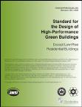
Material Selection
ASHRAE 189.1
9.4.1: Meets 2 of 4 requirements:
(1) Recycled content >10% based on cost
post-consumer + 0.5* pre-consumer
based on weight
(2) Regional materials >15% based on cost
Extracted/Harvested/Recovered or
manufactured within 500 miles of site
Rail & water at 25% of actual distance
(3) Bio-based materials >5%
USDA designation of bio-based
50% bio-based content to qualify
(4) EPDs for 10 products
☞
Notes:
ASHRAE 189.1 uses the international methodology of calculating recycled content as the post-consumer recycled content plus half the pre-consumer recycled content. This standard considers regional material to be any material extracted, recovered or (not and) manufactured within 500 miles of the project site. Distances for rail, barge or ship transportation are divided by a factor of four. For structural steel this means that if the source of the feedstock material, the mill or the fabricator is within an adjusted distance of 500 miles of a project site, the material qualifies as regional.

Slide 39
Material Selection
IgCC
505.2: Multi-attribute approach: Total >55%
Consistent cost, weight or volume
Multiple contribution of one material
Used material – full credit
Recycled material – full credit if:
recycled content >25% & >30% recovery
recycled content >50%
post-consumer + pre-consumer
Recyclable material – full credit if:
Recovery rate >30%
Bio-based – full credit if:
bio-based content >75%
Wood must be SFI,FSC,PEFC or equal
Indigenous – proportion within 500 miles
harvested/extracted/recovered and mfg
water and rail at 25% of actual distance
Project elective: Total >70%
Project elective: Total >85%
☞
Notes:
IGCC uses the simple sum of the pre-consumer and post-consumer content. The code considers regional material to be any material extracted, recovered and (not or) manufactured within 500 miles of the project site. Distances for rail, barge or ship transportation are divided by a factor of four. For structural steel this means that the source of the feedstock material and the fabrication facility must be within an adjusted distance of 500 miles of the project site to qualify as a regional material.

Slide 40
Material Selection Example
3 story office building with basement – 90’ x 120’
14 EPDs provided
Total project cost = $5,000,000 Materials = $2,250,000
Package Weight Volume Cost Post Pre Recov Local
Concrete $500k 1325 tons 700 cu yd $180k 0% 10% 5% 90%
Structural $600k 200 tons 30 cu yd $420k 57% 31% 98% 40%
Steel Deck $100k 100 tons 15 cu yd $100k 26% 7% 80% 0%
LEED 2009
Recycled = $180k*0.5*0.1 + $420k*(0.57+0.5*0.31)+$100k*(0.26+0.5*0.07)
= $343,000 or 15% - 1 point
Regional = $180k*0.9 + $420k*0.4+$100k*0.0
= $330,000 or 14% - 1 point

Slide 41
Material Selection Example
3 story office building with basement – 90’ x 120’
14 EPDs provided
Total project cost = $5,000,000 Materials = $2,250,000
Package Weight Volume Cost Post Pre Recov Local
Concrete $500k 1325 tons 700 cu yd $180k 0% 10% 5% 90%
Structural $600k 200 tons 30 cu yd $420k 57% 31% 98% 40%
Steel Deck $100k 100 tons 15 cu yd $100k 26% 7% 80% 0%
LEED V4 It is a whole different world…
How many products have EPDs? – not enough, need 20
How many products are responsibly sourced?
How many products have material disclosure?
Are material selections made on the basis of this information?
Adjust product counts based on information credibility and regional origination.

Slide 42
Material Selection Example
3 story office building with basement – 90’ x 120’
14 EPDs provided
Total project cost = $5,000,000 Materials = $2,250,000
Package Weight Volume Cost Post Pre Recov Local
Concrete $500k 1325 tons 700 cu yd $180k 0% 10% 5% 90%
Structural $600k 200 tons 30 cu yd $420k 57% 31% 98% 40%
Steel Deck $100k 100 tons 15 cu yd $100k 26% 7% 80% 0%
ASHRAE 189.1
Recycled=$180k*0.5*0.1+$420k*(0.57+0.5*0.31)+$100k*(0.26+0.5*0.07)
= $343,000 or 15% - exceeds 10%
Regional = $180k*0.9 + $420k*0.4+$100k*0.0
= $330,000 or 14% - does not exceed 15%
MEETS REQUIREMENT AS TWO OPTIONS EXCEED

Slide 43
Material Selection Example
3 story office building with basement – 90’ x 120’
14 EPDs provided
Total project cost = $5,000,000 Materials = $2,250,000
Package Weight Volume Cost Post Pre Recov Local
Concrete $500k 1325 tons 700 cu yd $180k 0% 10% 5% 90%
Structural $600k 200 tons 30 cu yd $420k 57% 31% 98% 40%
Steel Deck $100k 100 tons 15 cu yd $100k 26% 7% 80% 0%
IgCC Weight = 1325*0.9 + 200 + 200 + 100 + 100
= 1792/2000(?) tons = 90% - exceeds 55% threshold
Volume = 700*0.9 + 30 + 30 + 15 + 15
= 720/1000(?) cu yds = 72% - exceeds 55% threshold
Cost = $180k*0.9 + $420k +$420k + $100k + $100k
= $1,202k/$2,250k = 53% - does not exceed 55% threshold

Slide 44
Construction Site Materials
LEED 2009
Not addressed
EQc2: Low VOC emitting materials
EQc3: Protect absorptive materials
10.3.1.6: Construction Vehicle staging area >100 ft from outdoor air intake
10.3.1.4 Absorptive materials protected
Materials with visible mold cannot be installed
502.1.2: Absorptive materials protected
Materials with mold and/or dampness must be dried & cleaned prior to installation or discarded
LEED V4
ASHRAE 189.1
IgCC

Slide 45
Other Material Requirements
LEED 2009
None
None
9.3.2: Material manufacturing, harvesting, extraction or recovery compliant with laws and regulations of country of origin
A105.4.1: Project Elective: Service Plan projected life, maintenance schedule
A105.5: Project Elective: Design for Deconstruction & Building Reuse >90%
LEED V4
ASHRAE 189.1
IgCC

Slide 46
Life Cycle Assessment - Implementation
LEED 2009
Implementation: Pilot Credit - changes
Guiding Methodology: ISO 14044
Basis: Reference building
Metric: 3 of 6 +10% others <5%
Implementation: MRc1 (3)
Guiding Methodology: ISO 14044
Basis: Reference building
Metric: 3 of 6 +10% others <5%
Implementation: 9.5: Performance Path
Guiding Methodology: ISO 14044
Basis: Alternative design
Metric: 2 of 6 +5%
Implementation: 303: Preempts 505
Guiding Methodology: ASTM E2921
Basis: Reference building
Metric: GWP & 2 of 5 +20%
PILOT
LEED V4
ASHRAE 189.1
IgCC

Slide 47
Life Cycle Assessment - Impacts
ASHRAE 189.1
LEED 2009
LEED V4
IgCC
PILOT
Categories:
Land Use
Resource Use x
Global Warming x x x x
Ozone Depletion x x x x
Human Health x
Eco-toxicity x
Smog x x
Acidification x x x x
Eutrophication x x x x
Primary Energy x x x x
Ozone Formation x x
☞
Notes:
Differing LCA requirements look at different impact categories.

Slide 48
Life Cycle Assessment - Sources
ASHRAE 189.1
LEED 2009
LEED V4
IgCC
PILOT
Extract/Rec/Harv x x x x
Manufacturing x x x x
Transport x x x x
Assembly/Construction x x x x
Maintenance/Repair x x x x
Operating Energy x same x same optional x
Process Loads optional
Demolition/Deconstruct ? x x
☞
Notes:
And look at different lifecycle stages.

Slide 49
Life Cycle Assessment - Tools
LEED 2009
Air Emissions:
Process: same tool
Report: ISO 14044
Review:
Air Emissions:
Process: same tool
Report: ISO 14044
Review:
Air Emissions: EPA & Clean Air
Process: 3rd party impact indicator
Report: ISO 14044 model
Review: Independent LCA expert
Air Emissions:
Process: same tool approved by code official
Report: ISO14044
Review:
PILOT
LEED V4
ASHRAE 189.1
IgCC
☞
Notes:
Accurate life cycle inventories (LCI) of products are difficult to identify. LCIs for different products may have selected different boundary conditions in the calculation of their specific inventories. Some products may only include impacts of the production process (cradle-to-gate) while other products may include all phases of a products life from production through installation to demolition to reclamation (cradle-to-cradle). Any building analysis comparing framing systems or products with LCIs using different boundary conditions is invalid.

Slide 50
And these are not the only ones…
Living Building Challenge
20 Petals
11 – no red listed materials or chemicals with some temporary exceptions
12 – account for and offset embodied carbon footprint
13 – sustainable resource extraction and fair labor practices
14 – appropriate sourcing locations
15 – waste minimization during all phases
Dialogue based evaluation
Rating System
International Living Future Institute
Seattle, Washington
☞
Notes:
To be certified under the Challenge, projects must meet a series of ambitious performance requirements over a minimum of 12 months of continuous occupancy. Few projects have attained full certification under the Living Building Challenge.

Slide 51
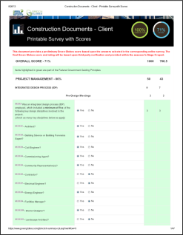
And these are not the only ones…
Green Globes
Checklist Based System
Moisture control
Structural frame commissioning
LCA evaluation
Environmental Product Declaration
Service life evaluation
Prefabrication & Modularization
Efficient use of raw materials
Design for deconstruction
Rating System
Green Building Initiative
Seattle, Washington
Notes:
Green Globes is based primarily on ASHRAE and on the ANSI/GBI 01-2010: Green Building Assessment Protocol for Commercial Buildings (http://www.thegbi.org/about-gbi/ANSI-GBI-standards-document.shtml). One of most often quoted studies was conducted by a team of researchers at the University of Minnesota led by Associate Professor Timothy M. Smith, who published an analysis of the two rating systems in a report titled "Green Building Systems: A Comparison of the LEED and Green Globes Systems in the U.S." (http://www.thegbi.org/gbi/Green_Building_Rating_UofM.pdf). The study provides a detailed comparison of how the systems operate as well as their respective strengths and weaknesses.

Slide 52
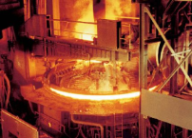
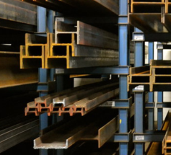
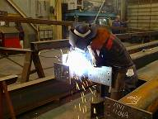
Impact on Industry Segments
LEED 2009
Structural Steel Producers
It doesn’t get simpler
You can’t choose one and ignore the rest
You must be prepared to deal with all of them
Produce, collect and compile more information
LEED V4
Service Centers
ASHRAE 189.1
Fabricators
Structural Engineers
IgCC
Notes:
Sustainable design and construction is not a passing trend. It has become an issue for consideration on every building project. Sustainable design practices and sustainable steel fabricating practices will become a normal business activity independent of whether they are codified or recognized.

Slide 53
Mills & Producers
For every product line:
Publish industry wide EPD
Publish product EPD (optional)
Publish chemical disclosure statement
Track sources of all major materials:
Scrap
Semi-finished product
Maintain records of pre and post consumer content
Distribute recovery rate of material
Track shipping mode by typical radius
Document EAF or BOF source material

Slide 54
Service Centers
For all stocked material:
Mill source (location)
Transportation history
Have in your possession:
Industry EPD for product type
Producer EPD if available
Product Chemical Disclosure Statement
Industry recycled content/recovery rate values

Slide 55
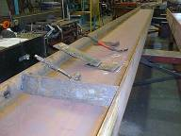
Fabricators
For every material order, document:
Mill source (location)
Mill type (BOF or EAF)
Recycled content (pre & post consumer)
% from project site radius
Transportation history
Have in your possession:
Industry EPD for product type
Producer EPD if available
Product Chemical Disclosure Statement
Industry recycled content/recovery rate values
For project:
Cost of material delivered to site
Mass of material delivered to site
Volume of material delivered to site
1-866-ASK-AISC posted on your desk

Slide 56
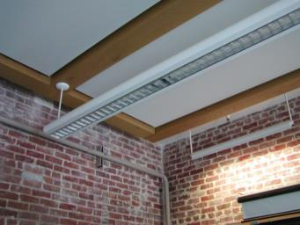
Sustainable Business Practice Opportunities
Fabricator Facilities
Fabrication and Erection Operations
Office Operations
Three Levels Of Activity
Savings requiring little spending
Savings needing investment
Major projects

Slide 57
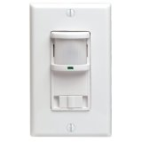
Sustainable Business Practices
Take a “Facility Management” approach to managing fabricator, erector and design operations
Create a “Corporate Commitment” to sustainable company practices and operations
Good Sustainability and Energy Management Practice involves
Vision
Strategy
Structure
Commitment

Slide 58
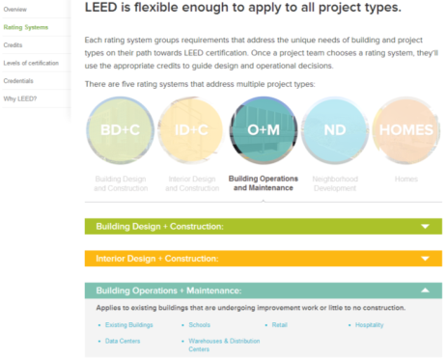
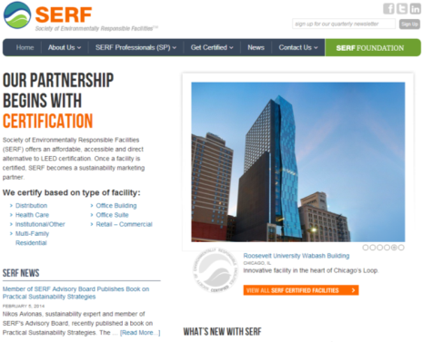
LEED O+M for Existing Buildings http://www.usgbc.org/articles/getting-know-leed-building-operations-and-maintenance-om
Sustainable Business Practices
Society for Environmentally Responsible Buildings
www.serfgreen.org
ASHRAE Resources www.ashrae.org/resources--publications/bookstore/guideline-32-2012
58

Slide 59
Structural Engineers
Have a cheat sheet for all materials showing:
Typical recycled content (post & pre)
Recovery rate
Typical sourcing for your area (scrap, mill, fab)
Typical transportation
Availability of EPD & Chemical sheets
Estimate building mass and volume
Perform preliminary threshold calculations
Evaluate possibility of used material
Prepare standard language for frame service life
Prepare to opine on de-constructability
Specify material requirements necessary to meet project thresholds not project thresholds for each material
Learn about LCAs and their limitations
Be prepared to educate local jurisdictions

Slide 60
Structural Engineers
LEED 2009
LEED V4
DESIGN FOR SUSTAINABILITY NOT COMPLIANCE
ASHRAE 189.1
IgCC

Slide 61
Resources
“A Complete Fabrication,” Modern Steel Construction March 2008 Issue.
(http://www.modernsteel.com/Uploads/Issues/March_2008/032008_30775_cives_web.pdf)
“A Model Approach,” Modern Steel Construction July 2012 Issue. (http://www.modernsteel.com/Uploads/Issues/July_2012/072012_model.pdf)
AISC Sustainability website www.aisc.org/sustainability
ANSI/GBI 01-2010: Green Building Assessment Protocol for Commercial Buildings (http://www.thegbi.org/about-gbi/ANSI-GBI-standards-document.shtml)
“AT YOUR SERVICE,” Modern Steel Construction August 2006 Issue.
(http://msc.aisc.org/globalassets/modern-steel/archives/2006/08/2006v08_at_your_service.pdf)
Cross, John, “Job Creation in the Fabricated Structural Steel Industry,” AISC White paper
(http://www.aisc.org/WorkArea/linkit.aspx?LinkIdentifier=id&ItemID=33666)
“Design for Deconstruction,” Modern Steel Construction June 2004 Issue. (http://www.modernsteel.com/Uploads/Issues/June_2004/30730_dfd.pdf)

Slide 62
Resources
"Green Building Systems: A Comparison of the LEED and Green Globes Systems in the U.S." (http://www.thegbi.org/gbi/Green_Building_Rating_UofM.pdf)
“Keep on Rolling,” Modern Steel Construction February 2014 Issue.
(http://www.modernsteel.com/Uploads/Issues/February_2014/022014_Keep_on.pdf)
Steel Takes LEED with Recycled Content
“The Fabricator Factor,” Modern Steel Construction July 2010 Issue. (http://www.modernsteel.com/Uploads/Issues/July_2010/072010_sustainability_web.pdf)
“Thermal Bridging Solutions,” Modern Steel Construction March 2012 Issue. (www.modernsteel.com/Uploads/Issues/March_2012/032012_thermal_bridging_March_insert)
Weisenberger, Geoff, “Steel's sustainability stance” Civil Engineering, March 2012. (http://cenews.com/article/8772/steels-sustainability-stance)

