Slide 1
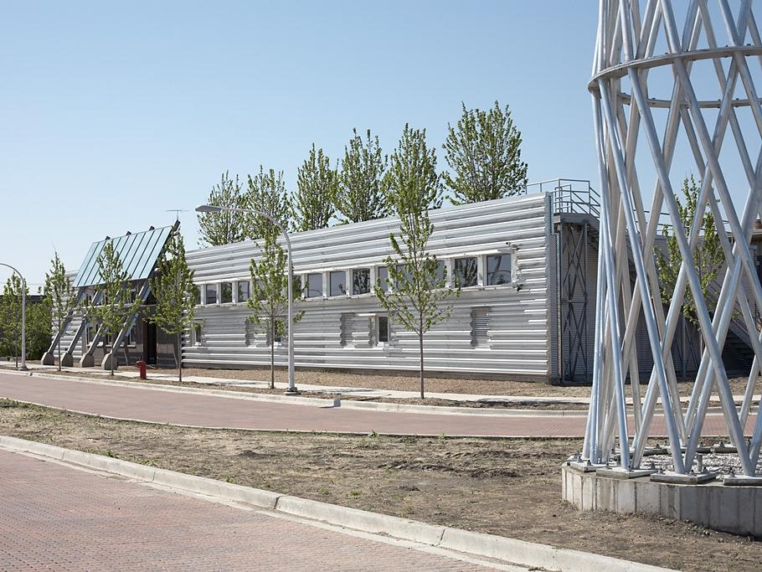

Structural Steel & Sustainability
Prepared by:
John Cross, PE, LEED AP
Vice President
American Institute of Steel Construction
Tim Mrozowski, A.I.A.
Construction Management Program
School of Planning Design and Construction
Michigan State University
Lawrence F. Kruth, PE
Vice President
Douglas Steel Fabricating Corp
March 2015

Slide 2
The information presented in this publication has been prepared in accordance with recognized engineering principles and is for general information only. While it is believed to be accurate, this information should not be used or relied upon for any specific application without competent professional examination and verification of its accuracy, suitability, and applicability by a licensed professional engineer, designer, or architect. The publication of the material contained herein is not intended as a representation or warranty on the part of the American Institute of Steel Construction or of any other person or entity named herein, that this information is suitable for any general or particular use or of freedom from infringement of any patent or patents. Anyone making use of this information assumes all liability arising from such use.
Caution must be exercised when relying upon specifications and codes developed by other bodies and incorporated by reference herein since such material may be modified or amended from time to time subsequent to the printing of this edition. The Institute bears no responsibility for such material other than to refer to it and incorporate it by reference at the time of the initial publication of this edition.

Slide 3
Course Description
The course is presented in three parts. Part 1 presents a comprehensive view of the cradle-to-cradle structural steel supply chain from a sustainability perspective. Part 2 provides an overview of the rating systems, codes and standards related to sustainable design and practice as it relates to structural steel buildings. Part 3 provides a brief introduction to the concepts and details related to thermal bridging for structural steel.
Notes:
3

Slide 4
Additional Resources
AISC provides a number of teaching aids for free downloads by students and faculty which provide background on structural steel construction.
Visit www.aisc.org and http://www.aisc.org/teachingaids to view and download these helpful resources.

Slide 5
Note to Presenter
Narrative speaker notes are available for this presentation by clicking on the “Notes Page” icon in the “View” tab.
This symbol ☞ on a slide indicates a note. You can right click your mouse to end a slide presentation and see the student/faculty notes in the bottom window pane. You can restart the slides from the current slide to restart the presentation.

Slide 6
Structural Steel & Sustainability
This presentation is Part 3 of 3 on Structural Steel & Sustainability titled Structural Steel & Sustainability 301: Structural Steel & Thermal Considerations. Parts 1 and 2 of the presentation are covered in the following separate presentations on the AISC Teaching Aids website:
Part 1 of 3 - Structural Steel & Sustainability 101: Introduction to Sustainability and Structural Steel
Part 2 of 3 - Structural Steel & Sustainability 201: Codes, Standards & Rating Systems

Slide 7
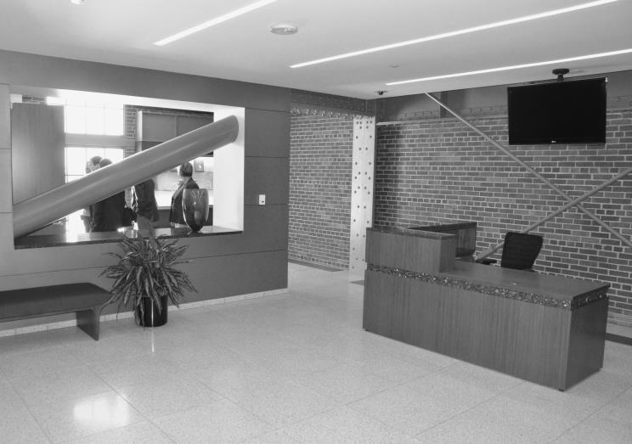
Structural Steel & Sustainability
Part 3 of 3
Structural Steel & Thermal Considerations
Prepared by:
John Cross, PE, LEED AP
Vice President
American Institute of Steel Construction
Tabitha Stine, S.E., LEED AP
Director of Technical Marketing
American Institute of Steel Construction

Slide 8
Course Description
The course explores the issues of thermal bridging and thermal capacity as they relate to structural steel framed buildings.
Notes:
8

Slide 9
Learning Objectives
At the end of the this course, participants will be able to:
List the different types of heat transfer through Building Envelopes
Explain the difference between "R-Values" and "U-Values" in regards to construction materials
Identify areas of typical building construction in which the five details presented would be good substitutes
Describe how improperly addressed thermal bridging problem areas can lead to areas of concern with a building's longevity and occupant comfort and health
Articulate how stainless steel, wood, and manufactured thermal breaks can be incorporated into building envelope details to mitigate effects of thermal steel bridging
Explain how thickness, material selection, finish placement, occupancy cycle, and exposed surface area of a typical floor slab affect the building's thermal capacity

Slide 10
Thermal Bridging + Thermal Capacity
Heating and Cooling Energy Use in Buildings
Overview of Thermal Bridging
  Solution Concepts
      Nonconductive Thermal Shims
      Intermittent Carbon Steel Supports
      Intermittent Stainless Steel Supports
      Material Separation
      Manufactured Structural Thermal Break Assemblies
    Recommendations
Thermal Capacity
What’s Ahead?
Notes:
10

Slide 11
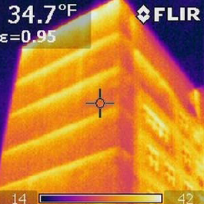


Thermal Bridging + Thermal Capacity:
Why Should I Care???
Notes:
11
What is long term cost of operating?
Reducing heat flow within the building envelope has benefits that extend beyond reducing energy use, such as minimizing the potential for condensation on surfaces. Also, colder interior surfaces can make people feel colder than the ambient air temperature, causing them to raise the temperature of the room or plug in an electric heater to feel comfortable.
The Architecture
2030 Challenge adopted by the American Institute
of Architects, The US Green Building Council, the US
Conference of Mayors, ASHRAE and many others has
as its goal to reduce building non-renewable energy
consumption in new buildings by 60% by the year
2030. Mayor Bloomberg’s PlaNYC initiative seeks to
reduce New York City’s greenhouse gas emissions by 30
percent by 2030 where nearly 80 percent of the citywide
emissions are attributed to buildings’ energy use.

Slide 12
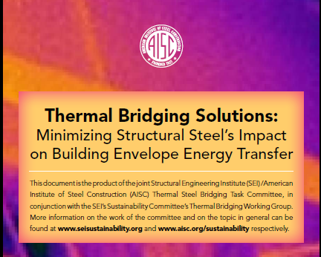
AISC Collaborative Publication
March 2012 Issue of Modern Steel Construction Magazine
www.modernsteel.com/Uploads/Issues/March_2012/032012_thermal_bridging_March_insert
Notes:
12

Slide 13

Heating and Cooling Energy Use in Buildings
Responsible for:
25% of energy use in commercial buildings
40% of energy use in residential buildings
Buildings consume approximately 40% of energy used in the United States.
Notes:
13
This is why it’s important to consider the energy efficiency of our buildings.

Slide 14
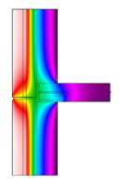
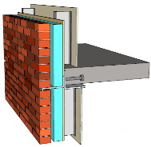
Thermal Bridging
Conductive heat transfer through thermally conductive materials across building envelope
Responsible for energy loss as well as potential for condensation, reduced occupant comfort
Occurs with structural steel, cold formed steel, concrete, masonry, and wood
Can be minimized if properly detailed
Notes:
14
Not just steel – concrete, masonry, timber have thermal bridging concerns.
Foundation is automatically a thermal bridge.

Slide 15
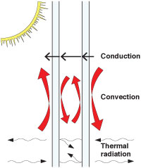
Heat Transfer in Building Envelopes
Types of Heat Transfer:
  Conduction
  Convection
  Radiation
Notes:
15
To understand thermal bridging, you need to understand the basics of heat transfer. Heat transfer occurs on one of these three ways.
Conduction is the transfer of heat through bodies in contact. It is the most significant form of energy loss through building envelopes. Materials with good insulation properties reduce conductive heat flow.
Convection is the transfer of thermal energy through air flow. Cold wind blowing in through leaks in a building’s air barrier can account for a lot of energy loss – in some cases 30 percent or more of the total thermal energy lost through the envelope. That’s why more and more codes are including specific requirements for an air barrier in new buildings and additions.
Radiation does not play a significant role in heat loss through a building envelope. It does play a role in the summertime with solar heat gain on unshaded surfaces. Also, in the wintertime, cold surfaces such as windows can make occupants feel colder than the air, since their bodies radiate heat to the cold surface.

Slide 16
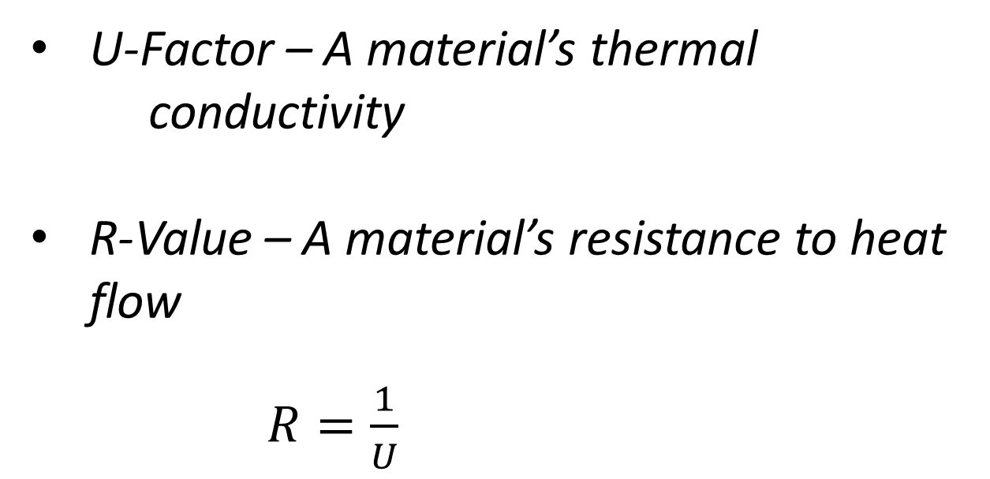
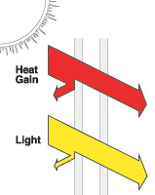
Heat Transfer in Building Envelopes
Notes:
16
Materials conduct heat according to their thermal conductivity. This is a property that all materials have, which is called the U-factor. The greater the U-factor, the more quickly heat moves through the material. The inverse of that is the R value of the material.

Slide 17
Heat Transfer in Building Envelopes
Common R-Values and U-Factors
MATERIAL (per inch) | R-Value ft²·°F·h/Btu | U-Factor Btu/ft²·°F·h
Silica Aerogel | R-10 | 0.1
Expanded Polystyrene | R-3.8 to R-4.2 | 0.26 to 0.29
Cellulose | R-3.0 to 3.8 | 0.33 to 0.26
Hardwood (most) | R-0.71 | 1.4
Concrete, normal weight | R-0.08 | 12
Stainless Steel | R-0.009 | 110
Carbon Steel | R-0.0031 | 320
Notes:
17
These are the R-values and U-factors of some common building materials. Note that stainless steel is about one-third as thermally conductive as carbon steel. Also, note that carbon steel conducts heat about 1200 times better than expanded polystyrene insulation, so a small amount of thermal steel bridging can conduct a lot of heat across an envelope.

Slide 18


Heat Transfer in Building Envelopes
- Conductive Heat Transfer Paths:
- Series - Add up
R-values along the
path of heat flow
- Parallel - Heat
chooses path of
least resistance
Notes:
18
Understanding the path that heat conducts through the building envelope is also important in minimizing heat losses. The difference between series heat flow and parallel is fundamental. The goal is to put the steel in a series assembly, so that heat flowing through it also has to flow through less thermally conductive material. The bottom diagram –the parallel heat path – is what happens when a highly conductive material such as steel extends across the insulation material - creating a thermal bridge.

Slide 19
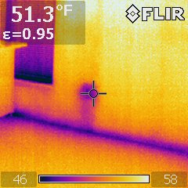
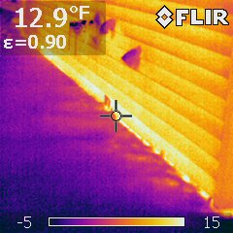
Infrared Building Images
Notes:
19
Infrared cameras indicate the surface temperature of non-reflective objects. They can be used to identify areas of building energy loss, provided there is at least approximately 20 degrees Fahrenheit difference between the interior and exterior temperatures. Such imaging identifies energy losses at thermal steel bridging elements, as well as energy loss at the top of foundation wall / edge of concrete floor slabs. Here we see heat escaping out from a slab edge at the top of a foundation wall.

Slide 20
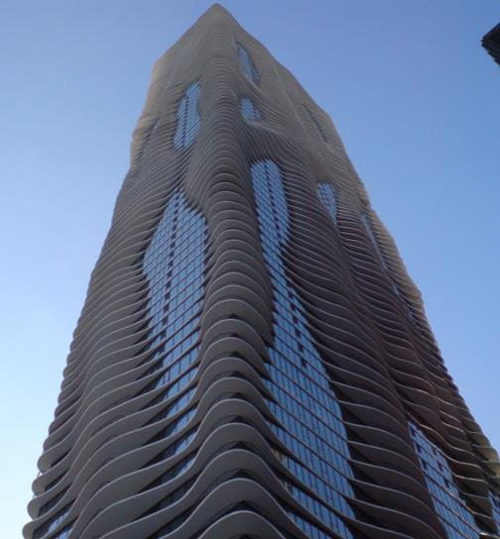
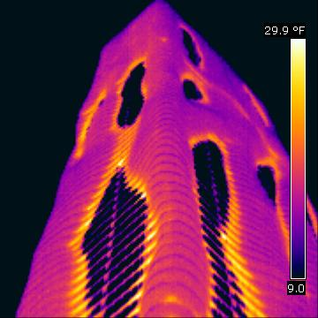
Infrared Building Images
The Aqua
Notes:
20
This is a famous building in Chicago. Its signature look is formed by serpentine concrete balconies cantilevering out from the plane of the building envelope. Unfortunately, these represent concrete thermal bridges, which conduct heat out from the building in the wintertime, and conversely, air-conditioned coolness in the summertime.

Slide 21
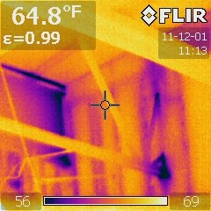
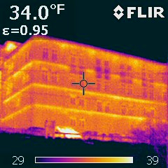
Infrared Building Images
Notes:
21
This is what steel looks like when it passes through the insulated building envelope with a significant temperature differential between inside and outside.
On the left we’re looking at a steel beam and open-web steel joist from the inside, where they pass through an exterior insulated wall. The purple colors indicate that the steel is conducting the cold from the outside into the interior of the building. This is not only a source of some heat loss, but it also has the potential for condensation, if the interior air is sufficiently humid.
On the right is the exterior of a four-story brick faced building, with 5/8” thick steel shelf angles supporting the brick at every floor level. The yellow lines indicate that the façade is significantly warmer at these shelf angle locations than the other areas of the façade.

Slide 22
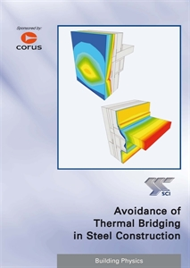
Other Countries and Thermal Bridging
All European Union countries have new energy codes
Based on limiting carbon emissions of buildings for Kyoto Protocol
Set limits of thermal bridging, varying with building types
Notes:
22
In the US, thermal bridging limits are implied in energy codes, but in Europe the condition is explicitly addressed, and thermal bridging is limited by building type, for example, residential buildings that require more heat per square foot (or meter) are more restricted, since more energy can be saved.

Slide 23
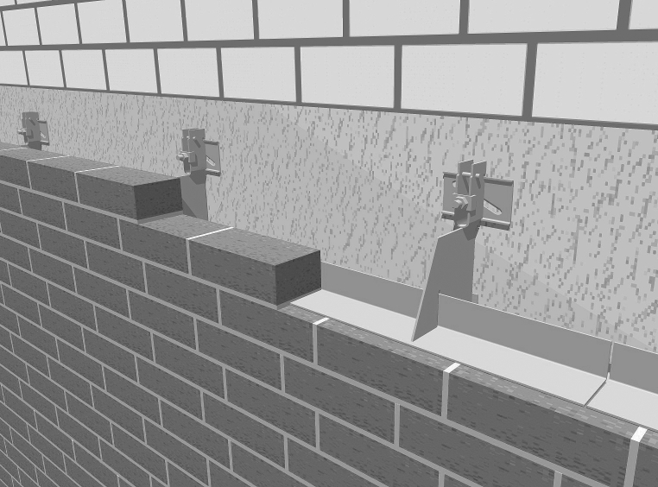
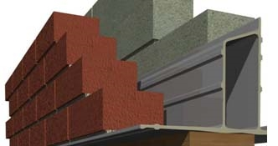
Other Countries and Thermal Bridging
European Stainless Steel Relieving Angle Assembly
European Glass Fiber Reinforced Plastic Lintel
Notes:
23
In Europe there are proprietary systems for both relieving angles – made of stainless steel with minimal steel area bridging the insulation plane - and for masonry lintels – made of out structural plastic. No need for flashing or corrosion protection, and very, very little thermal bridging!

Slide 24

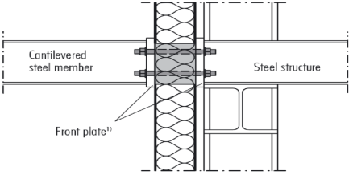
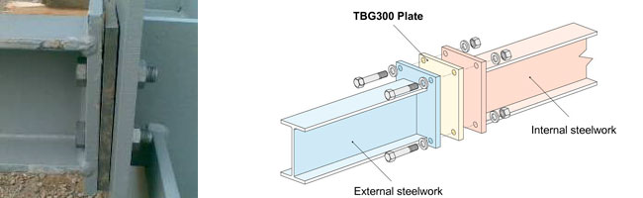
Manufactured Structural Thermal Break Assemblies
Notes:
24
German engineers have developed manufactured assemblies that provide structural load transfer while minimizing the thermal heat transfer. They are available in the U.S., but are much more popular in Europe and other countries. No one yet has been able to quantify energy savings.

Slide 25
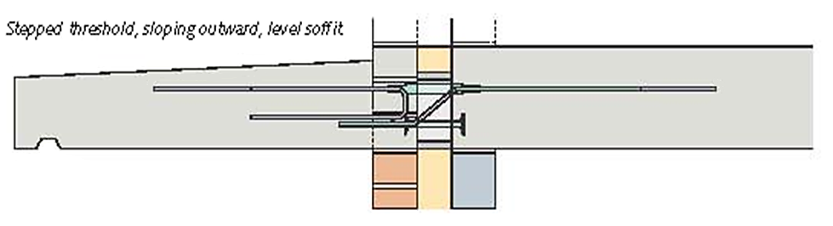
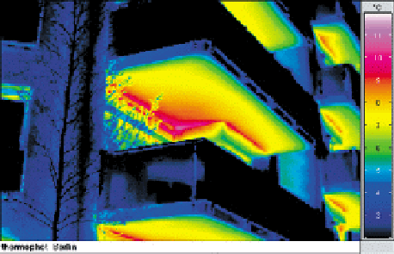
Manufactured Structural Thermal Break Assemblies
Notes:
25
MTBA’s are used for concrete elements, as well. This is important, since concrete balconies represent a continuous line of thermal bridging, rather than a single point of bridging, such as a beam extending out of a wall.

Slide 26
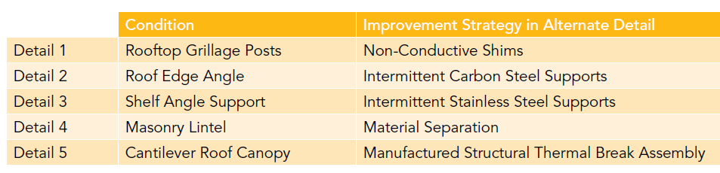
Solution Concepts
So now that we know a little about the problem, let’s look at specific details and some solutions to the more significant problems of thermal steel bridging.
Notes:
26
AISC and ASCE/SEI together looked at several key areas of thermal bridging in buildings. Results are published March 2012 Issue of Modern Steel Construction Magazine titled “Thermal Bridging Solutions”. (www.modernsteel.com/Uploads/Issues/March_2012/032012_thermal_bridging_March_insert)
Our goal is to look at a typical structure – and remember, that not every structure is identical – but where can we find some “typical locations” where solutions MAY be able to be presented that are worth it economically for both the short term construction and also in long term energy. Our structure is a 3 story commercial steel framed building, 75 feet long by 40’ wide and 40’ tall with approximately 9000 sf of gross floor area. These are 5 details we decided to tackle and investigate – are there better ways to detail them differently than traditional steel construction details?

Slide 27
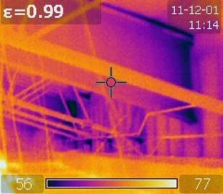
Energy Costs
Chicago:
$5,092 HVAC + $5,954 other (lighting and plug loads) = $11,885
Phoenix:
$10,954 HVAC + $9,972 other = $20,927
Notes:
27
We decided to compare two temperature extremes: Chicago and Phoenix.
The goal was to compare the extremes in cold and warm weather – and the cost of operating facilities are also much different due to changes in the electric grid in the different areas of the country (for example…it is air conditioning being less efficient than natural gas heating, and the overall electricity costs are higher in Phoenix than Chicago.

Slide 28
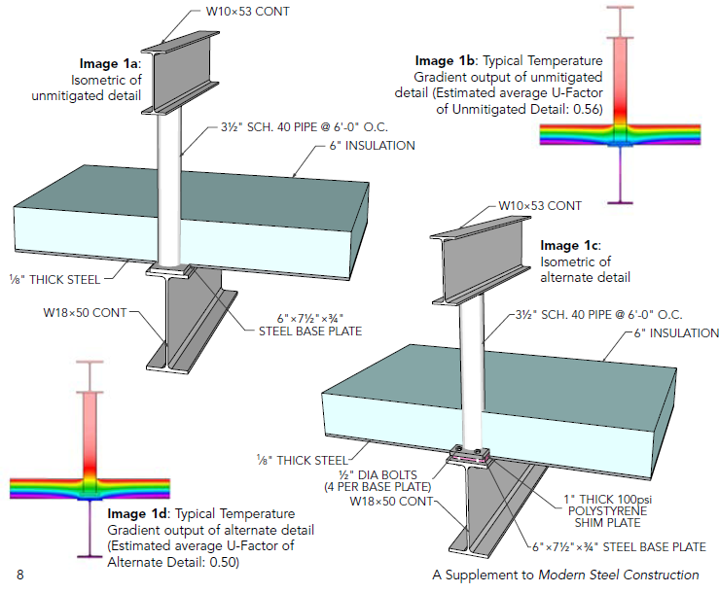
Detail 1: Rooftop Grillage Posts, Non-Conductive Shims
Traditional
Improved
Notes:
28
So we looked at these five locations and pulled typical current used details and compared the details against improved details that have been implemented in similar projects already. Because AISC has their membership at their disposal, we also wanted to know costs. Costs for implementation are just as important as the energy cost savings later…you shouldn’t consider one without the other. Therefore, it was paramount to take the time and effort to survey our fabricator base to learn if the energy cost savings down the road would outweigh the implementation costs down the road.
So, you can see in this example…the traditional detail is on the left and the improved is on the right.
We also did energy modeling to determine the true temperature gradient to best determine the energy loss thru the details and then extrapolate that out at each location throughout the structure.
Detail 1 is shown here, it looks at introducing non conductive polystyrene shim plates at an areas of your roof that is penetrating thru your roof insulation envelope to possibly support a rooftop air-handling unit.
This shim plate is very inexpensive and the question really is – how much energy is saving by doing this method…we’ll find out soon.

Slide 29
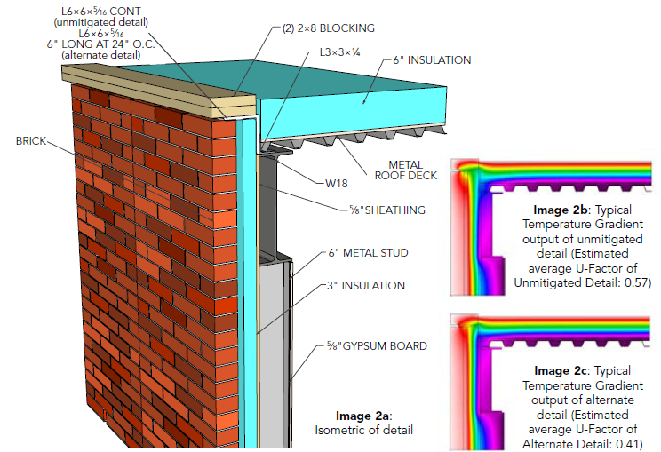
Detail 2: Roof Edge Angle:
Intermittent Carbon Steel Supports
Notes:
29
Detail 2 looks at improving a roof edge angle. This typical detail is seen on nearly all structures where you have continuous angles that provide a heat chase in and out of the structure.
The mitigated detail looks at introducing in wood blocking to help make the improved detail use less steel and translating into less steel and no longer having a continuous heat path from the outside to the inside.
Our first “gut reaction” was that this would be very economical. We would be reducing the overall steel tonnage at the entire roof perimeter location, but the questions arose such as – “by bringing in other materials, does the GC not like it and thus…inflate the bid??”.. That was our cost…what was the true implementation costs and really – how much energy are we really saving by doing this?

Slide 30
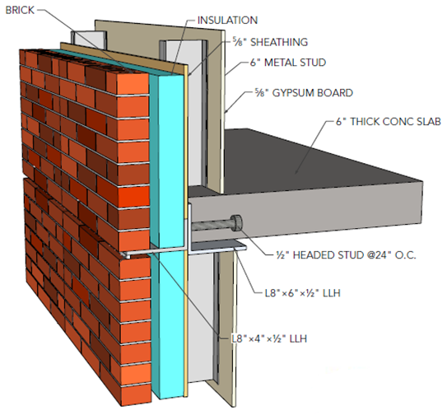
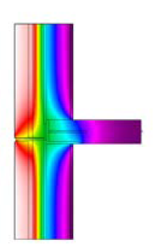

Detail 3: Shelf Angle Support, Unmitigated
Traditional
Notes:
30
Detail 3 is a common typical shelf angle depicting a parallel heat path as opposed to series. This is a common situation that you have anytime you have a shelf angle supporting a façade section of a floor height of wall unit. It is a continuous angle that is in there which is back connected to another angle providing another continuous method of a parallel heat path – which is not ideal. The heat path can easily be seen in the gradient thermal image on the lower right hand section of the slide.

Slide 31
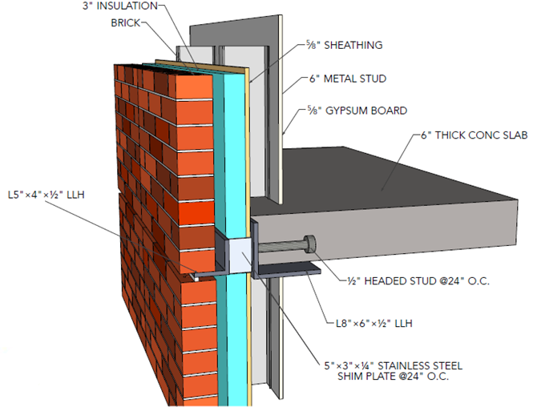
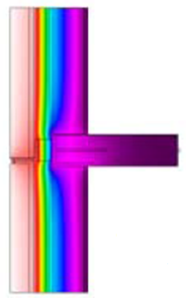

Detail 3: Shelf Angle Support, Intermittent Stainless Steel Supports
Improved
Notes:
31
The improved details looks at introducing the concept of stainless steel shim plates. By introducing this “spacer” which can be seen to be a 5”x3”x14” plate every 24”, you are now forcing a non-continuous parallel heat path problem…but allowing it to transfer in series THRU the stainless steel from one carbon angle to another. As we know, stainless steel is much less thermally conductive than stainless steel…and the concept has been done on some projects before.
However – was it worth it…that was the question. SS is more expensive at the material base price level. Also, welding SS does require proper venting due to the off gases produced in the process. Could these costs of implementation out-weigh the energy savings?
Through this whole process we had to remember that sustainability is a very PASSIONATE topic. Many individuals in the “green world” want to negate the cost factors and only focus on the energy savings portion. It was imperative for us in this process to include them all. In addition to using the SS, we also are adding a spacer, now requiring the two carbon angles to be drastically reduced in size, so we are using smaller angles, which will save us in tonnage over the original detail as well.

Slide 32
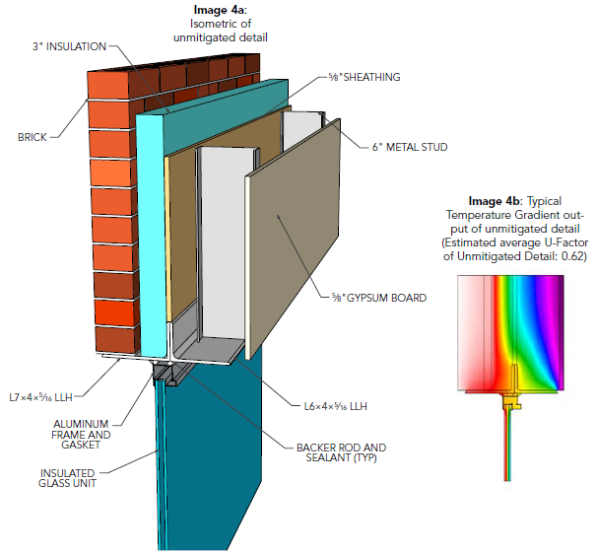
Detail 4: Masonry Lintel, Material Separation
Traditional
Notes:
32
Detail 4 looks at improving the typical lintel detail… as you can see in this image….we have two back to back angles supporting the lintel.

Slide 33
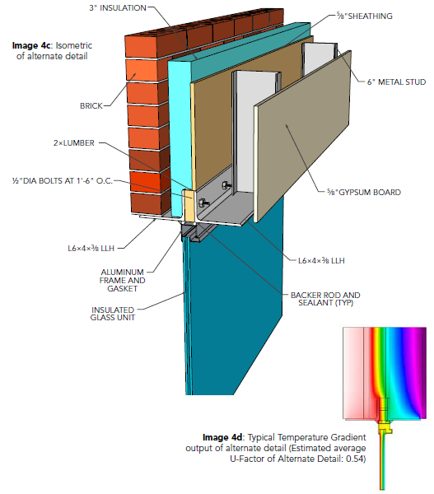
Detail 4: Masonry Lintel, Material Separation
Improved
Notes:
33
The improved details looks at using the concept of low conducting wood once again as a way to remove that parallel continuous heat path. Per the detail notes, we are adding in 2x lumber with a bolted connection between the angles (now are also smaller size Ls compared to the original details). We thought this would help with the heat path as we did at the shelf angle detail since this was a “spacer” and also like our roof edge detail of substituting in more material that was less conductive than steel. But the question remained…how much energy would be saved vs. the costs of all those bolts?

Slide 34
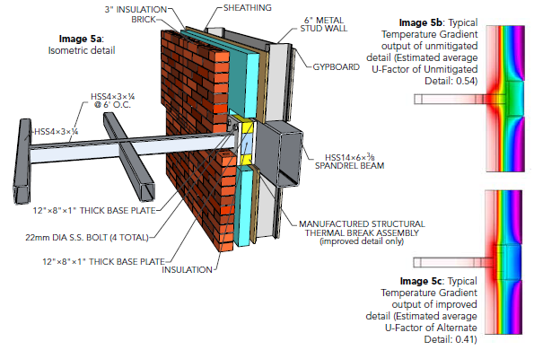
Notes:
34
Detail 5 (no header title shown)
Is a roof canopy that is stub cantilevered off a HSS spandrel beam. The improved detail used a MTSB. These are widely used and we found on the project we looked at they were $700/location. The big question was, on a project like this…that is used in 20 spots on a job, are we making this back in the energy savings?

Slide 35
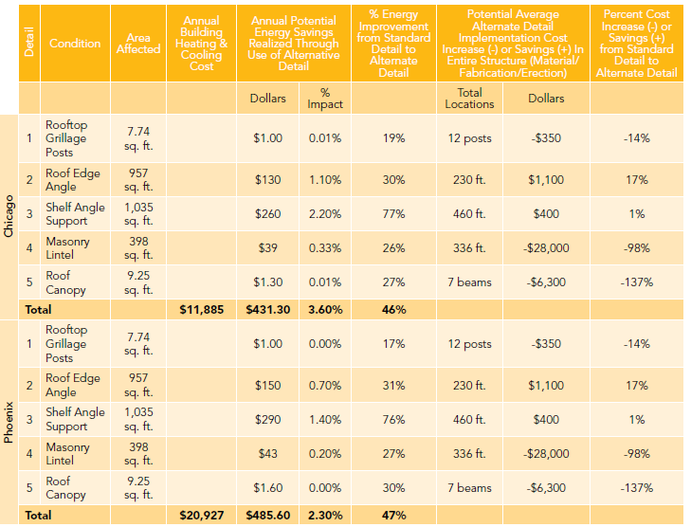
Notes:
35
But we are letting out energy and something as small as detailing can improve annual energy cost of whole building operation by 2%. So…we did our energy models and looked at the average implementation costs…and this is what we found.
The landslide “wins” were details 2 and 3 (roof blocking used at the roof edge and stainless steel at the shelf angle). So…we could save 2% in energy costs in a year. Detail 1 was a waste….$1 in savings per year was a big disappointment. Same with detail 5, $1.30/savings in Chicago
Detail 4 saved money with the energy savings….but to be honest, the implementation costs were truly cost prohibitive. They didn’t like the labor intensive bolting. Surprisingly stainless steel was a great value with the extra costs savings compared to the energy savings.…and the polystyrene pads were very economical in detail 1. However, the low energy costs made it seem like a slight waste to spend the money with little to no energy return. Remember, every building is unique and these are not hard an fast numbers…but truly a metric to consider when you evaluate your own unique structure.

Slide 36
Recommendations
for improved building envelope performance
Minimize thickness of bridging elements, where structurally possible
Minimize conditions of continuous bridging, substituting intermittent bridges
Use stainless steel when possible
Work with architects to provide wraparound insulation when possible
Look for new information and research
Notes:
36
Bottom line, details 2 and 3 are no brainers…saving money on implementation AND energy and should be considered on future projects.
We also don’t consider future energy costs savings due to future rising energy costs as well…which will be another cost savings factor.

Slide 37

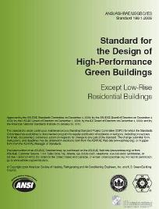
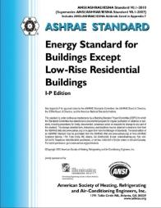

Codes and Standards
IgCC
ASHRAE
Notes:
37
Building envelope considerations for energy efficiency that take into account thermal bridging are now being evaluated for inclusion in codes and standards for both baseline and high-performance green buildings. The International Green Construction Code (IgCC) and ASHRAE 189.1 and 90.1 offer some insight on how codes may potentially adopt thermal bridging provisions. The IGCC states that the “building thermal envelope” shall exceed requirements in the International Energy Conservation Code (IECC) by 10%.
ASHRAE Standards. ASHRAE 189.1, Standard for the Design of High-Performance, Green Buildings Except Low-Rise Residential Buildings, contains tables that list maximum U-values for various envelope assemblies and minimum R-values for insulation. ASHRAE 1365-RP, “Thermal Performance of Building Envelope Details for Mid- and High-Rise Buildings” may affect how the ASHRAE standards address the issue and potentially incorporate thresholds. While none of these publications currently incorporate thermal transmittance requirements of steel elements that bridge the building envelope, the potential for future recommendations and guidance is certainly there, especially as opportunities to increase energy efficiency in buildings are pursued.

Slide 38
What’s Ahead?
Steel Connection Assemblies with Fiberglass Reinforced Plastic “Shims” Research
Thermal Bridging Task Committee to Expand Purview to Include Concrete and Masonry
Exploring Improved Energy Modeling and Envelope Requirements
More Practitioner Experience
Notes:
38

Slide 39
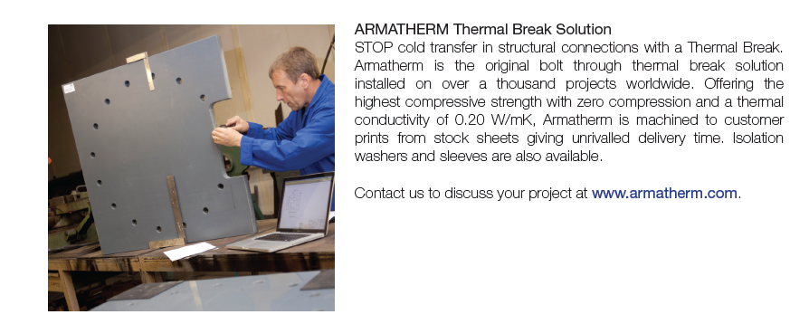

Slide 40
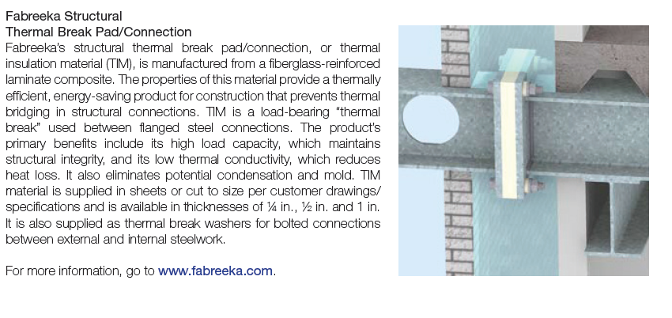

Slide 41
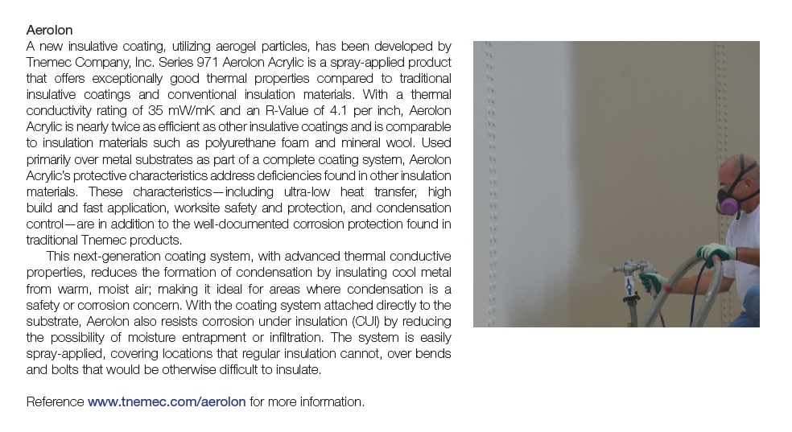

Slide 42
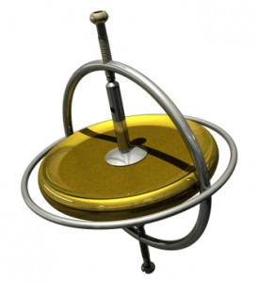
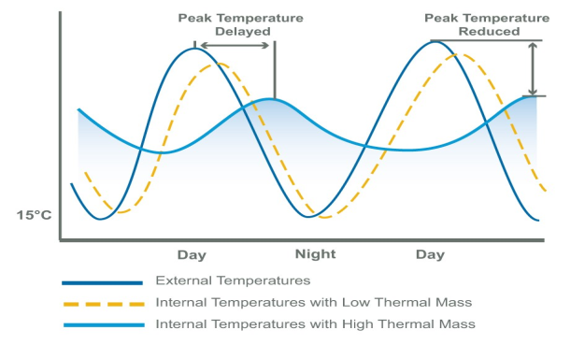
What is thermal capacity?
Thermal capacity is analogous to a flywheel. It allows a building to store excess thermal energy and then releases it over time.
Notes:
42

Slide 43

Overcoming the Myth of Thermal Mass
The Myth: The more mass the greater the thermal capacity of the building.
The Fact: Mass is only one factor in developing the thermal capacity of a building.
Notes:
43
Parallel to believing that the only characteristic of a football offensive lineman is his mass; the more mass, the better the player. Not the case, as other characteristics matter as well--such as speed, height, reaction time, etc.

Slide 44
Mass versus Capacity
Thermal Mass or Thermal Capacity?
The measure of thermal mass is a material’s ability to absorb, store and release heat. It is measured by the amount of thermal energy stored per unit of mass.
The measure of thermal capacity is a building’s ability to absorb, store and release heat. It is measured by the amount of thermal energy stored per unit of building volume.
Notes:
44

Slide 45
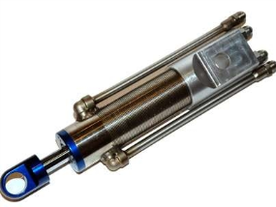

Why is it important?
Building elements can act as “shock absorbers” to dampen peak heating and cooling demands reducing energy consumption and operational costs.
Notes:
45
Utilize the mass of the building to exchange heat in and out of structure.

Slide 46
Factors Impacting the Thermal Capacity of a Building
The climate zone the building is located in
The occupancy cycle of the building
The selection of building materials
The mass of the material
The thickness of the material
The exposed surface of the material
The placement of the material
The placement of finishes used in the building
Notes:
46
All of these factors, not just mass, affect the thermal capacity of the building.

Slide 47
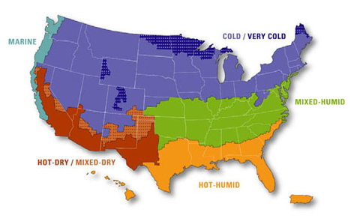
The Climate Zone of the Building
Little value due to limited temperature variation
Best use is to flatten the demand curve for mechanical heating and cooling
Summer benefits may be offset by winter losses
Classic use, mitigates hot days and cool nights based on solar gain
Most challenging and must be strategically located to prevent overheating
Notes:
47
How to add thermal capacity in most optimal way.

Slide 48
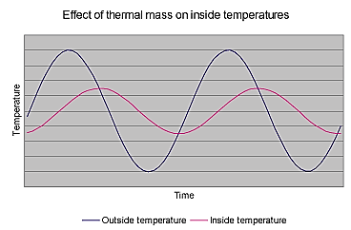
The Occupancy Cycle
The closer the occupancy cycle of building follows the temperature cycle of the day, the greater will be the impact of energy savings
Notes:
48
The release of energy based on office occupancy throughout the day and evening. The further the cycle is pushed, then the less opportunity you have to reduce energy loss.

Slide 49
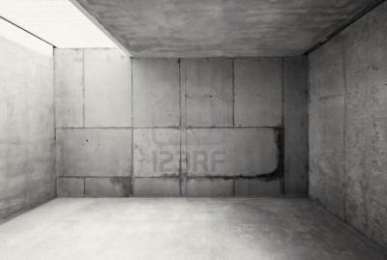
The Selection of Building Materials
Materials with a high density
Materials with a low strength
Materials with a low thermal conductivity
Result favors high mass (not density) materials
Notes:
49
Steel has a high density but a lower mass than concrete. Also steel has high thermal conductivity. Concrete, stone, masonry have higher mass.

Slide 50
The Mass of the Material
The more mass the more thermal energy a material can store.
Q = mC_{p}∆T
where:
Q = thermal energy transferred
m = mass of the body
C_{p} = the isobaric heat capacity of the material
∆T = change in temperature
Notes:
50
Energy stored is directly proportional to the mass of system.

Slide 51
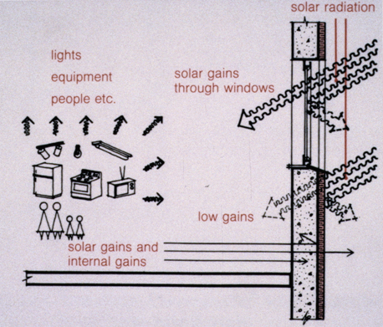
The Placement of the Material
Exposure to solar heat sources, air movement and internal spaces is critical
Materials located outside the insulated envelope of the building do not contribute to the thermal capacity of the building
Notes:
51

Slide 52
The Exposed Surface of the Material
Isolating the surface of material with thermally resistive materials significantly limits the exchange of thermal energy. Avoid the use of:
  Carpeting
  Dropped ceilings with no free air flow (15% minimum openness recommended)
  Plastered walls
  Gypsum wall linings
  False floors
Ensuring thermal connectivity to air flow (convection) is critical.
Notes:
52

Slide 53
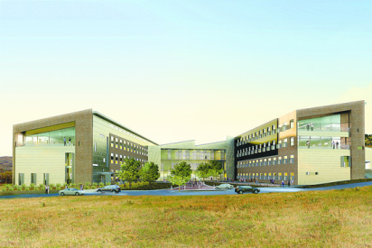
How Much Mass Is Required?
Typically the mass of concrete in the floor and wall systems are adequate to develop the necessary thermal capacity of the building
National Renewable Energy Laboratory
Golden, Colorado
Notes:
53
This project is an example of a net zero building.

Slide 54
The Thickness of the Material
The absorption and release of heat energy takes place on a cyclical rather than absolute basis. The rate of heat energy penetration into the material is just as important as the mass of the material. The effective thermal mass of a material is limited by the depth to which the thermal energy can penetrate the material in a typical 24 hour cycle.
For concrete the limiting thickness is 4 inches from the exposed surface.
4 inches
12 inch
thickness
8 inches effective
4 inches
4 inches
Notes:
54
Adding more mass (thickness) of concrete slab doesn’t increase the thermal capacity of the building.

Slide 55
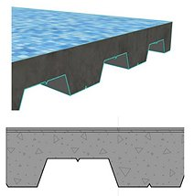
The Exposed Surface of the Material
The corollary is that increasing the exposed surface area increases the thermal efficiency of the material.
Steel decking has a high rate of thermal transmission and does not adversely impact the energy transfer.
Notes:
55

Slide 56
Taking Advantage of Thermal Capacity
Optimized design requires significant modeling and specialized passive systems if the goal is eliminate mechanical heating systems
Improved building efficiency can be accomplished through design decisions:
  Consider the climate zone
  Evaluate the occupancy cycle
  Don’t needlessly increase building mass
  4 inch thickness per exposed side
  Increase surface area
  Don’t isolate or insulate the concrete surfaces
Notes:
56

Slide 57

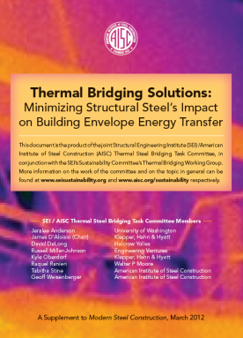
www.aisc.org/sustainability
A second option for the location of the “branding title.”
A second option for the location of the “branding title.”
Notes:
57

Slide 58
Resources
“A Complete Fabrication,” Modern Steel Construction March 2008 Issue.
(http://www.modernsteel.com/Uploads/Issues/March_2008/032008_30775_cives_web.pdf)
“A Model Approach,” Modern Steel Construction July 2012 Issue. (http://www.modernsteel.com/Uploads/Issues/July_2012/072012_model.pdf)
AISC Sustainability website www.aisc.org/sustainability
ANSI/GBI 01-2010: Green Building Assessment Protocol for Commercial Buildings (http://www.thegbi.org/about-gbi/ANSI-GBI-standards-document.shtml)
“AT YOUR SERVICE,” Modern Steel Construction August 2006 Issue.
(http://msc.aisc.org/globalassets/modern-steel/archives/2006/08/2006v08_at_your_service.pdf)
Cross, John, “Job Creation in the Fabricated Structural Steel Industry,” AISC White paper
(http://www.aisc.org/WorkArea/linkit.aspx?LinkIdentifier=id&ItemID=33666)
“Design for Deconstruction,” Modern Steel Construction June 2004 Issue. (http://www.modernsteel.com/Uploads/Issues/June_2004/30730_dfd.pdf)

Slide 59
Resources
"Green Building Systems: A Comparison of the LEED and Green Globes Systems in the U.S." (http://www.thegbi.org/gbi/Green_Building_Rating_UofM.pdf)
“Keep on Rolling,” Modern Steel Construction February 2014 Issue.
(http://www.modernsteel.com/Uploads/Issues/February_2014/022014_Keep_on.pdf)
Steel Takes LEED with Recycled Content
“The Fabricator Factor,” Modern Steel Construction July 2010 Issue. (http://www.modernsteel.com/Uploads/Issues/July_2010/072010_sustainability_web.pdf)
“Thermal Bridging Solutions,” Modern Steel Construction March 2012 Issue. (www.modernsteel.com/Uploads/Issues/March_2012/032012_thermal_bridging_March_insert)
Weisenberger, Geoff, “Steel's sustainability stance” Civil Engineering, March 2012. (http://cenews.com/article/8772/steels-sustainability-stance)

